Slide 1
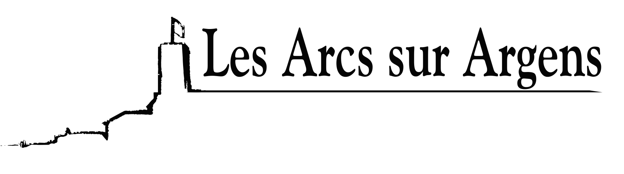

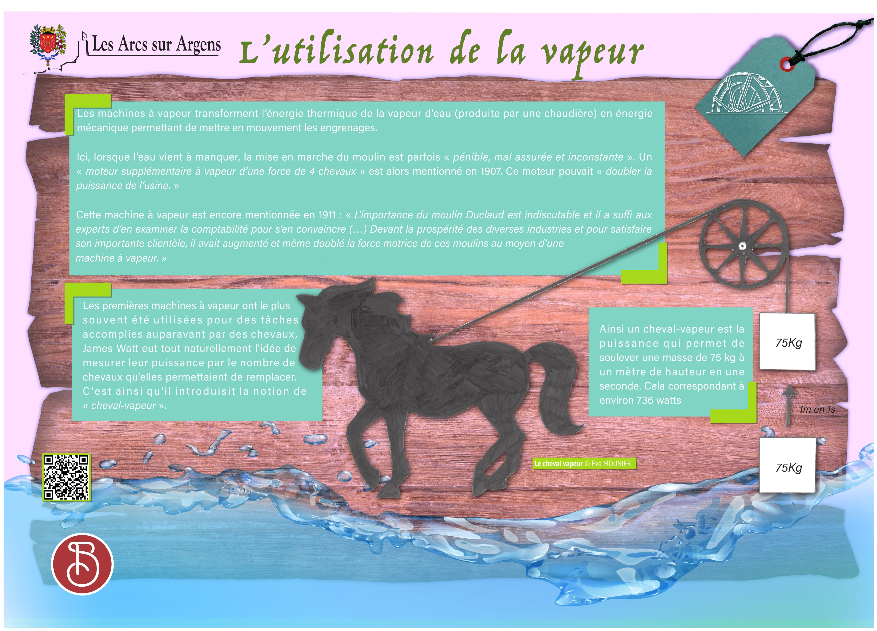



Sainte Cecile
Using steam
The steam engines turned the thermal energy of steam water (produced by a boiler) into mechanical energy to set the gears in motion.
When the water ran out, turning on the mill was sometimes “hard, unreliable, and fickle”. An “additional steam engine with a force of 4 horses” was mentioned in 1907. This engine could “double the power of the factory”.
This steam engine was mentioned again in 1911: “The importance of the Duclaud mill is unquestionable, and it was enough for experts to examine the accounting to be convinced (…). Given the prosperity of the various industries and to satisfy its large clientele, it had increased and even doubled the driving force of these mills thanks to a steam engine”.
The first steam engines were used, most of the time, for tasks previously performed by horses. James Watt had the idea of measuring its power by the number of horses it could replace. Thus, he introduced the notion of “horsepower”.
Horsepower was the power that permitted lifting a mass of 75kg to one meter in one second. This corresponds to approximately 736 watts.
Les Arcs sur Argens
Bastide Sainte
Cécile
Find all our news on the site of the Arcs town hall
here

