Slide 1
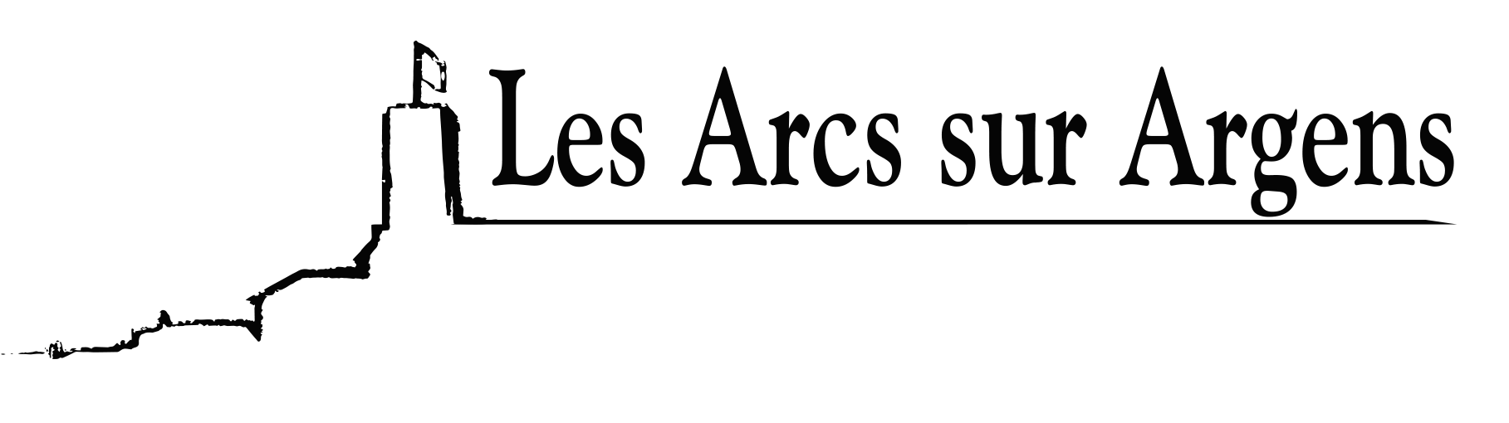

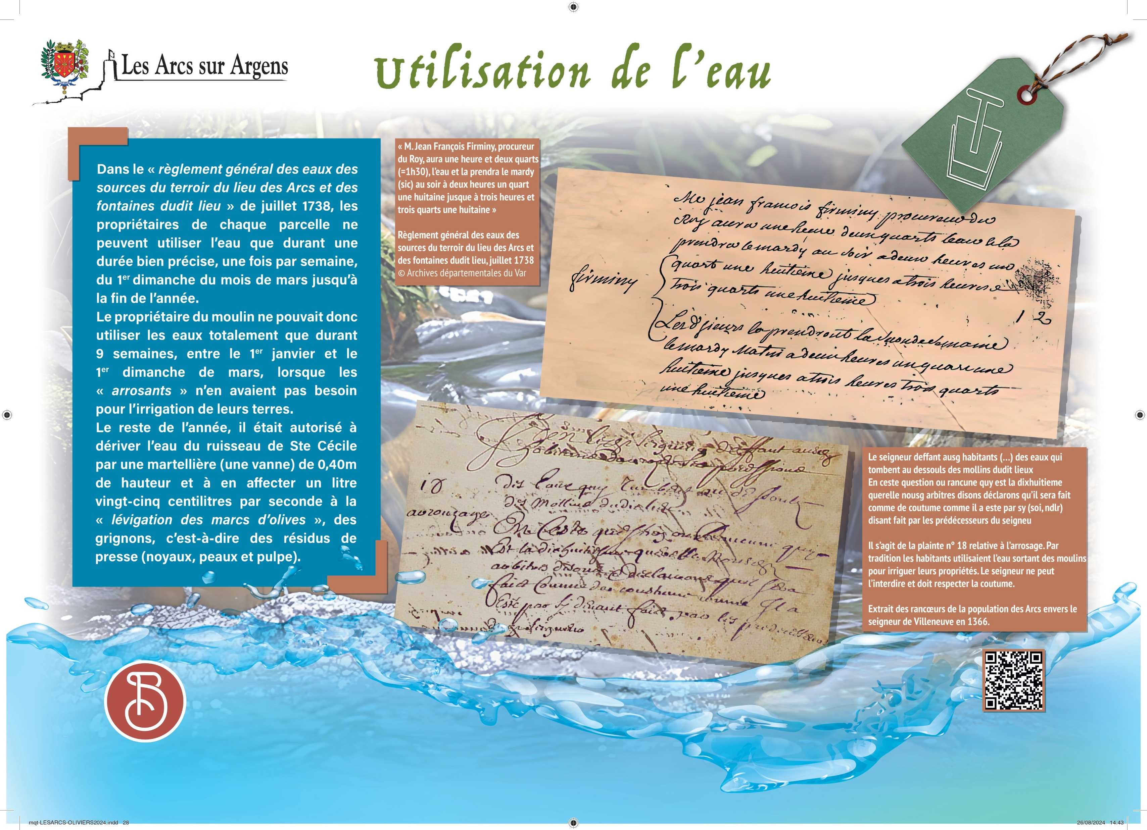



Sainte Cecile
Water uses
In the “general regulation of the waters, of the sources, of the terroir of the place Les Arcs and fountains of said place” in July 1738, the owners of each parcel may use the water only for a specified period, once a week, from the 1st Sunday of March until the end of the year.
The mill owner could therefore use the water only for 9 weeks, between 1st January and 1st Sunday of March, when the “waterers” did not need it for irrigation of their lands.
During the rest of the year, he could derive water from the stream of Sainte Cécile by a martellière (a valve) of 0.40m height and allocate 1.25L per second to the “levigation of olive pomace”, that is to say, press residues (grignons: pits, skins, and pulp).
Transcriptions of the historical texts
“Mr. Jean François Firminy, prosecutor of Roy, he will have an hour and two quarters, the water and will take it on Tuesday evening at two o’clock a quarter an eighth until three and three quarters an eighth”.
The lord defends the inhabitants (…) waters that fall below the mills of said place. In this question or grudge which is the eighteenth quarrel, we say arbitrators declare that it will be done as usual as it was supposedly done by the predecessors of the lord. This complaint #18 regarding watering. Traditionally, residents used water from mills to irrigate their properties. The lord cannot forbid it and lust respect the custom.
Les Arcs sur Argens
Bastide Sainte
Cécile
Find all our news on the site of the Arcs town hall
here

