Slide 1
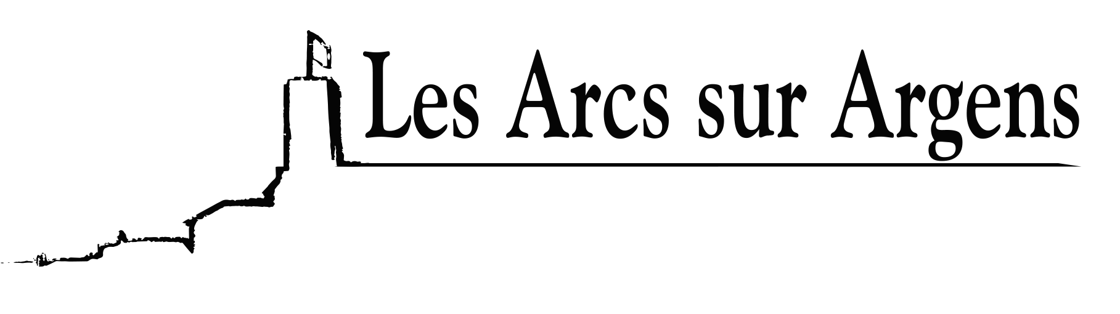

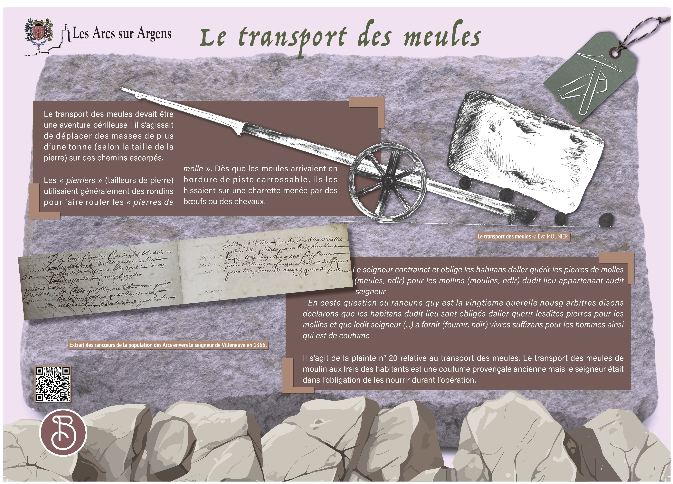



Sainte Cecile
Transportation of the mill stones
Millstone transportation was surely a risky adventure: they had to move masses of more than 1 ton (according to the size of the stone) on steep paths.
The ‘pierriers’ (stonemasons) used logs to roll the millstones. As soon as the millstones arrived at the edge of a passable track, they dragged them on a cart driven by oxen or horses.
Translation of the medieval text :
The lord compelled inhabitants to go fetch the millstones for “mollins” (mills) of said place belonging to the said lord.
In this question or grudge which is the 20th quarrel, our arbitrators say and declare that the inhabitants of said place are obliged to go and fetch said stones for the mills and that said Lord (…) to provide sufficient food for men as is customary.
It is the 20th complaint about the millstone transportation. The millstone transportation of mills at the expense of the inhabitants is an ancient Provençal custom but the lord was obliged to feed them during the operation.
Les Arcs sur Argens
Bastide Sainte
Cécile
Find all our news on the site of the Arcs town hall
here

