Slide 1
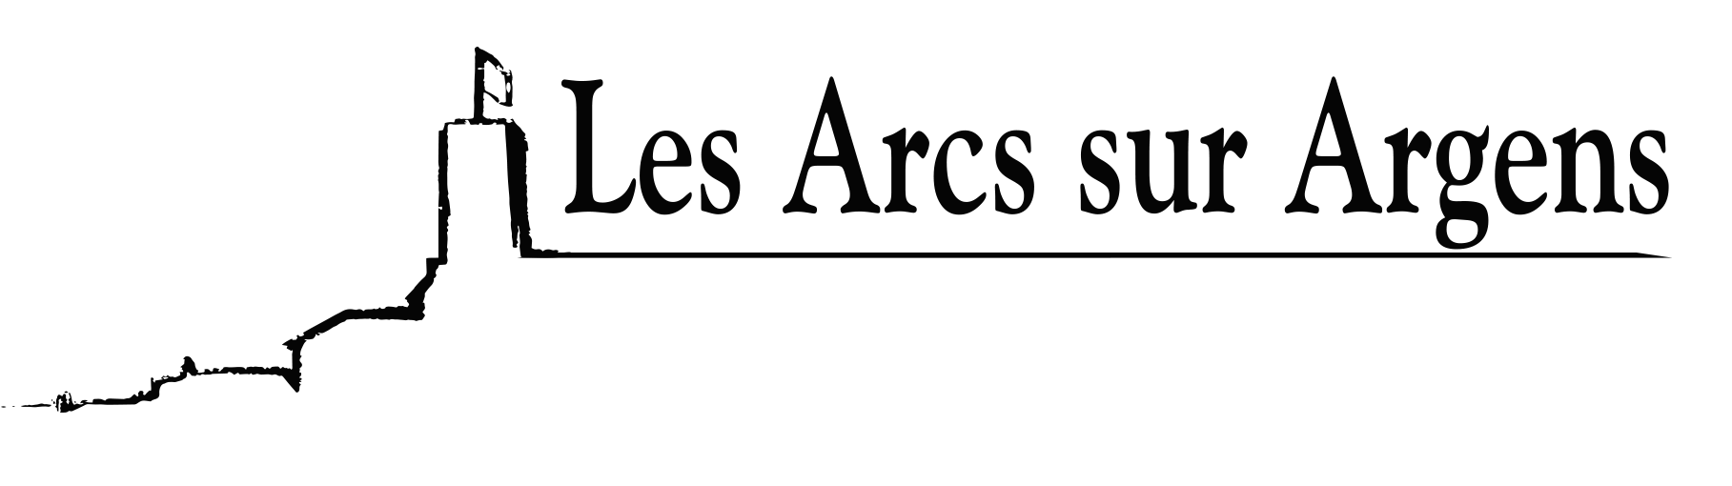

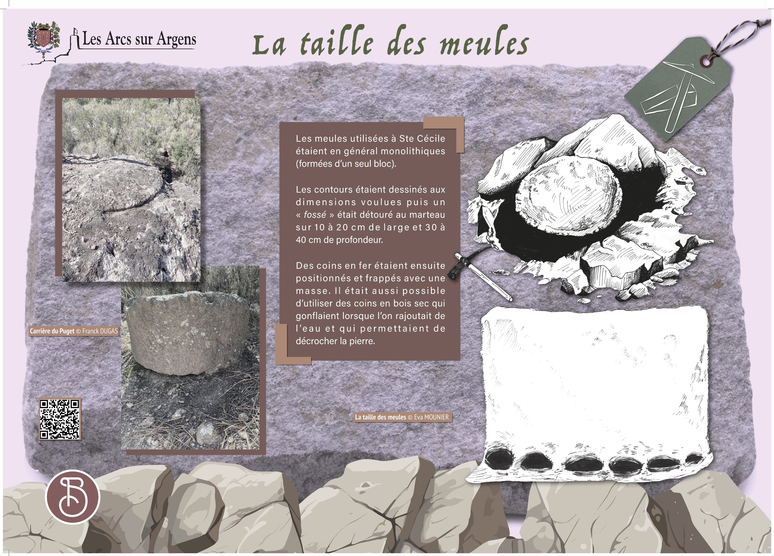


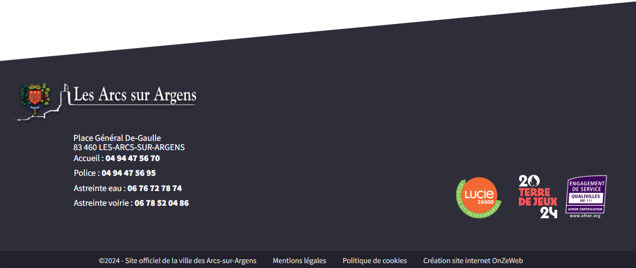
Sainte Cecile
The carving of the millstones
The millstones used in Sainte Cécile were generally monolithic (formed in one block).
Edges were shaped to the desired dimensions, then a “ditch” was hammered 10cm (4 inches) to 20cm (8 inches) wide and 30cm (12 inches) to 40cm (16 inches) deep.
Iron corners were then placed and hit with a sledgehammer. It was also possible to use dried wooden corners that swelled when water was added, and this allowed to break the stone.
Les Arcs sur Argens
Bastide Sainte
Cécile
Find all our news on the site of the Arcs town hall
here

