Slide 1


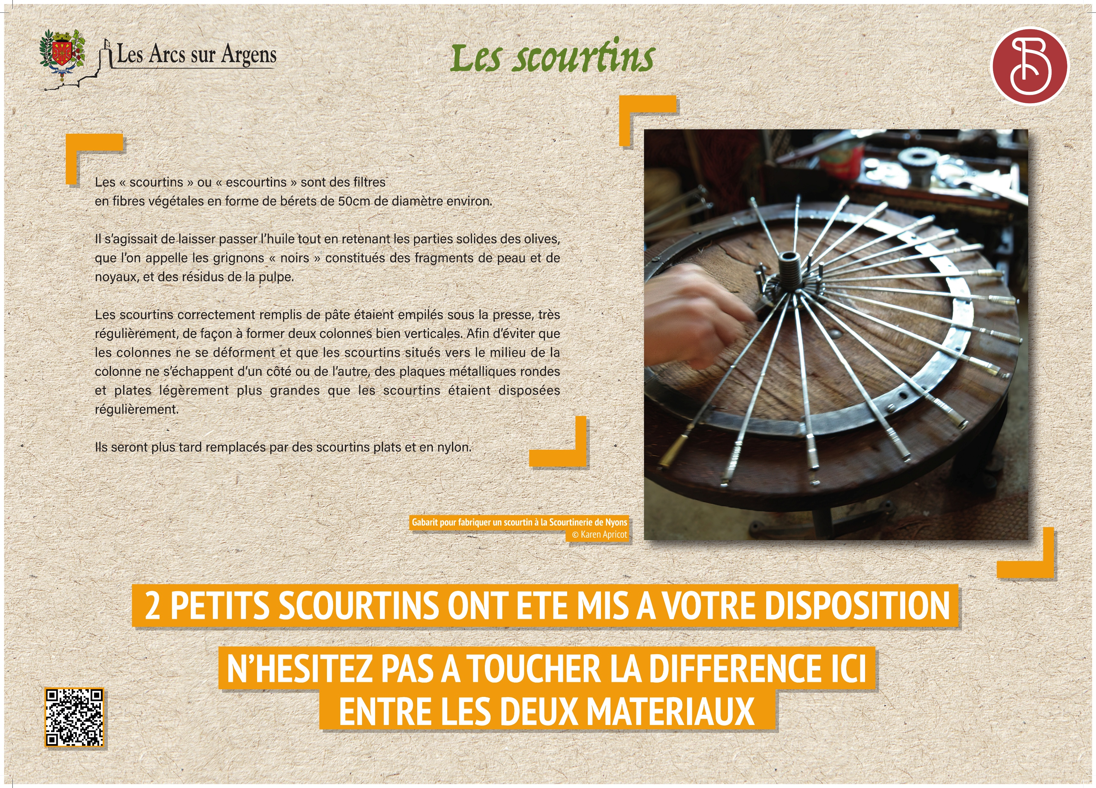



Sainte Cecile
The “scourtins”
“Scourtins” or “escourtins” are filters made of plant fibers, shaped like berets about 50 cm in diameter.
They allowed the oil to pass through while retaining the solid parts of the olives, called “black grignons”, which are composed of skin fragments, pits, and pulp residue.
The scourtins, once properly filled with olive paste, were stacked neatly under the press to form two straight vertical columns. To prevent the columns from deforming or the middle scourtins from slipping out to the sides, flat round metal plates slightly larger than the scourtins were placed at regular intervals.
They were later replaced by flat nylon scourtins.
2 SMALL SCOURTINS ARE AVAILABLE FOR YOU
FEEL THE DIFFERENCE BETWEEN THE TWO MATERIALS
Les Arcs sur Argens
Bastide Sainte
Cécile
Find all our news on the site of the Arcs town hall
here

