Slide 1


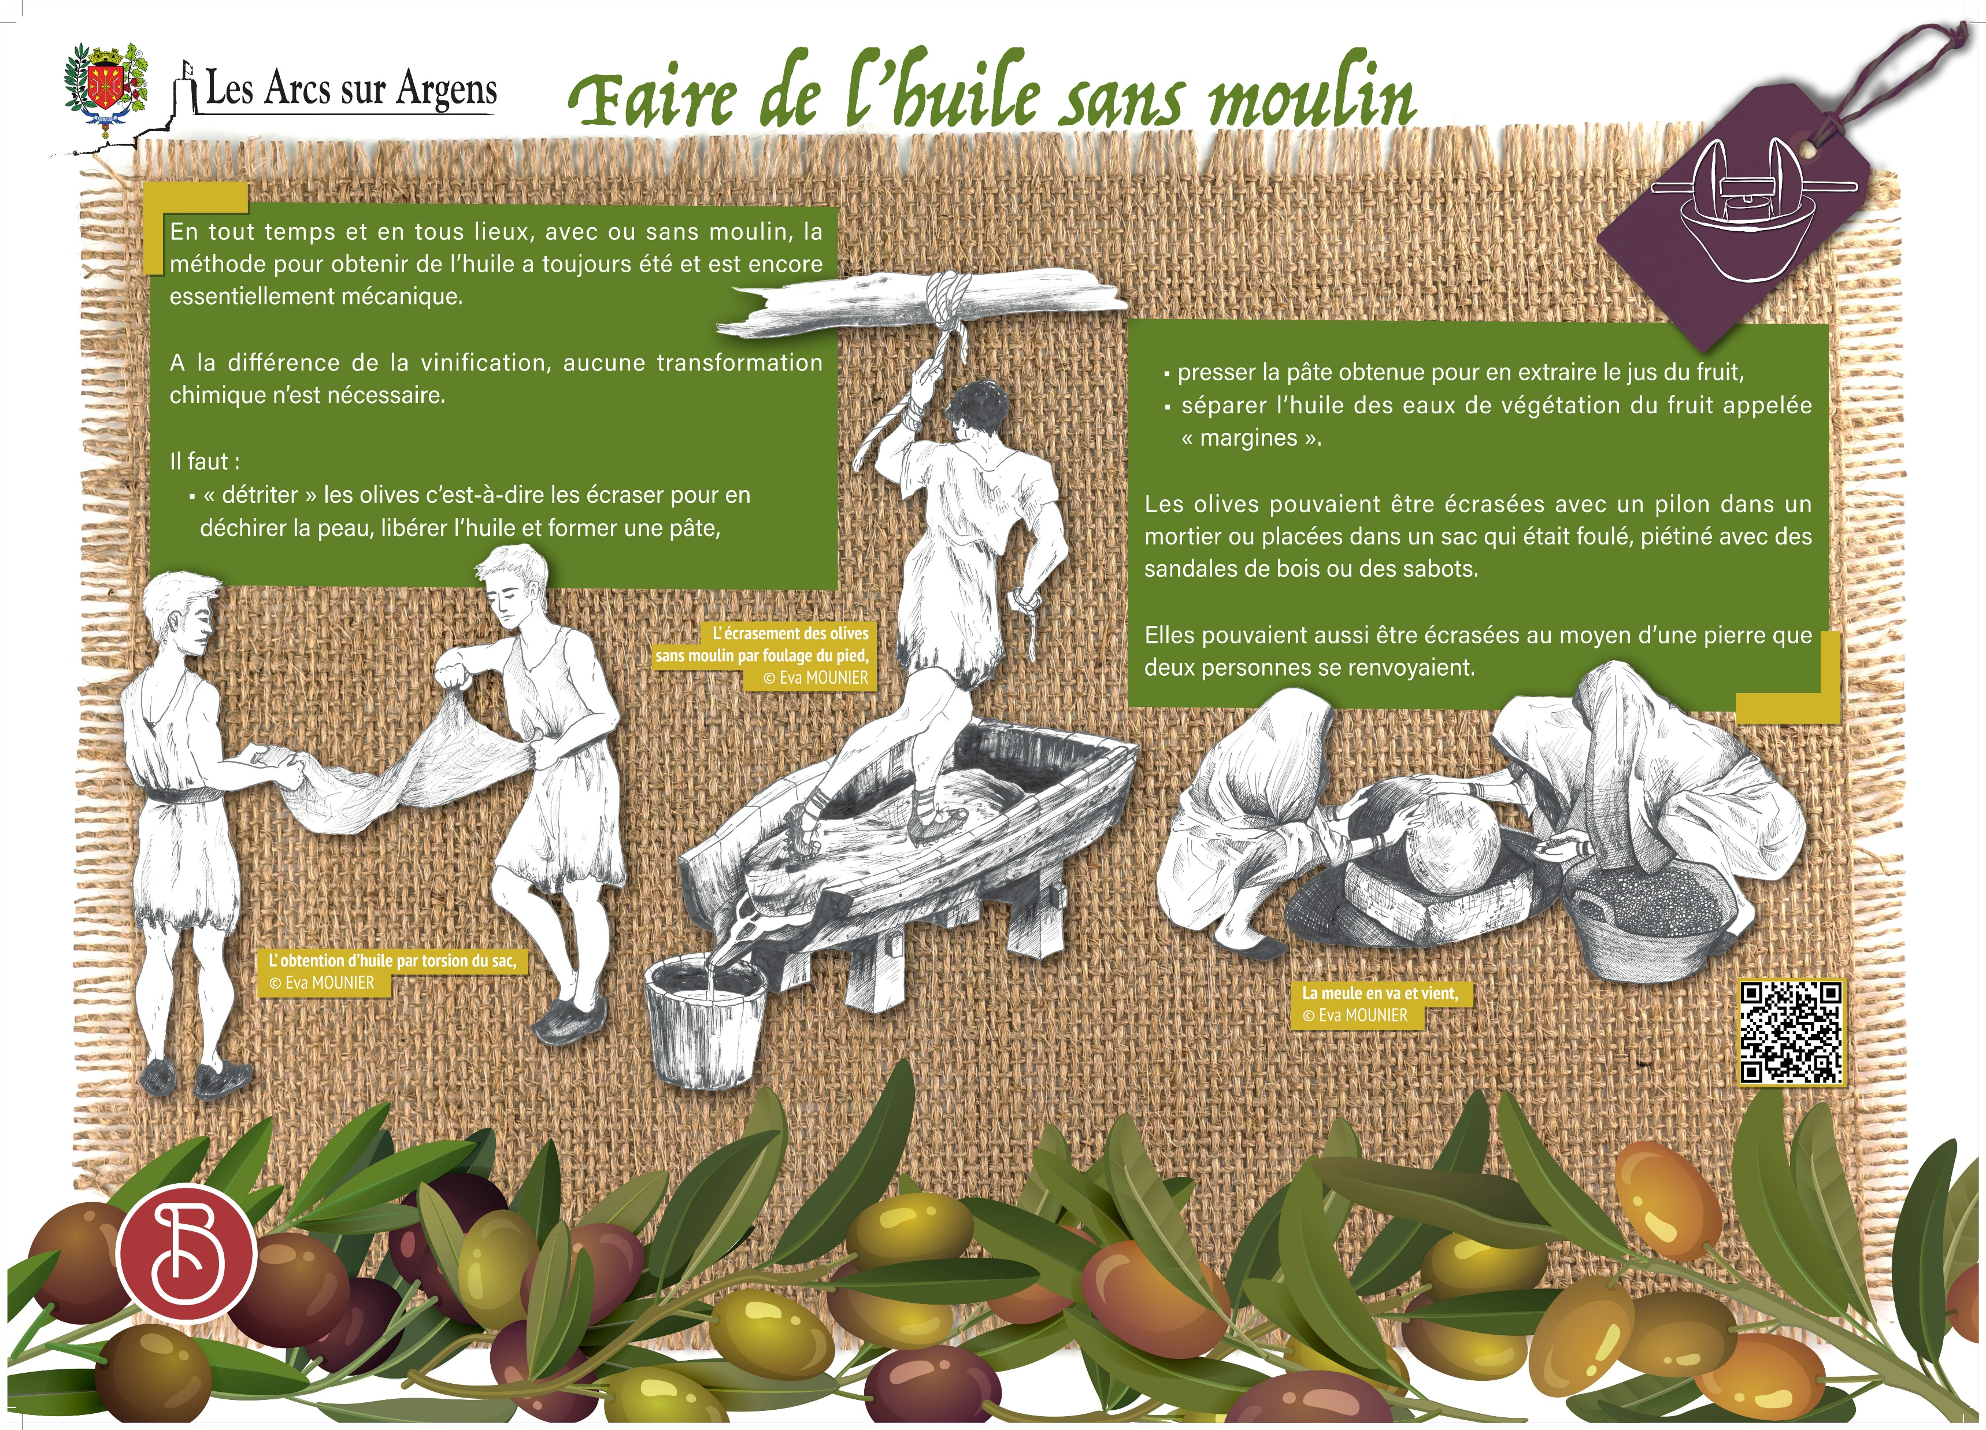



Sainte Cecile
How to produce olive oil without mills
In every place at every time, with or without a mill, the method to make olive oil had always been and is still essentially mechanical.
Unlike the wine-making process, no chemical transformation is necessary.
You need to:
• “Triturate” olives, that is to say, crush them to tear the skin, release the olive oil and form a paste.
• Press the paste to extract the juice of the fruit.
• Separate oil from the fruit vegetation waters called “margines”.
Olives could be ground with a pestle in a mortar or put in a bag that was stomped with wooden sandals or clogs and then twisted.
They also could be ground thanks to a stone that two people rolled on each other.
Les Arcs sur Argens
Bastide Sainte
Cécile
Find all our news on the site of the Arcs town hall
here

