Slide 1
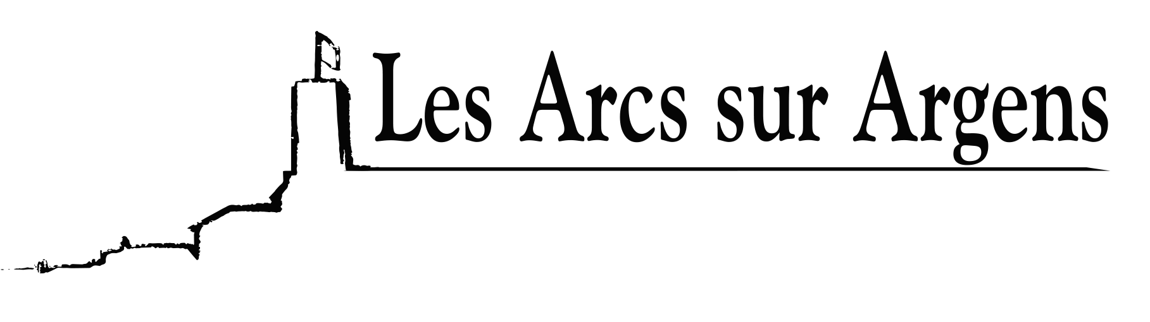

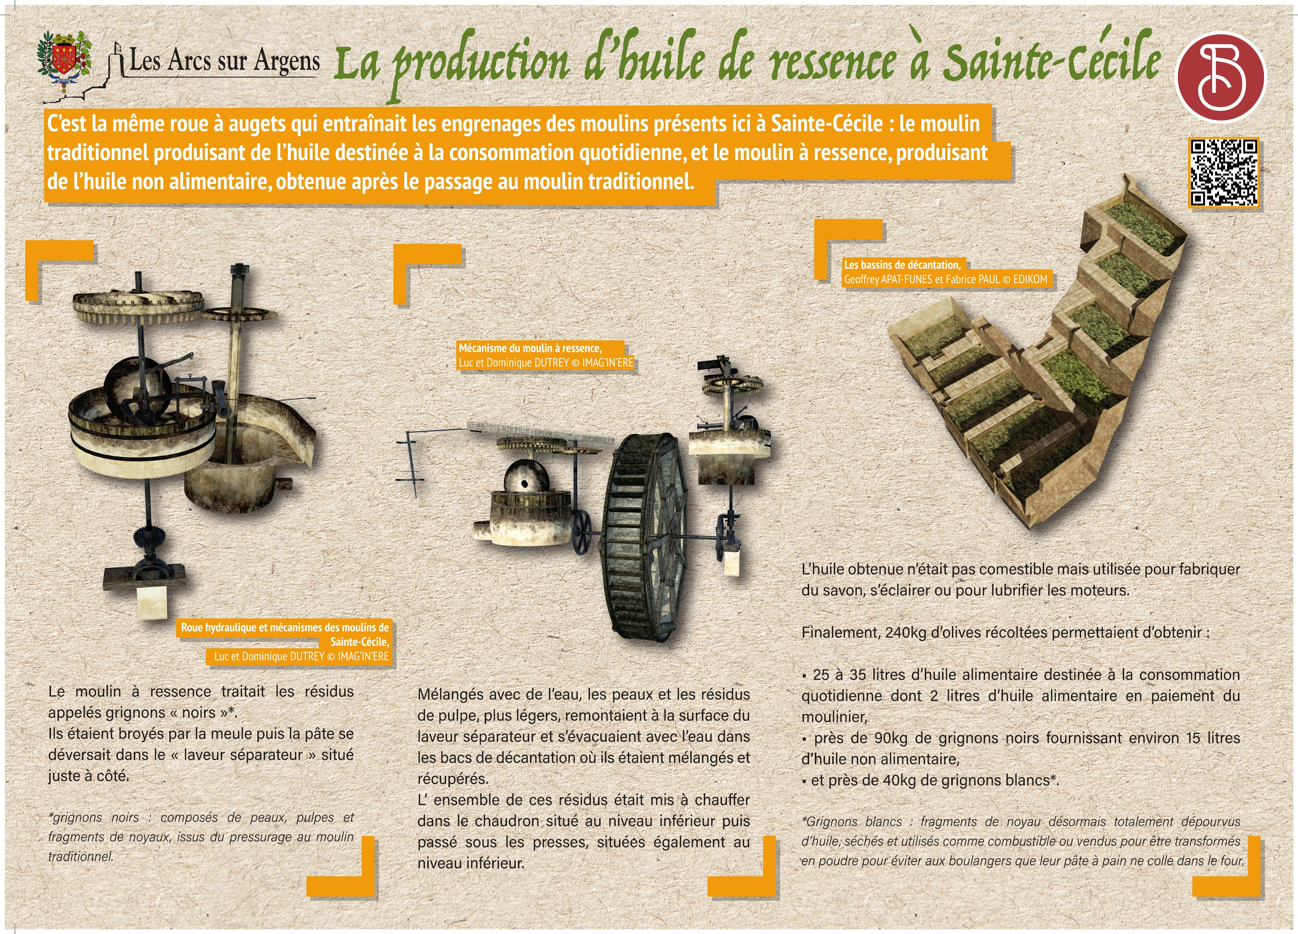


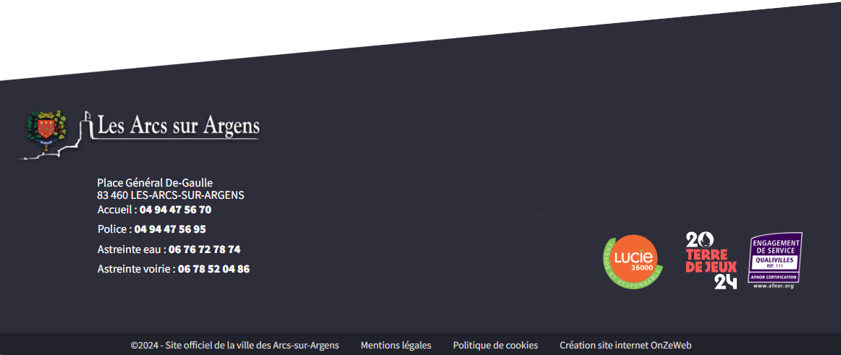
Sainte Cecile
The production of residual oil in Sainte Cécile
It is the same bucket wheel that generated gears’ mills that are here in Sainte Cécile: the traditional mill producing oil for daily use, and the mill for residual oil, which was inedible, obtained right after the first grinding in the traditional mill.
The mill for residual oil treated residues, called ‘black’ grignons*.
The millstone grinded them. Then, the olive paste was poured into the ‘separator’ located right beside it.
Mixed with water, skins, and pulp residues that were lighter rose to the water surface of the ‘separator’ and were then were send with water in the settling vats where they were mixed and picked up.
All the residues were heated in the caldron on the lower level, and then ground under the presses on the lower level.
The oil obtained wasn’t edible but was used for making soap, lighting, or lubricating engines.
After all, 240kg of harvested olives were needed to produce:
- 25 to 35 liters of edible oil for daily use including 2 liters of edible oil in payment of the mill worker.
- Around 90kg of black grignons gave approximately 15 liters of inedible oil.
- About 40kg of white grignons*.
*White grignons: pieces of pits without any oil in them, dried and used as fuel or sold to be transformed into powder to avoid bread dough sticks in the oven.
*Black grignons: made of olive skin, pulps, and pieces of pits, from the pressing in the traditional mill.
Les Arcs sur Argens
Bastide Sainte
Cécile
Find all our news on the site of the Arcs town hall
here

