Slide 1
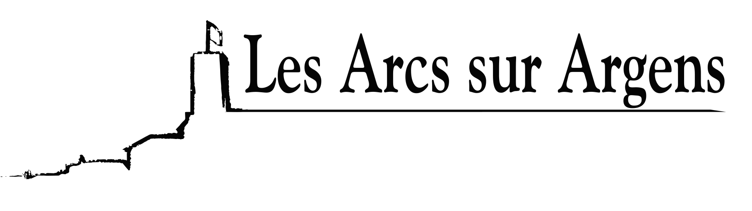

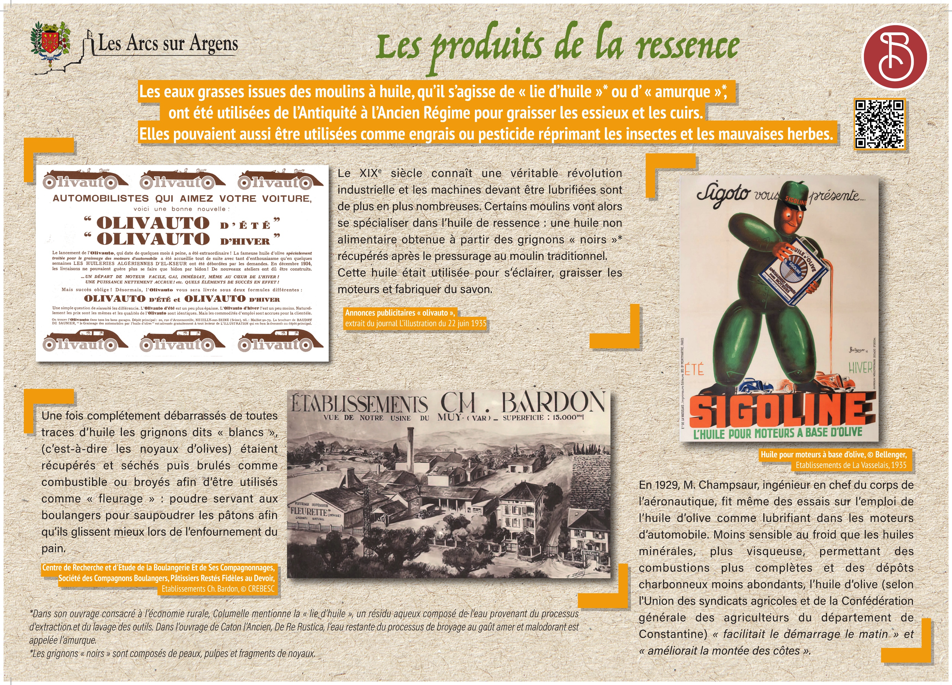



Sainte Cecile
Products of the non food oil
The greasy waters from the oil mill were used from Antiquity to the Ancien Régime to lubricate pieces of wood of machinery or to grease leathers. These greasy waters were called "lie d'huile" or “amurque” *. They could also be used as a fertilizer or a pesticide to control insects and weeds.
The 19th century was a real industrial revolution and more and more machines had to be lubricated. Some mills would specialize in residual oil: inedible oil obtained from “black” grignons” recuperated after pressing at the traditional mill. This oil was used for lighting, greasing engines, and producing soap.
*In his book on the rural economy, Columelle mentions the “lie d’huile”, an aqueous residue composed of water from the extraction process and the washing of tools. In the work of Cato the Elder, De Re Rustica, the remaining water of the process of grinding with a bitter and smelly taste is called the “amurque”.
Once all traces of oil had been removed, the “white” grignons”, (olive pits) were picked up and dried then burnt as fuel or ground to be used as “fleurage”: powder used by bakers to dust loaves, so that they slid better when baking bread.
In 1929, Mr. Champsaur, Chief Engineer of the Aerospace Corp, also tested the use of olive oil as a lubricant in automobile engines. Less sensitive to cold than mineral oils, more viscous, allowing more complete combustions and less abundant coal deposits. Olive oil “facilitated the start of the car in the morning” and “improved the climb of the hills”, according to the Union of Agricultural Unions and the General Confederation of Farmers of the Department of Constantine.
Les Arcs sur Argens
Bastide Sainte
Cécile
Find all our news on the site of the Arcs town hall
here

