Slide 1


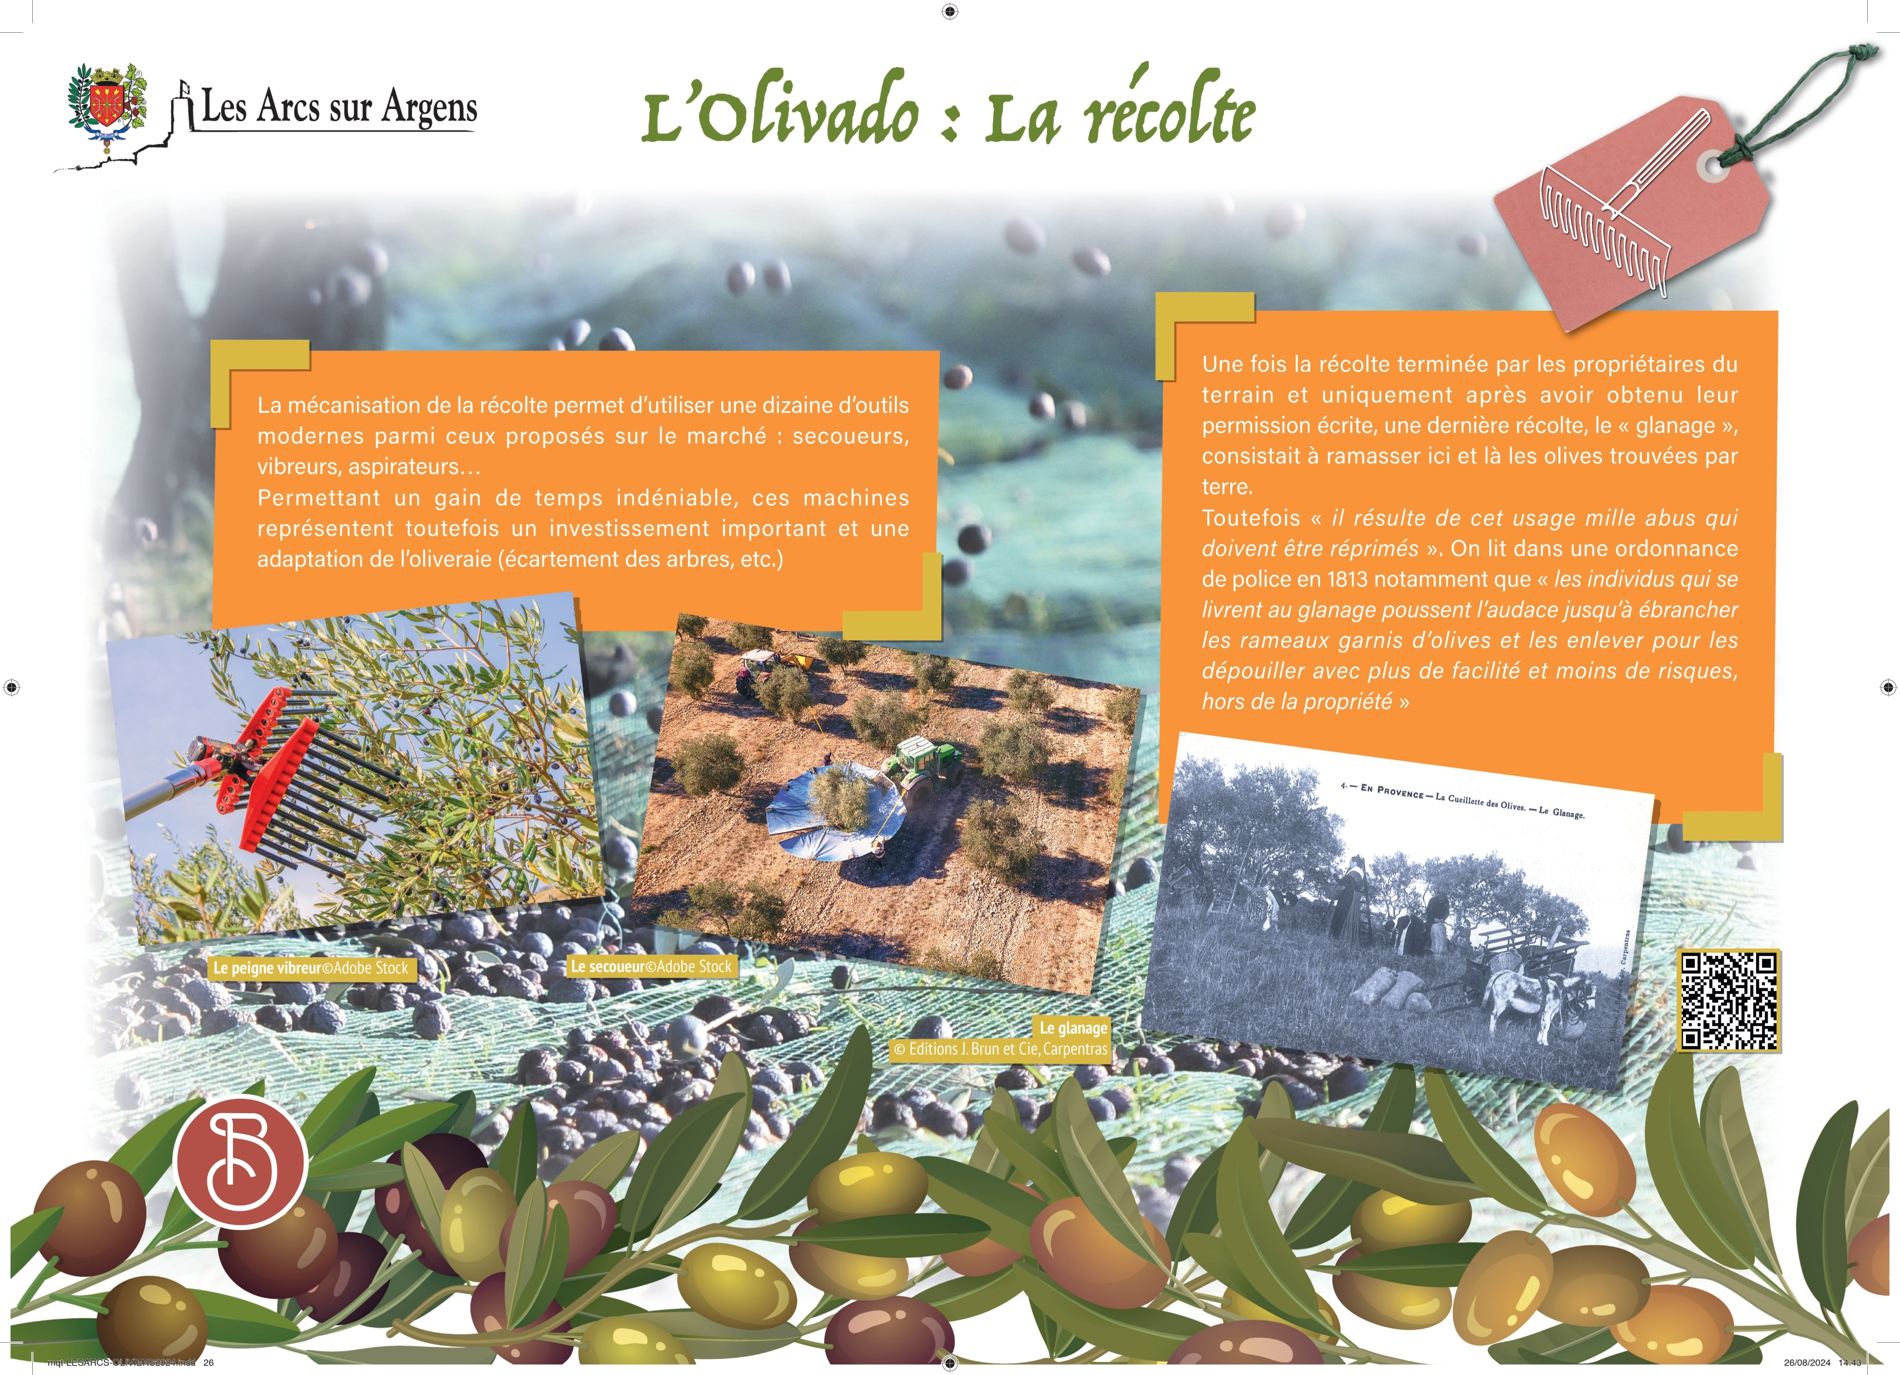



Sainte Cecile
The mecanical harvest.
The mechanization of the harvest allows to use of around ten modern tools among those on the market: shakers, vibrators, vacuums…
These machines represent a major investment and an adaptation of the olive grove (tree spacing…) which is undeniably timesaving.
Once the owners of the land finish the harvest, and only after having written permission for a last harvest the “gleaning” consisted of picking here and there olives found on the ground.
However, “it results in a thousand cases of abuse that must be repressed”. We can read in a police order in 1813 that “the individuals who engage in the gleaning push the audacity to shake the branches covered with olives and remove them with more facilitate and less risk, out of the property.
Les Arcs sur Argens
Bastide Sainte
Cécile
Find all our news on the site of the Arcs town hall
here

