Slide 1


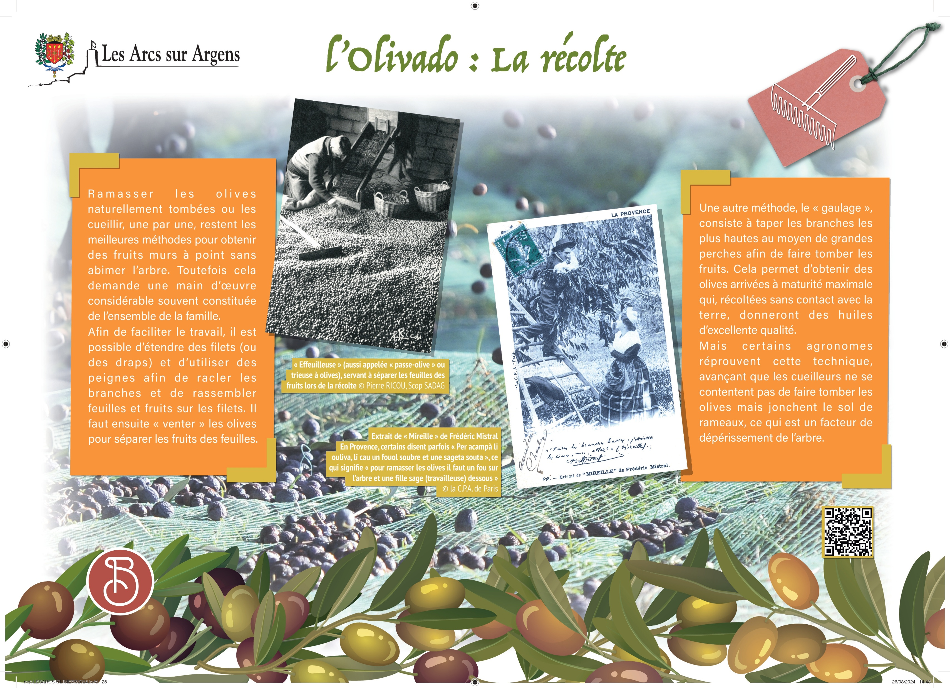



Sainte Cecile
The artisanal harvest
Pick the olives naturally fallen or harvesting them one by one are the best methods to obtain ripe fruits without damaging the tree. However, it requires a considerable labor force made up of the whole family.
To facilitate the work, it is possible to spread nets and to use combs by scrubbing branches off to gather leaves and fruits on the nets. The olives must then be "vented" to separate the fruits from the leaves.
Another method, the “gaulage” consists in hitting the highest branches thanks to big poles to bring down fruits. It allows olives to reach maximum maturity which harvested without contact with the ground will give excellent quality oils.
However, some agronomists reject this technique because according to them the pickers do not just drop the olives but litter the ground with branches and it is a factor of tree dieback.
In Provence, some say “Per acampà li ouliva, li cau un fouol soubre et une sageta souta » which means that “to pick the olives you just need a crazy man on the tree and a kind lady below”.
Les Arcs sur Argens
Bastide Sainte
Cécile
Find all our news on the site of the Arcs town hall
here

