Slide 1
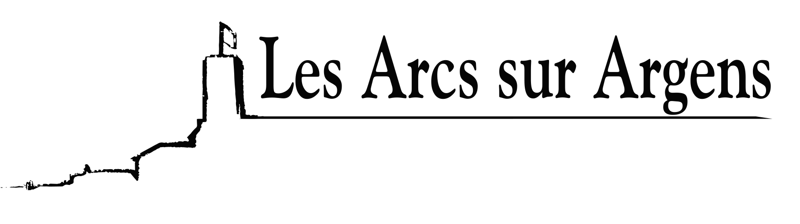

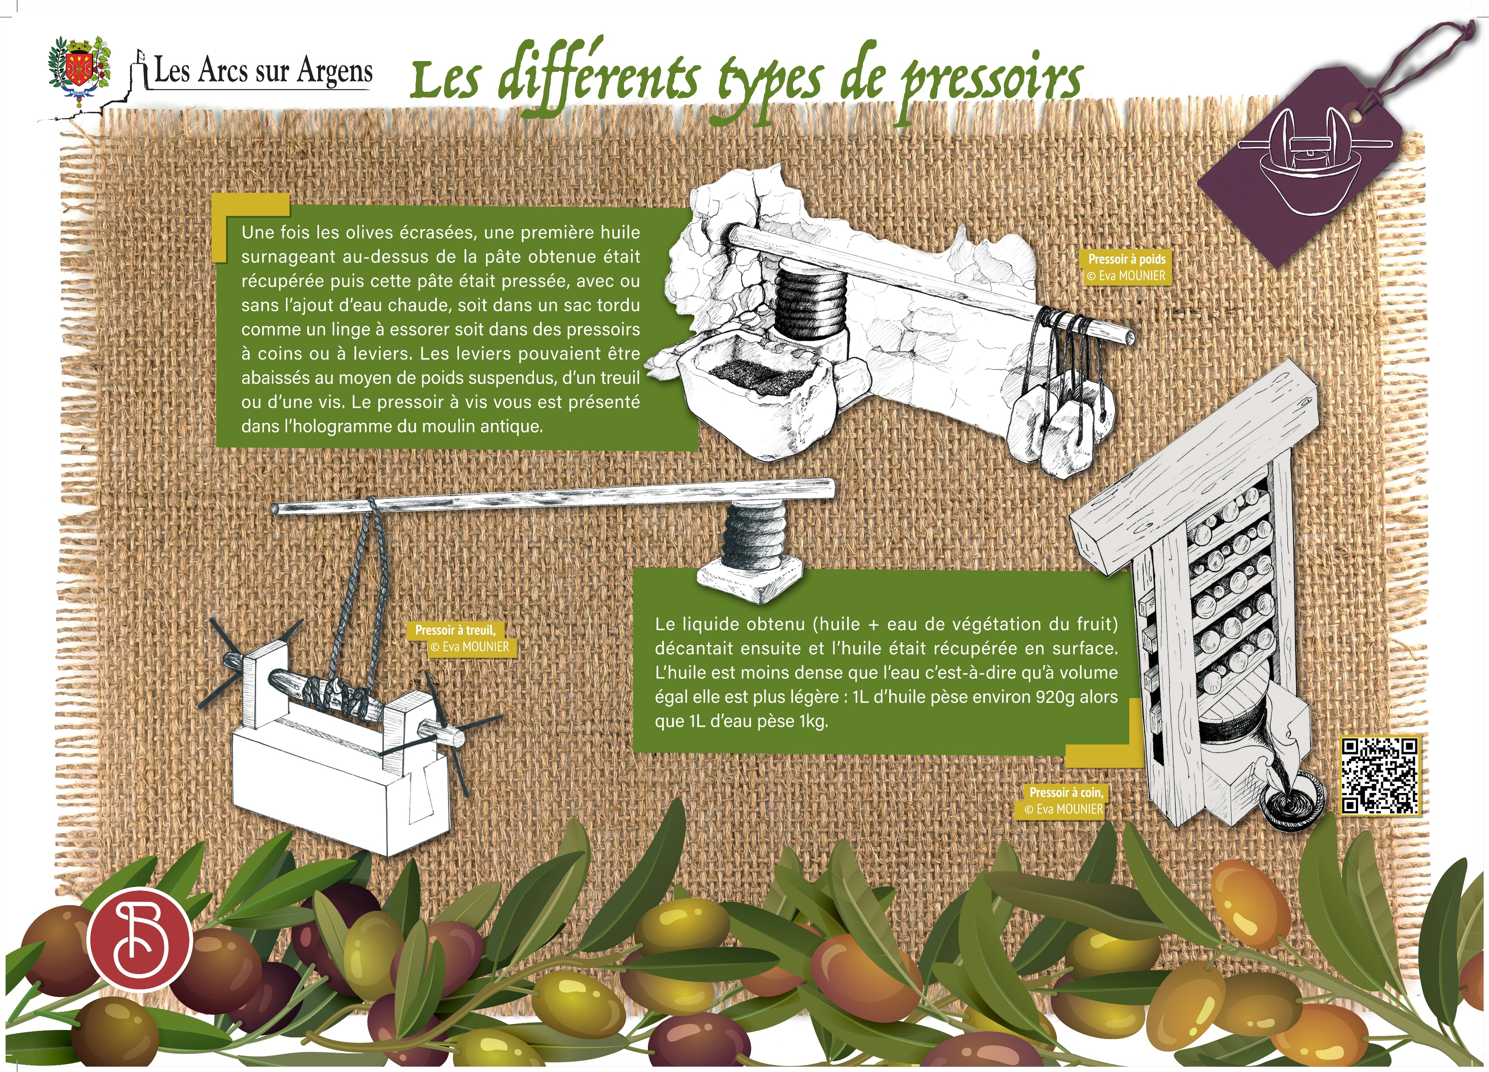


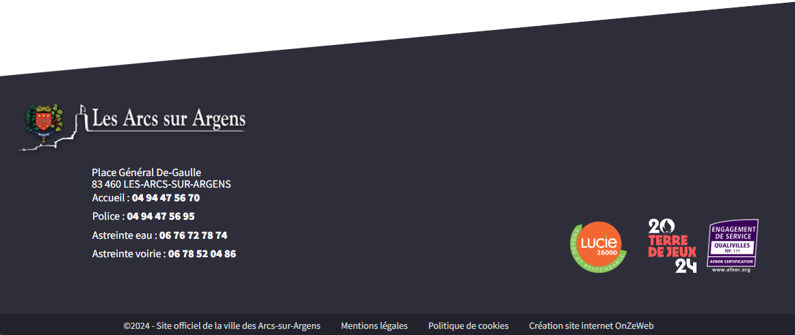
Sainte Cecile
The different types of press
Once the olives were ground, the first olive oil floated above the paste. This olive oil was picked up, and then this paste was pressed with or without the addition of hot water, whether in a twisted bag like laundry to wring out or corner or lever presses. The levers were lowered thanks to hanging weights, a winch, or a screw. The screw press is visible in the hologram of the antique mill.
The obtained liquid (oil + fruit vegetation water) then decanted, and oil was picked up on the surface. Oil is less dense than water, so at equal volume, it is lighter: 1L of oil weighs approximately 920gr while 1L of water weighs 1kg.
Les Arcs sur Argens
Bastide Sainte
Cécile
Find all our news on the site of the Arcs town hall
here

