Slide 1


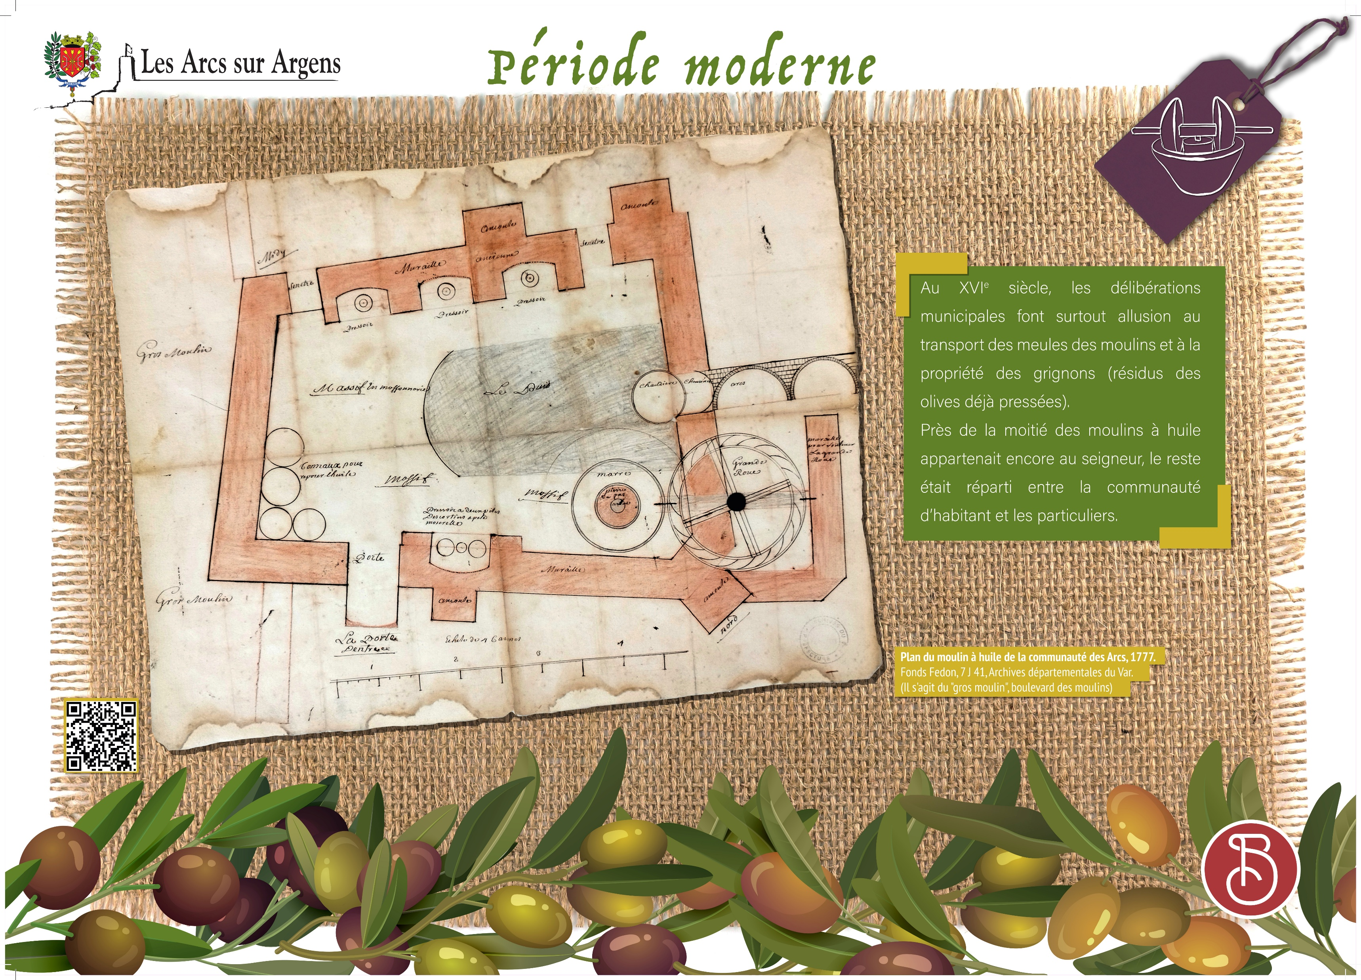



Sainte Cecile
Vestiges of the olive-growing activity in Les Arcs in “modern times” (between the middle age and the french Revolution)
In the 16th century, the local decisions of the town council were about the mill’s millstone transportation and the property of the grignons (residue of olives already ground).
Almost the half of oil mills still belonged to the Lord, the rest was divided between the inhabitants and private individuals.
Les Arcs sur Argens
Bastide Sainte
Cécile
Find all our news on the site of the Arcs town hall
here

