Slide 1
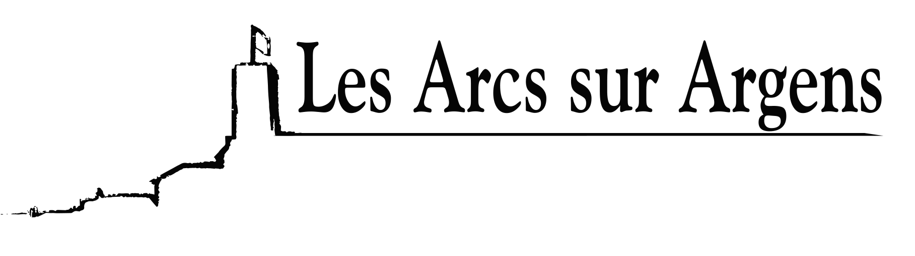

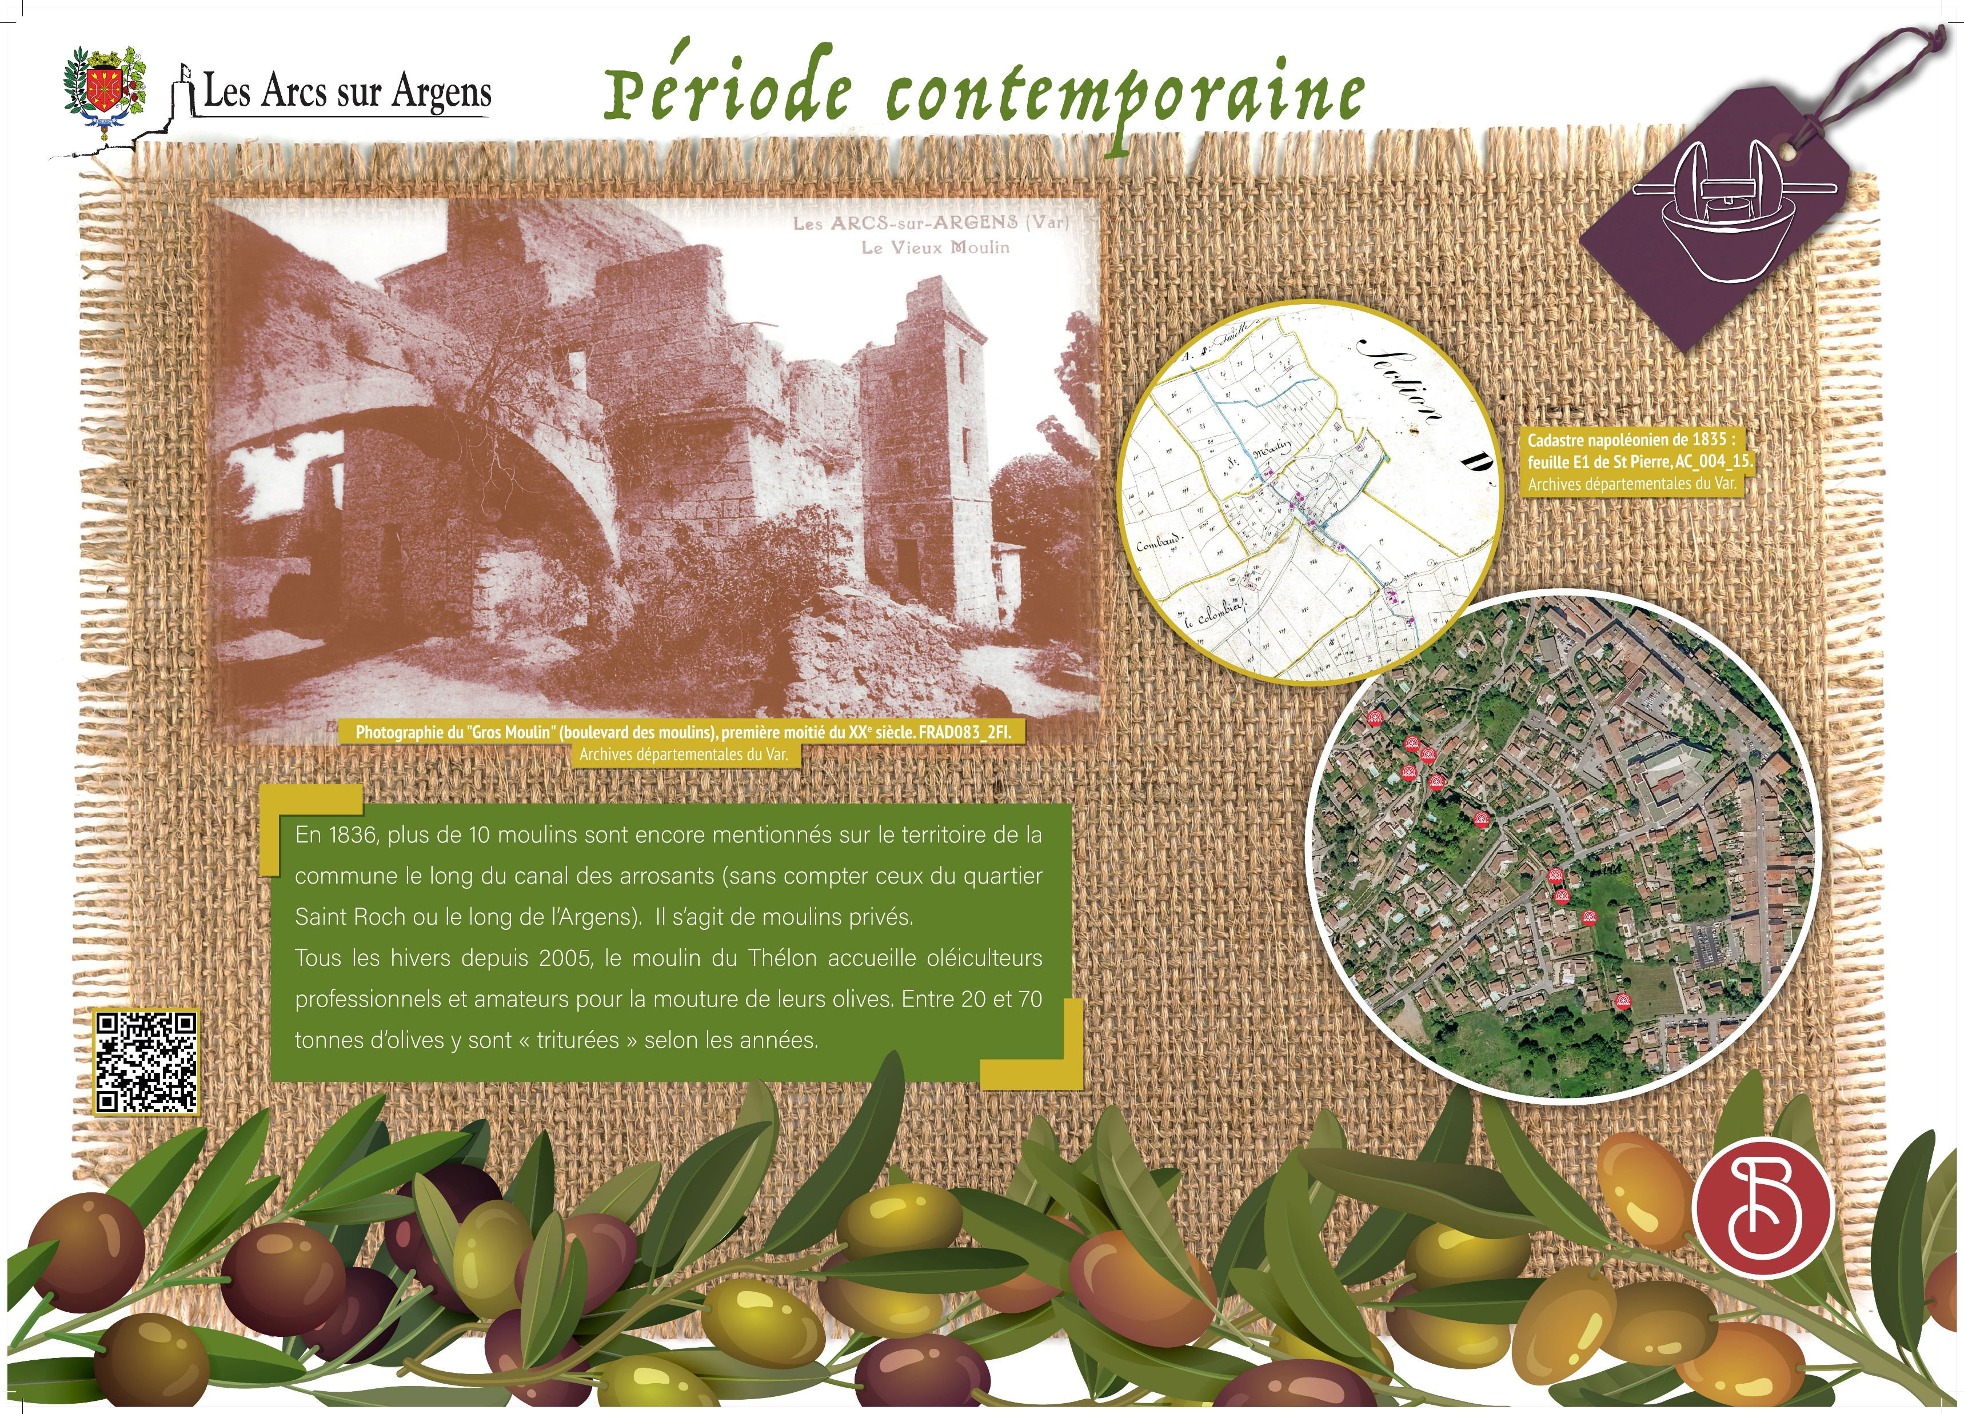



Sainte Cecile
Vestiges of the olive-growing activity in Les Arcs from the French Revolution till today
In 1836, more than 10 mills were still mentioned on the town territory along the irrigation canal (without considering those in the Saint Roch district or alongside the Argens River). They were private mills.
Every winter since 2005, Thélon mill has welcomed professional and amateur olive growers for the grinding of their olives.
According to the year, 20 to 70 tons of olives are ‘crushed’.
Les Arcs sur Argens
Bastide Sainte
Cécile
Find all our news on the site of the Arcs town hall
here

