Slide 1
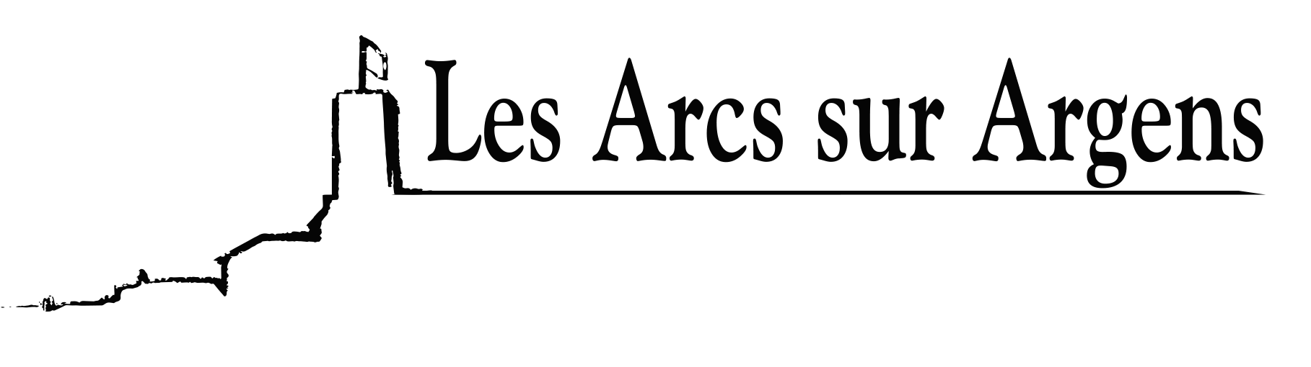

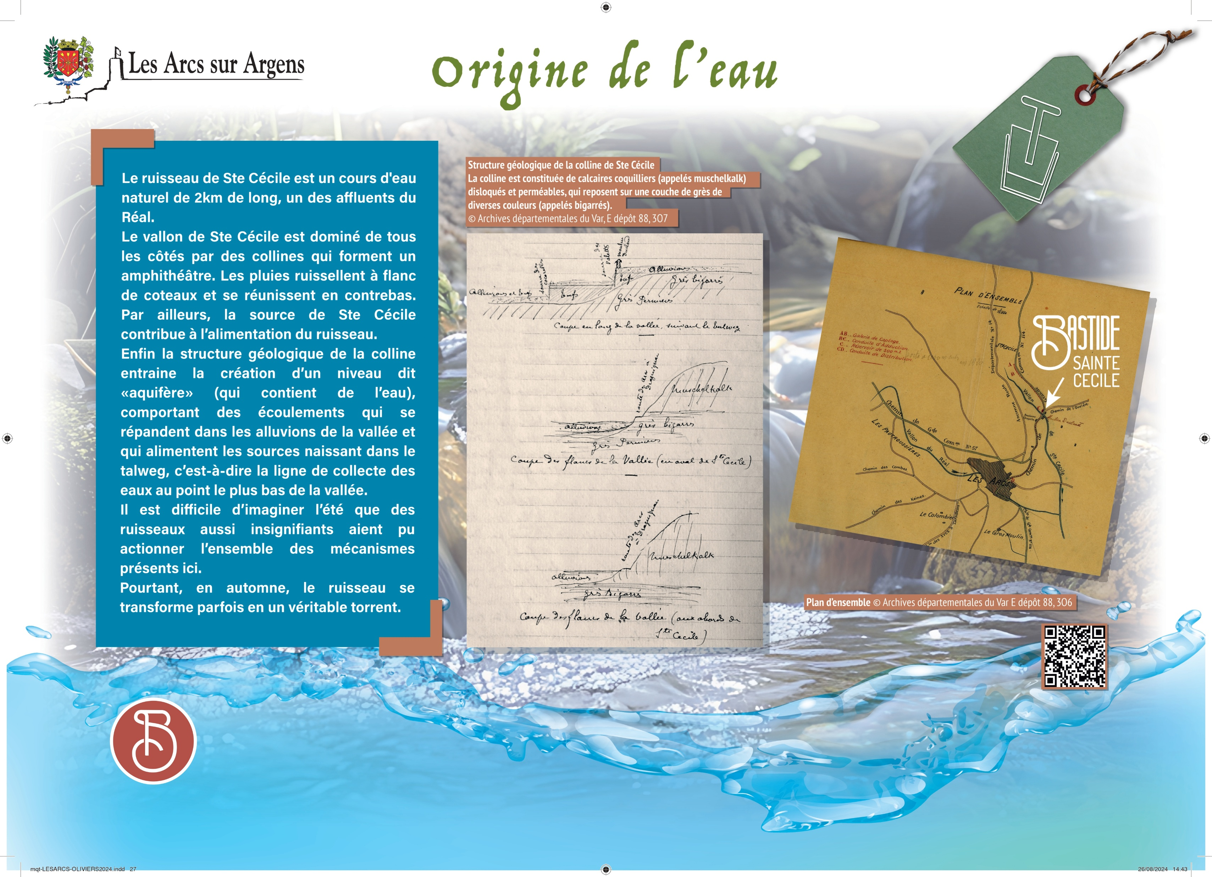



Sainte Cecile
The origin of the water.
The Sainte-Cécile stream is a natural river 2 km long (1.24 miles), one of the tributaries of the Réal.
The Sainte-Cécile small valley is dominated on all sides by the hills that form an amphitheater. The rains run down hillsides and meet below. However, the Sainte-Cécile source contributes to supplying the stream.
Finally, the geological structure of the hill leads to the creation of a so-called “aquifer” (which contains water), with flows that are distributed in the alluvium of the valley, and which supply the nascent springs in the thalweg, that is, the water collection line at the lowest point of the valley.
It is difficult to imagine during summer that such insignificant streams could operate all the mechanisms present here.
Yet, in autumn the stream sometimes turns into a real torrent.
Les Arcs sur Argens
Bastide Sainte
Cécile
Find all our news on the site of the Arcs town hall
here

