Slide 1
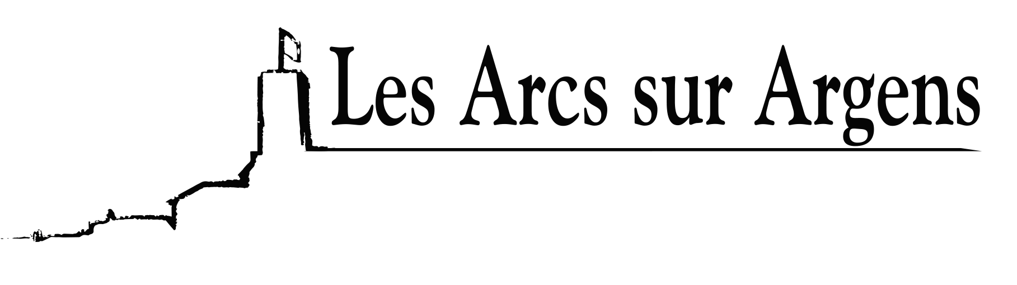

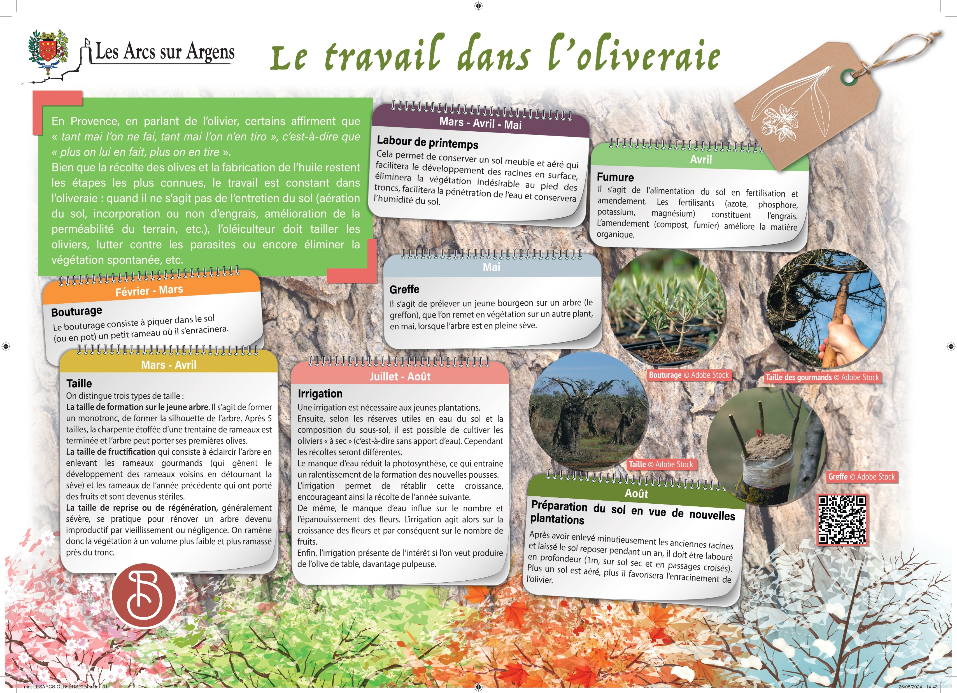



Sainte Cecile
The work in the olive grove.
In Provence, some affirm that “tant mai l’on ne fait, tant mai l’on n’en tiro” which means “the more we do to it, the more we get out of it”, talking about the olive tree.
Even if the harvest of the olives and the production of oil are the most known steps, the work is consistent in the olive grove: when it is not the ground maintenance (ground airing, incorporation or not of fertilizer, improvement of the permeability of the ground…), the olive grove worker has to prune the trees, control pests or eliminate spontaneous vegetation.
February and March
The taking of cuttings.
The action of taking cuttings consists of putting a small branch into the ground or pot where it will take root.
March and April
We can see 3 types of pruning:
The formation pruning on the sapling. To form a trunk to form the silhouette of the tree. After 5 pruning, the frame of about thirty branches is completed and the tree can carry its first olives.
The fruiting pruning consists of illuminating the tree by removing the greedy branches (which hinder the development of the neighboring branches by diverting the sap) and the branches of the previous year which bore fruit and became sterile.
The recovery or regeneration pruning, usually severe, is practiced when renovating a tree that has become unproductive by aging or neglect. Vegetation is therefore reduced to a lower volume and more collected near the trunk.
April
The manure.
It is the feeding of the soil by fertilization and amendment. The fertilizers are nitrogen, phosphorus, potassium, and magnesium. The amendment is compost and manure, it improves the organic matter.
May
Grafting
To take a small bud off a tree (the graft), that we put in vegetation on another plant, in May when the tree is in full sap.
March, April, and May
Spring plowing.
It permits to keep a soft and airy soil that will facilitate the root's development on the surface. It will eliminate the undesirable vegetation at the roots of the trunks, facilitate water penetration, and retain soil moisture.
July and August
Irrigation
Irrigation is necessary for young plants.
Then, according to the water reserves of the soil and the composition of the subsoil, it is possible to cultivate the olive trees “dry” (that is, without a water supply). However, harvests will be different.
The lack of water reduces photosynthesis, resulting in slower formation of new sprouts.
The irrigation allows to restoration of this growth, thus encouraging the harvest of the following year.
Likewise, the lack of water influences the number and the fulfillment of the flowers. The irrigation then acts on the growth of flowers and consequently on the number of fruits.
Finally, irrigation presents interest if you want to produce table olive or pulpier.
August
The preparation of the soil for new plantations.
After carefully removing the old roots and leaving the soil to rest for a year it must be plowed deeply (1 meter, on dry soil and crossed passages). The more the soil is aerated, the more it will favor the rooting of the olive tree.
Les Arcs sur Argens
Bastide Sainte
Cécile
Find all our news on the site of the Arcs town hall
here

