Slide 1


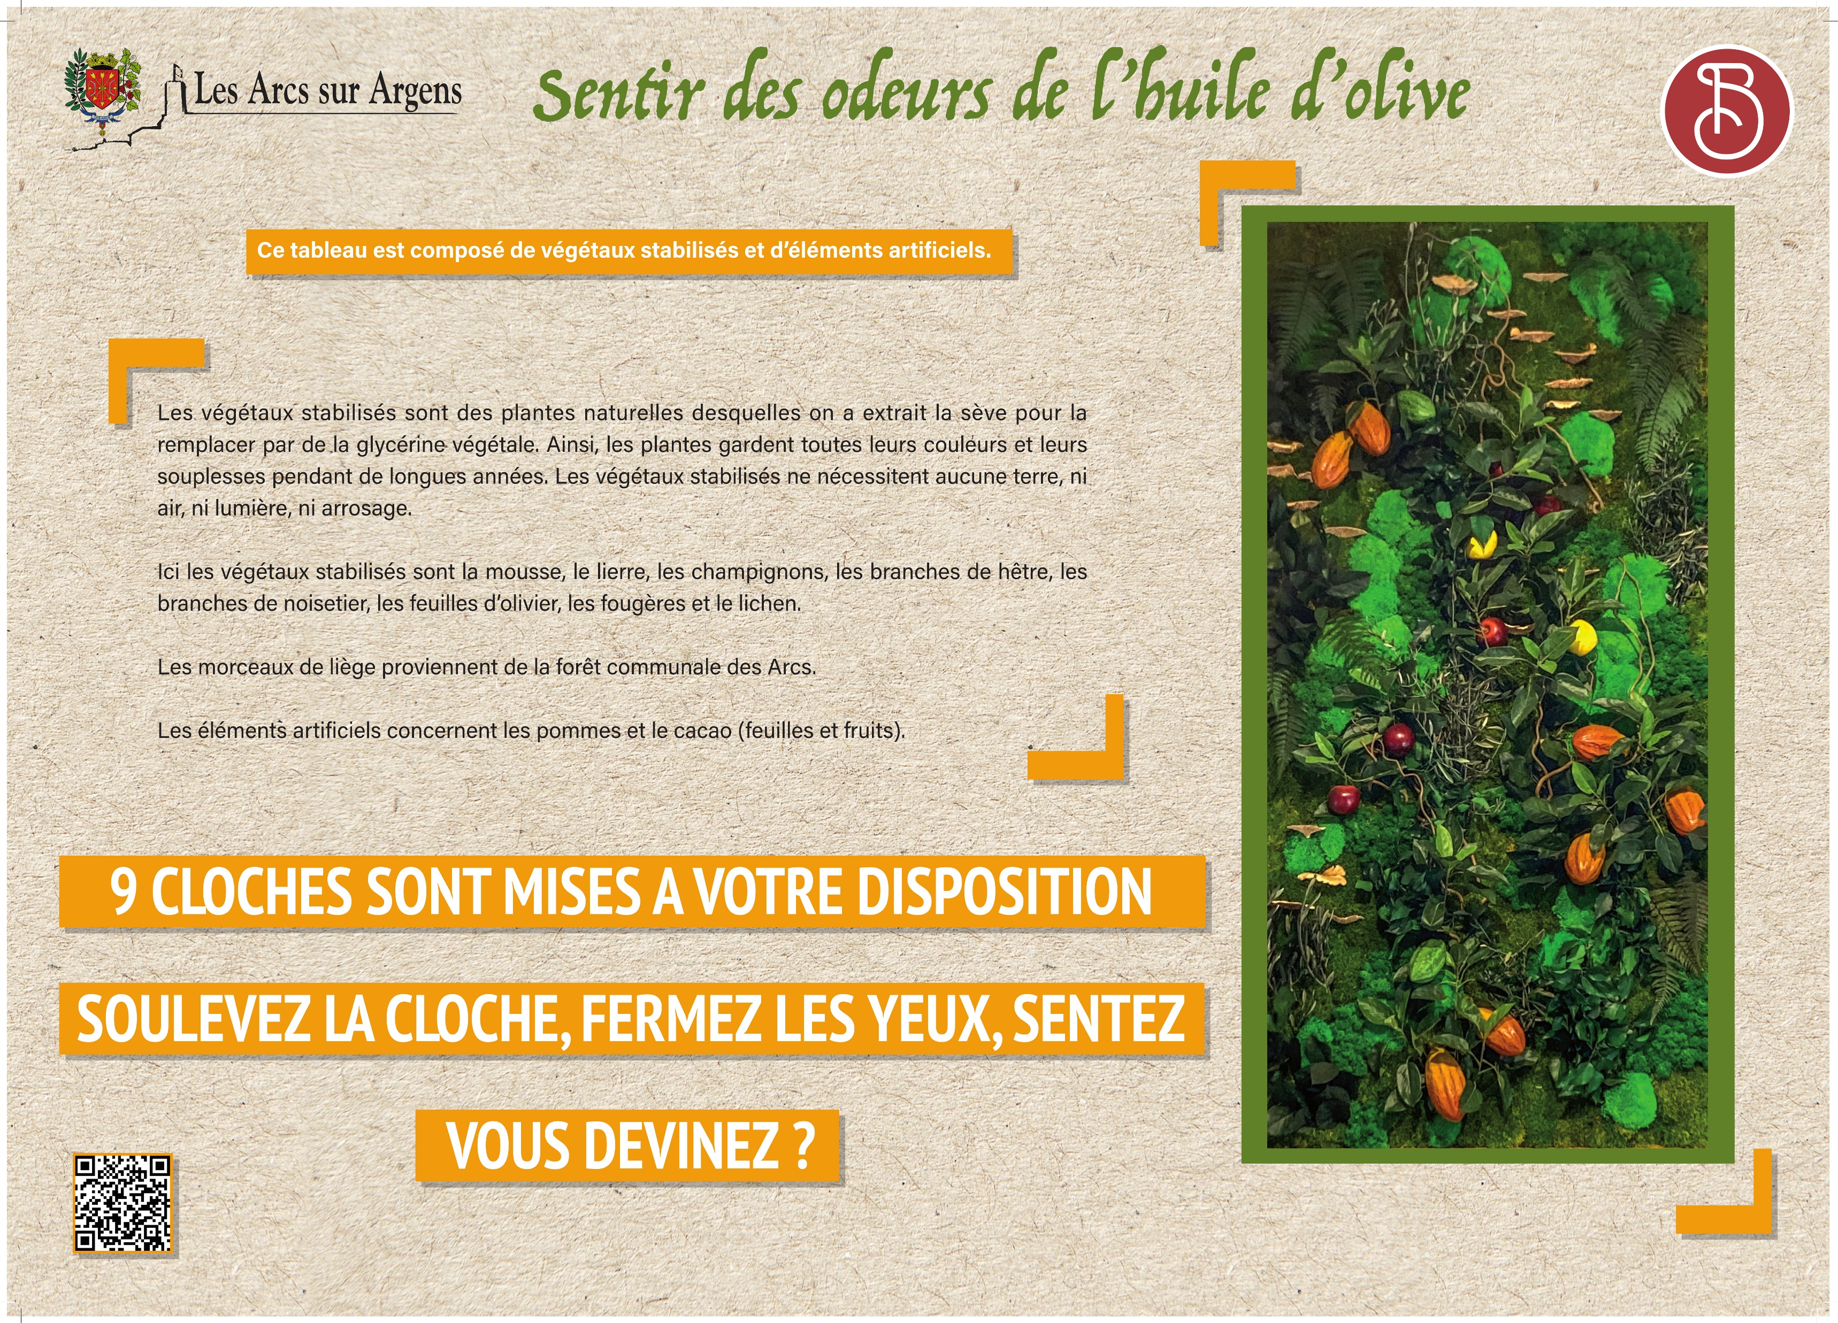



Sainte Cecile
Smelling the Scents of Olive Oil
This display is made up of preserved plants and artificial elements.
Preserved plants are natural plants whose sap has been replaced with vegetable glycerin. In this way, the plants retain their color and suppleness for many years.
They require no soil, air, light, or watering.
Here, the preserved plants include moss, ivy, mushrooms, beech branches, hazel branches, olive leaves, ferns, and lichen.
The artificial elements include apples and cocoa (leaves and pods).
9 BELLS ARE AVAILABLE TO YOU
LIFT THE BELL, CLOSE YOUR EYES, SMELL
CAN YOU GUESS?
Les Arcs sur Argens
Bastide Sainte
Cécile
Find all our news on the site of the Arcs town hall
here

