Slide 1
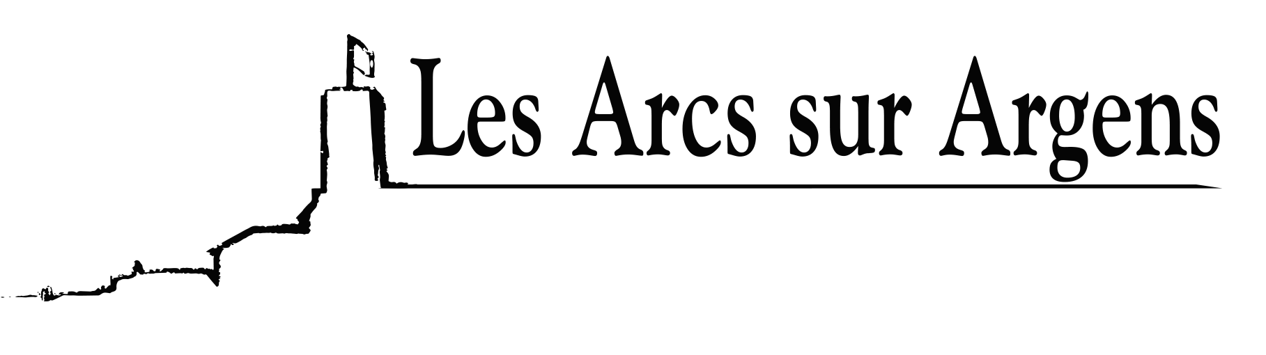

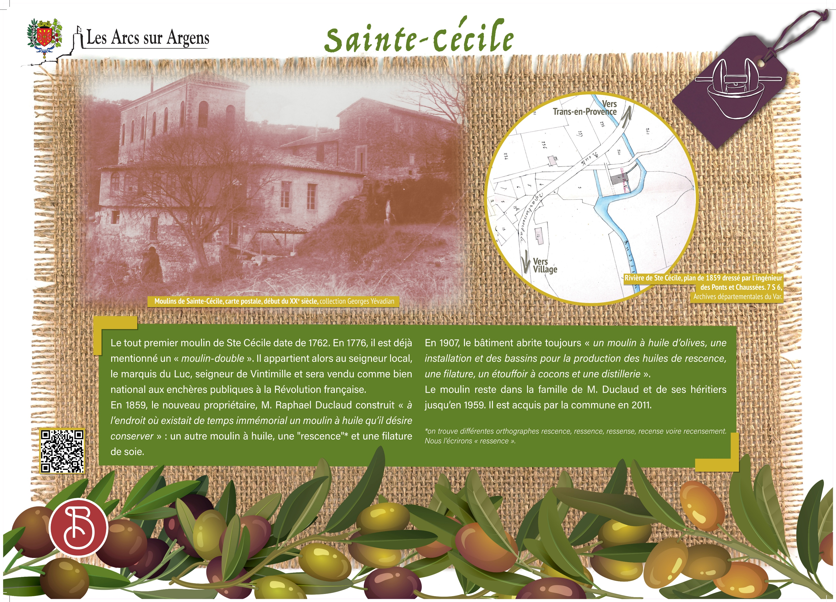



Sainte Cecile
The mills of Sainte Cecile
The first mill of Sainte Cécile dates from 1762. In 1776, it was already mentioned as a “double mill”. It belonged to the local Lord, the Marquis of Le Luc, Lord of Ventimiglia, and was sold as a national property at public auction during the French Revolution.
In 1859, the new owner Mr. Raphael Duclaud built “in the place where an oil mill existed from time immemorial which he wishes to preserve”: another oil mill, a “mill for residual oil (= non food oil) ” and a silk spinning mill.
In 1907, in this building there still was an “olive oil mill, a facility and vats for the production of residual oil, a spinning mill, a cocoon damper, and a distillery”.
The mills stayed in the Duclaud family and its heirs until 1959. It was acquired by the town in 2011.
Les Arcs sur Argens
Bastide Sainte
Cécile
Find all our news on the site of the Arcs town hall
here

