Slide 1
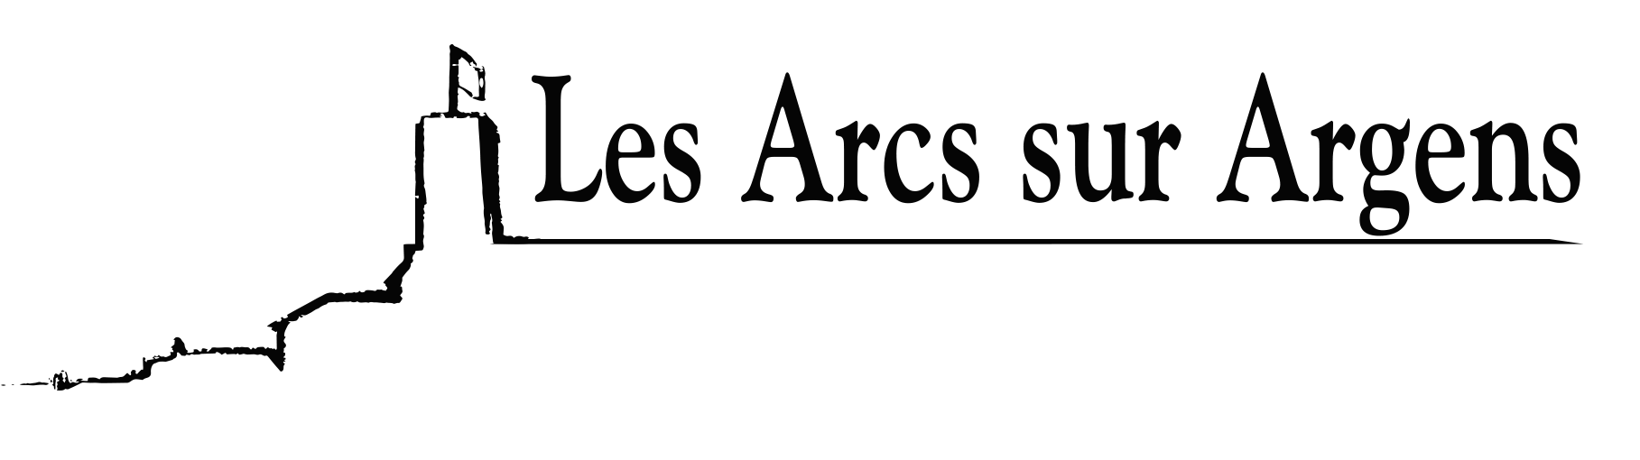

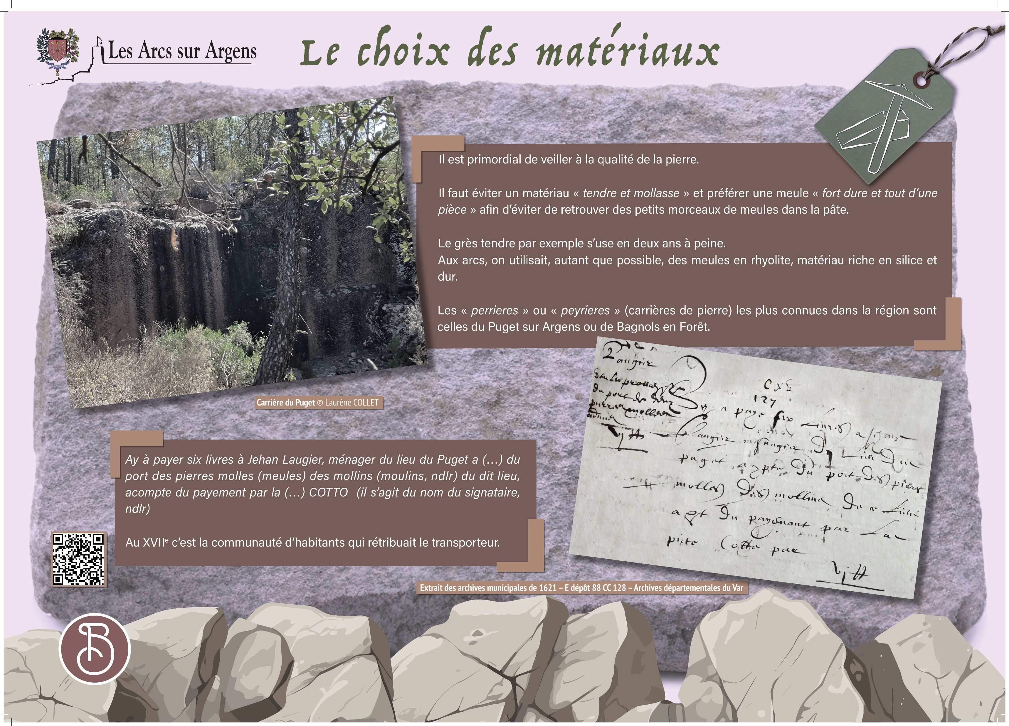



Sainte Cecile
The choice of materials
It is essential to ensure the stone's quality.
We must avoid a “soft and limp” material and prefer a “very hard and a one-block” millstone to avoid finding small pieces of millstones in the paste.
The soft sandstone for example wears out in 2 years.
In Les Arcs we used as much as possible rhyolite millstones, silica-rich and hard material.
The most known “perrieres” or “peyrieres” (stone quarries) in the region are the ones in Puget sur Argens or the ones in Bagnols en Forêt.
Translation of the text of 1621
Have to pay 6 pounds to Jehan Laugier, the housekeeper of the place in Puget at (…) for the transportation of the millstones of the said place, a deposit of the payment by the (…) COTTO (name of the signatory).
In the 17th century, inhabitants remunerated the carrier.
Les Arcs sur Argens
Bastide Sainte
Cécile
Find all our news on the site of the Arcs town hall
here

