Slide 1
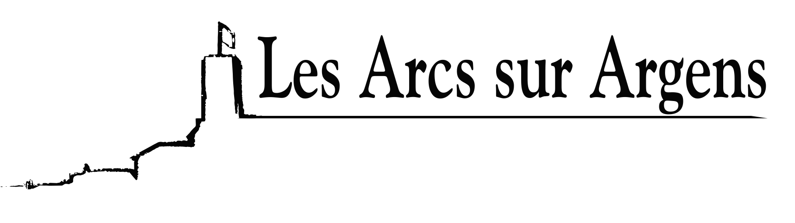

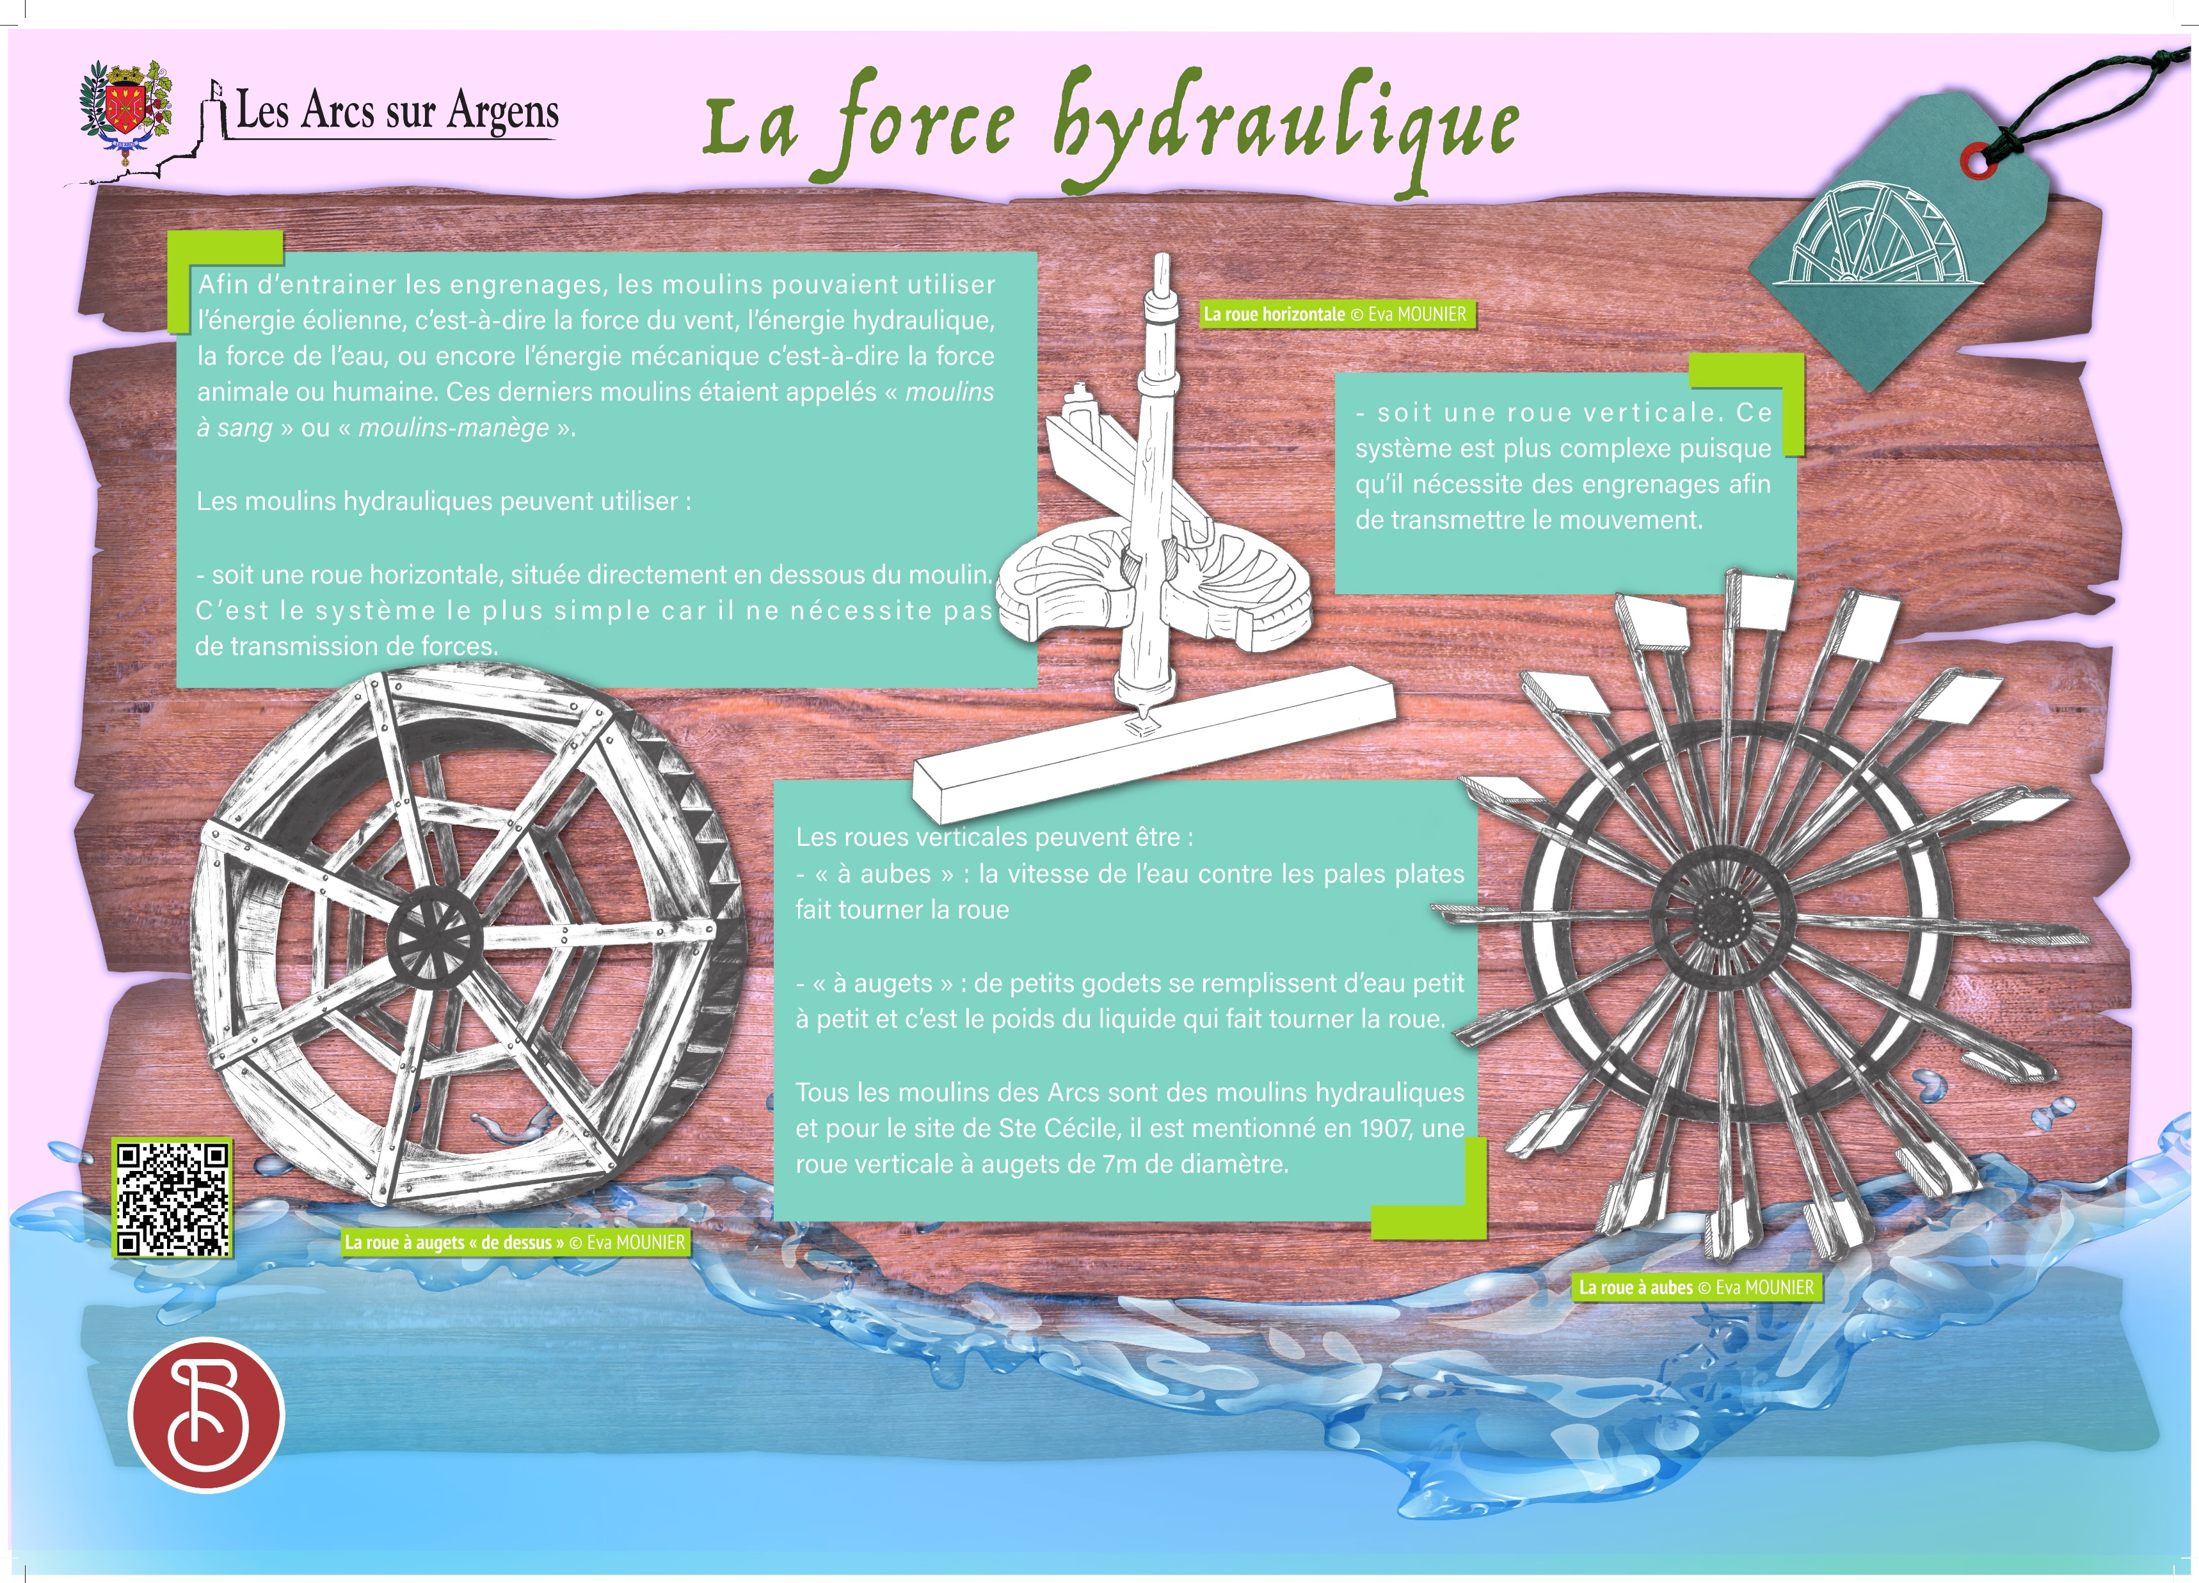


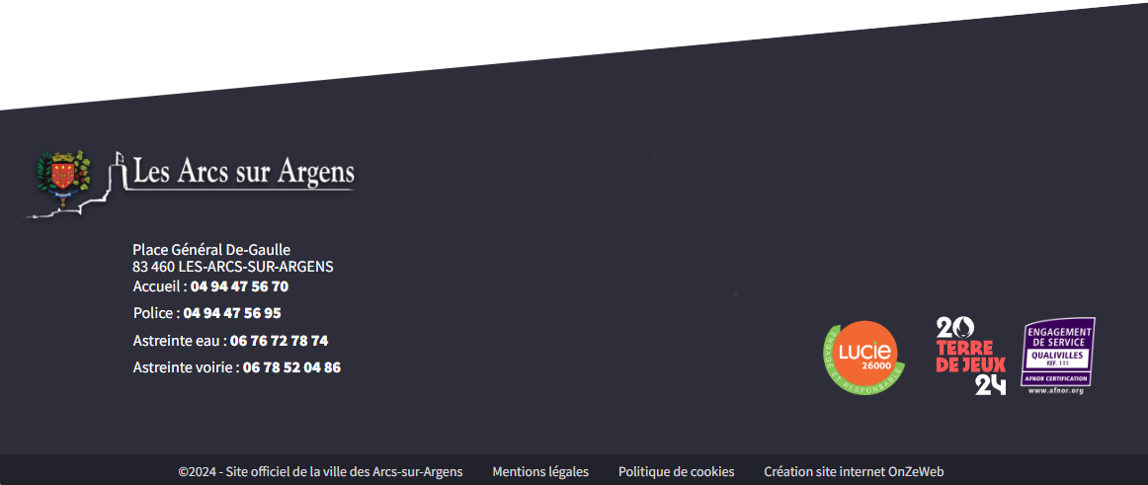
Sainte Cecile
The power of water
To drive the gears, the mills could use wind power, water power, or mechanical power (animal or human force). These mills were called “blood mills” or “mills-carousel”.
Hydraulic mills can use whether:
- A vertical wheel located below the mill. It is the simplest system because it doesn’t require any force transmission.
- A vertical wheel. This system is more complex because it requires gears to transmit the movement.
Vertical wheels can be whether:
- “Waterwheel”: the water speed against the flat paddles and turn the wheel.
- “Bucket wheel”: small buckets filling up with water little by little and it is the liquid weight that turns the wheel.
All mills in Les Arcs are hydraulic mills. For the Sainte Cécile site, it was mentioned in 1907 that there was a vertical bucket wheel of 7 meters (22.96 feet) in diameter.
Les Arcs sur Argens
Bastide Sainte
Cécile
Find all our news on the site of the Arcs town hall
here

