Slide 1
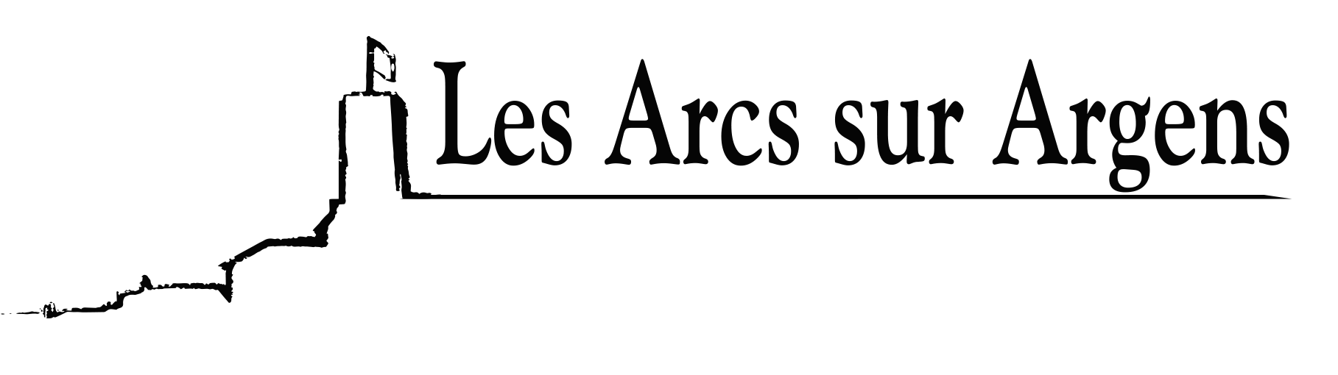

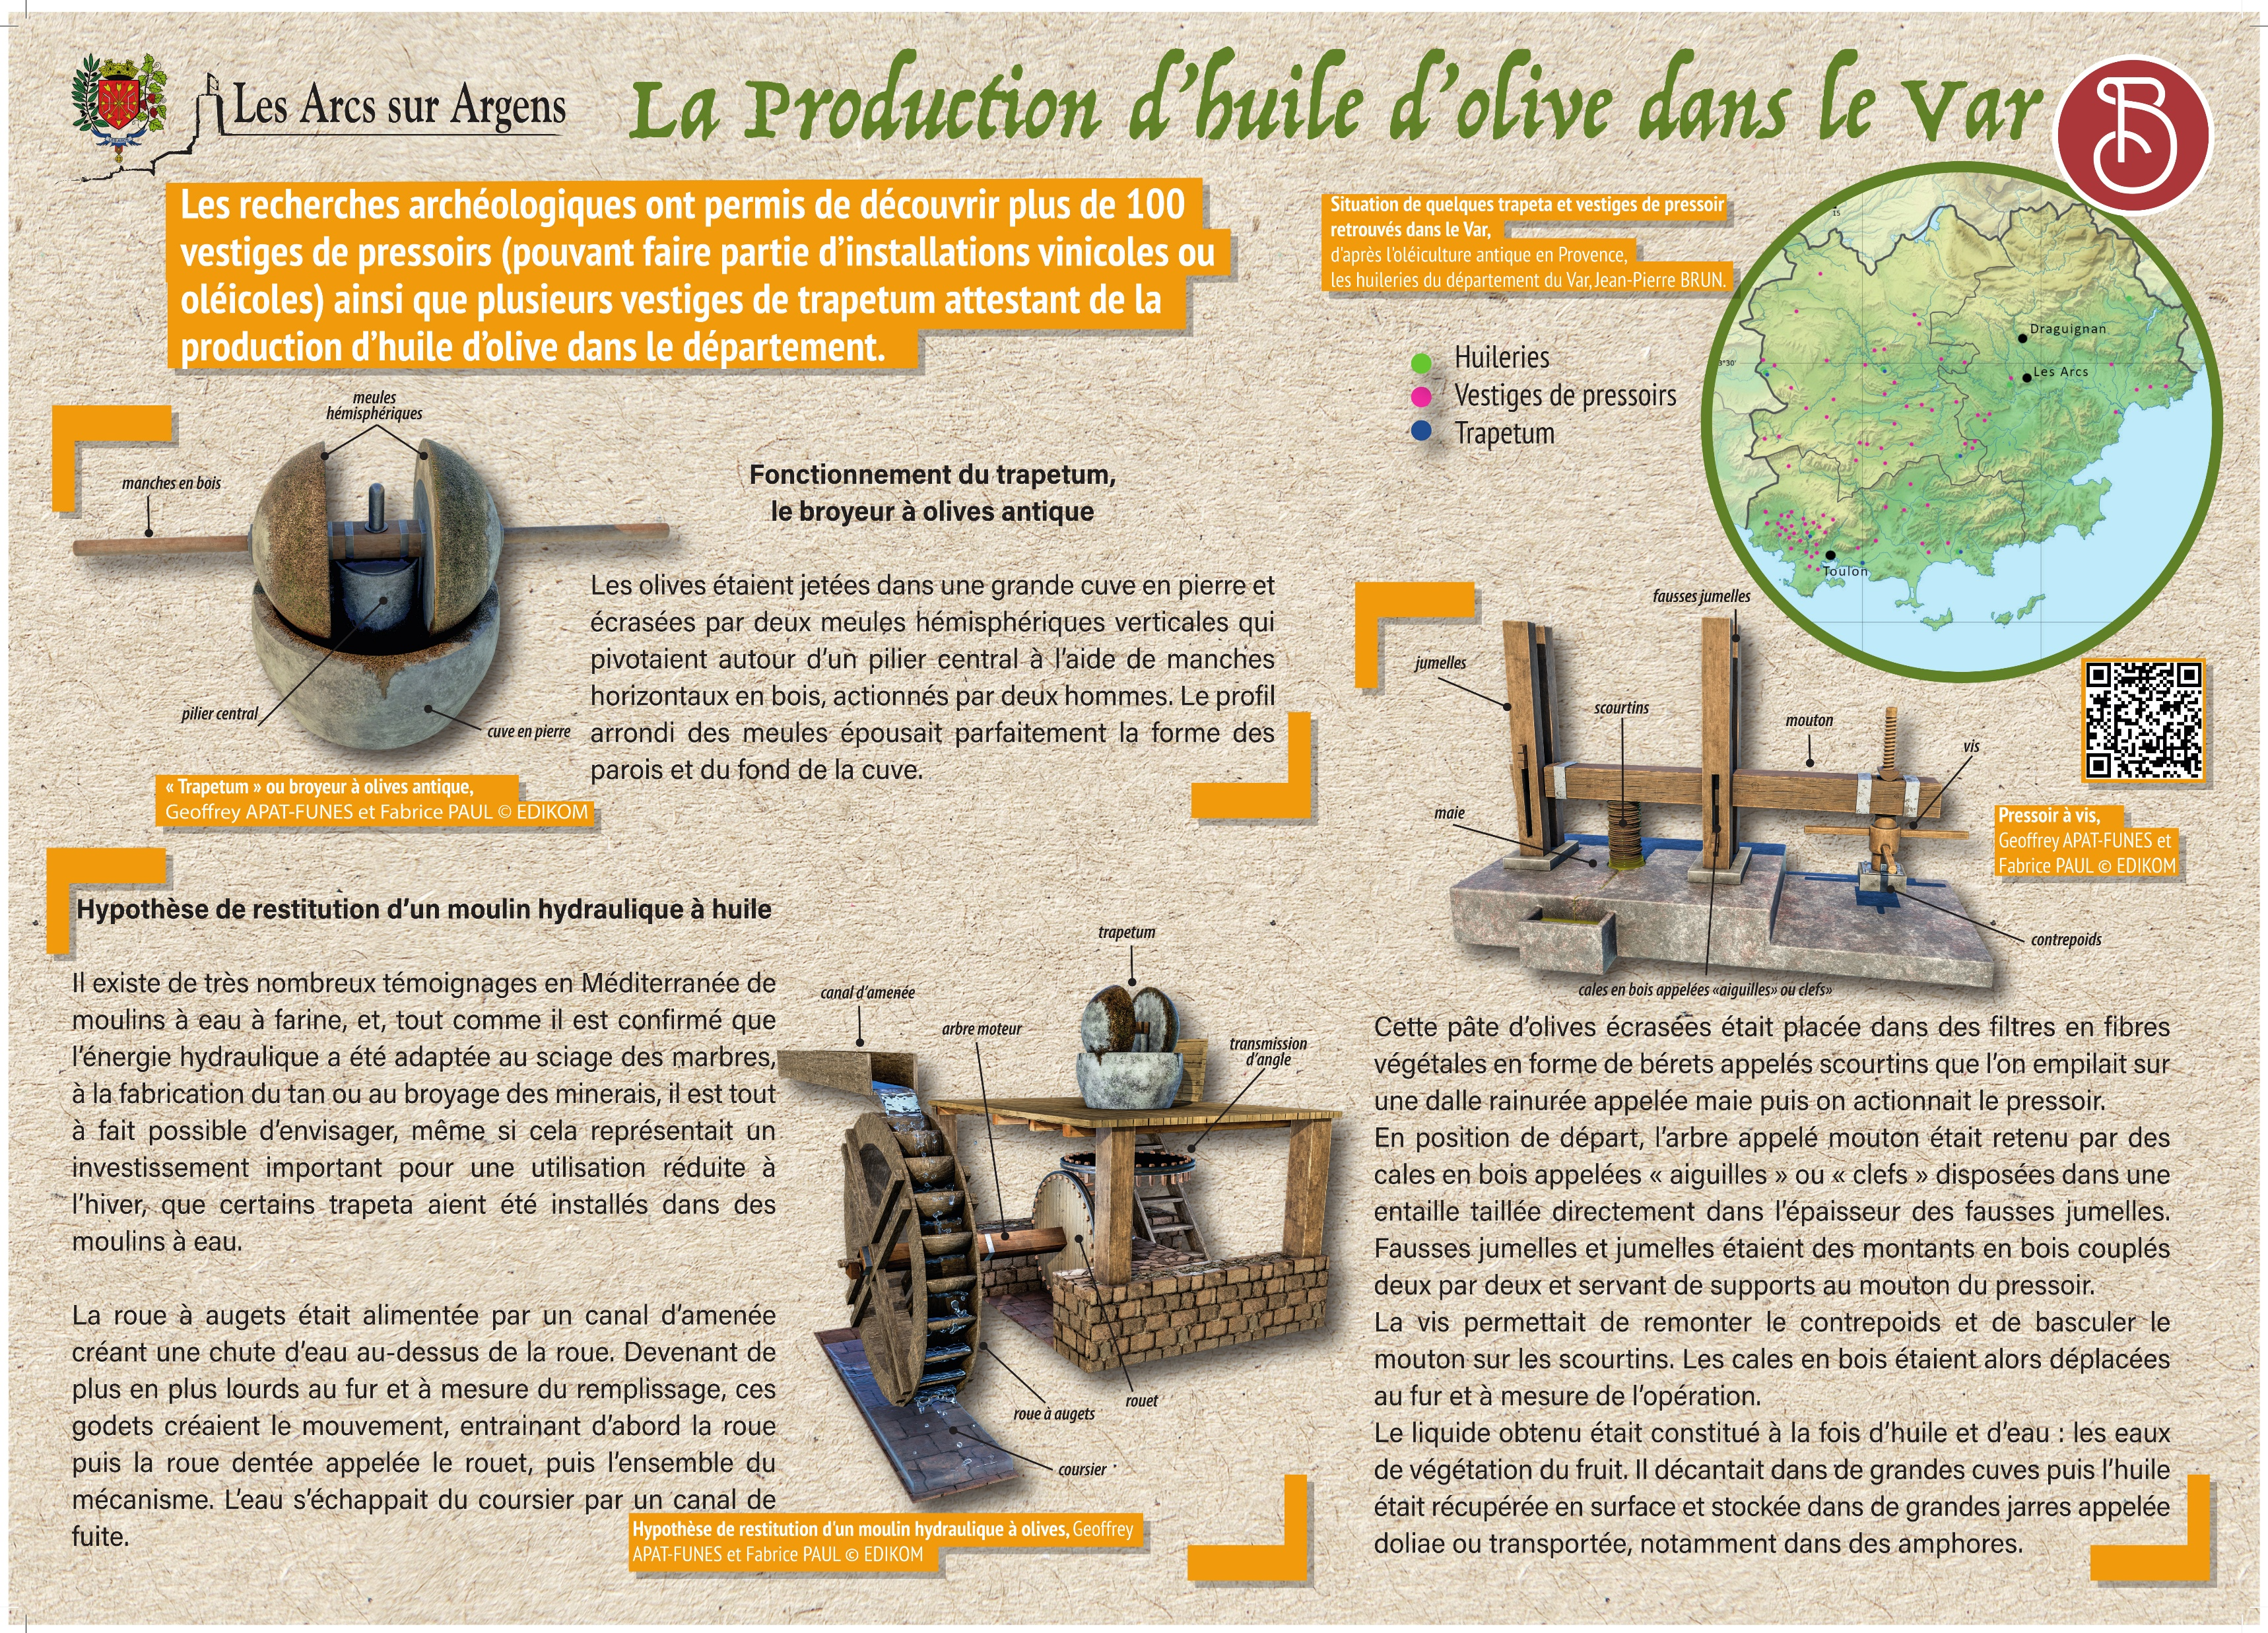



Sainte Cecile
The production of olive oil in the whole Var
The archaeological research permitted the discovery of more than 100 presses vestiges (may be part of wine or olive-growing facilities) and several trapetum vestiges attesting to the production of olive oil in the department.
Olives were dropped in a huge stone vat and ground by two vertical hemispherical millstones that rotated around a central column using horizontal wooden handles operated by two men. The rounded profile of the millstones perfectly matched the shape of the walls and bottom of the vat.
There are many testimonies in the Mediterranean region of hydraulic flour mills. Just as it is confirmed the hydraulic power had been adapted to the sawing of marbles or the grinding of ores. It is possible to envisage that some trapeta had been installed in water mills, even if this represented a significant investment only for winter use.
An inlet canal supplied the bucket wheel, creating a waterfall above the wheel. The wheel buckets became heavier and heavier in the course of filling, and it created a motion. First, the wheel moved, then the cogwheel and the whole mechanism. The water leaked from the outlet canal through a leaking canal.
This crushed olive paste was put in baskets made of vegetable fiber in the shape of berets called scourtins that was stacked on a grooved slab called a press table, and then the press was operated.
In the starting position, the main axis called the lever was secured by wooden wedges called “needles” or “keys” arranged in a notch directly cut into the thickness of the second twin beams.
The second twin beams and twin beams were wooden uprights coupled two by two and used as supports for the lever of the press.
The screw was used to pull the counterweight up and tilt the lever over the fiber basket. The wooden wedges were then moved as the operation progressed.
The liquid obtained was composed of oil and water: the vegetation waters of the fruit. It was decanted in large vats then the oil was picked up on the surface and stored in large vats called doliae or transported in particular in amphorae.
Les Arcs sur Argens
Bastide Sainte
Cécile
Find all our news on the site of the Arcs town hall
here

