Slide 1
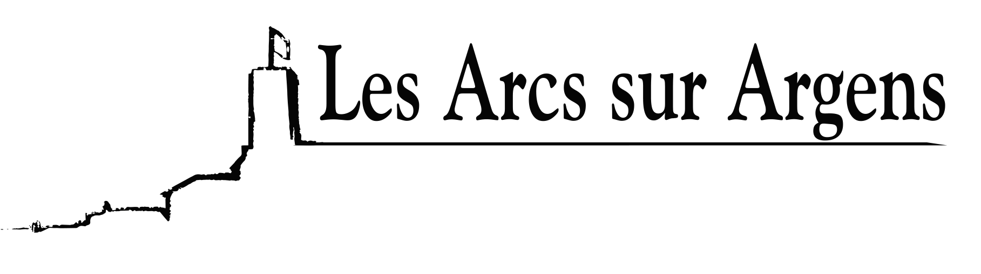

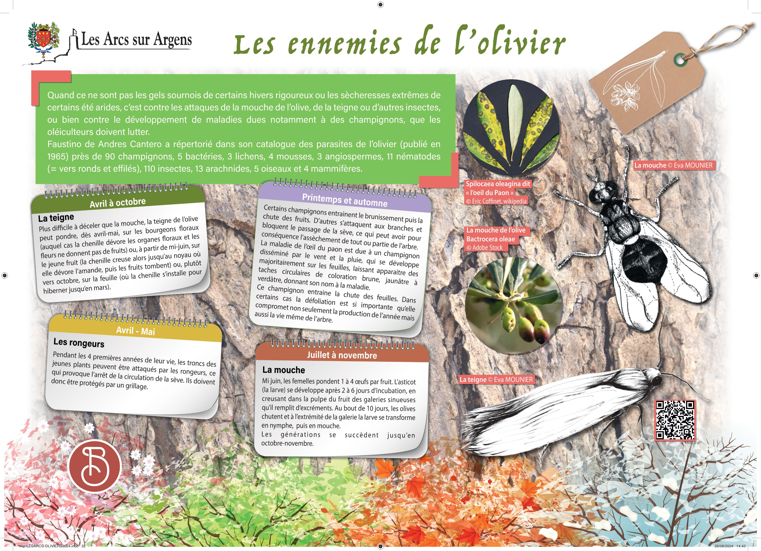



Sainte Cecile
The olive tree enemies.
When it is not the sneaky frosts of some winters or the extreme droughts of some arid summers, the olive grove workers have to struggle against attacks of the olive fly, the moths, or other bugs, or the disease’s development due to fungi.
Faustino de Andres Cantero identified in his olive tree pests’ catalog (published in 1965) approximately 90 fungi, 5 bacteria, 3 lichens, 4 mosses, 3 angiosperms, 11 nematodes (round and slander worms), 110 bugs, 13 arachnids, 5 birds, and 4 mammals.
From April to October
Moth
More difficult to detect than fly, the olive moth can lay eggs from April or May on floral buds (the caterpillar devours the floral organs and flowers don’t give fruits), or from mid-June, on the young fruit (the caterpillar digs until the pit where it devours the kernel, and then the fruits fall) or, in October, on the leaf (where the caterpillar stay to hibernate until March).
April and May
The rodents
During the four first years of its existence, the trunks of the seedling can be attacked by rodents which stops the flow of sap. Therefore, they have to be protected with grillage.
Spring and autumn
Some fungi cause browning and then fruits fall, others attack branches and block the passage of sap, which may result in the dewatering of all or part of the tree.
The peacock eye disease is due to a fungus disseminated by the wind and by the rain which develops mainly on the leaves. It reveals circular spots of brown, yellowish to greenish color, giving its name to the disease.
This fungus causes the leaves to fall. In some cases, the defoliation is so important that it compromises not only the production of the year but also the very life of the tree.
From July to November
The fly
Mid-June, females lay 1 to 4 eggs in each fruit. The maggot (larva) develops after 2 to 6 days of incubation, digging in the pulp of the fruit's sinuous galleries that it fills with excrement. After 10 days, the olives fall and at the end of the gallery, the larva turns into a nymph and then a fly.
Generations follow one another until October or November.
Les Arcs sur Argens
Bastide Sainte
Cécile
Find all our news on the site of the Arcs town hall
here

