Slide 1
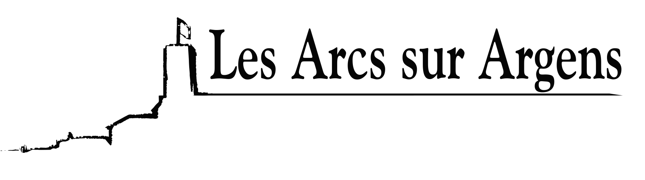

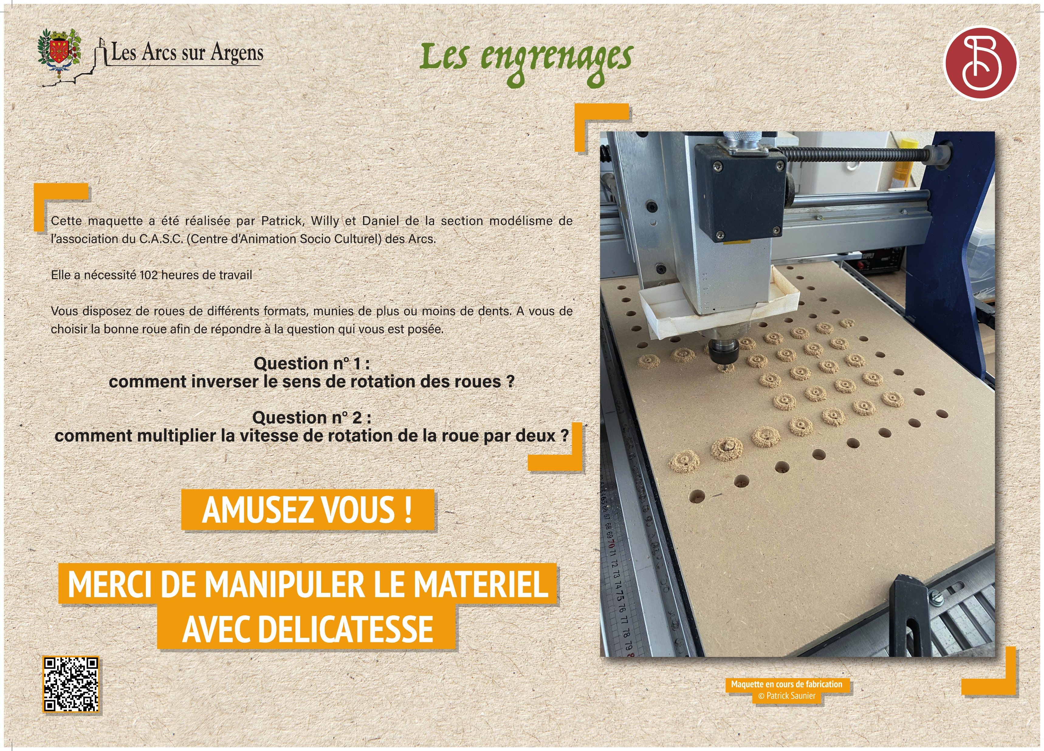



Sainte Cecile
The gears
This model was built by Patrick, Willy, and Daniel from the modeling section of the C.A.S.C. (Centre d’Animation Socio-Culturel) of Les Arcs.
It required 102 hours of work.
You have wheels of various sizes, with more or fewer teeth. It’s up to you to choose the right wheel to answer the question asked.
Question 1: How can you reverse the direction of rotation of the wheels?
Question 2: How can you double the rotation speed of the wheel?
HAVE FUN!
PLEASE HANDLE THE MATERIAL WITH CARE
Les Arcs sur Argens
Bastide Sainte
Cécile
Find all our news on the site of the Arcs town hall
here

