Slide 1
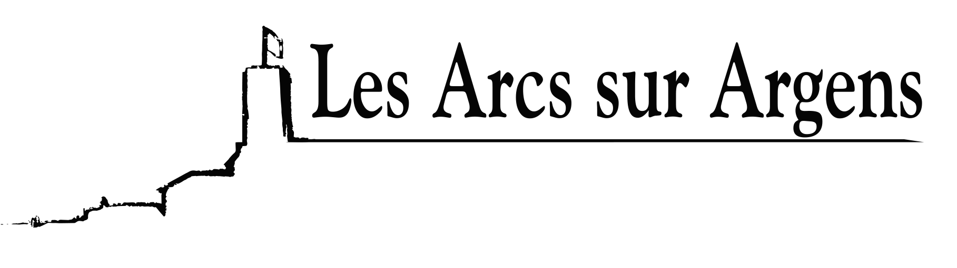

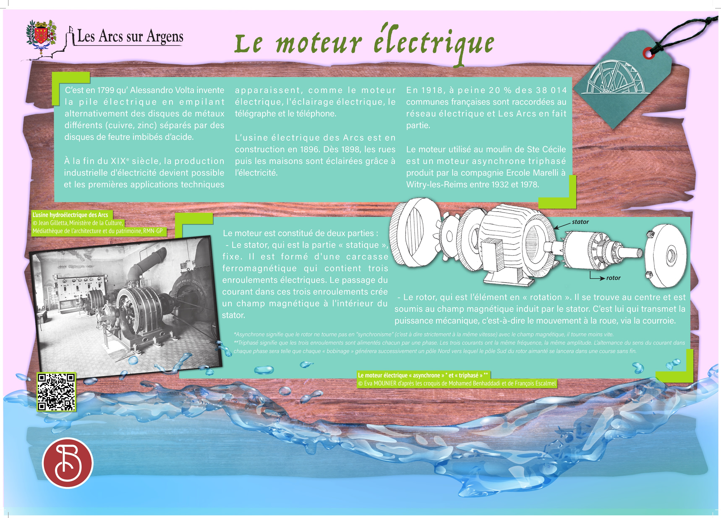


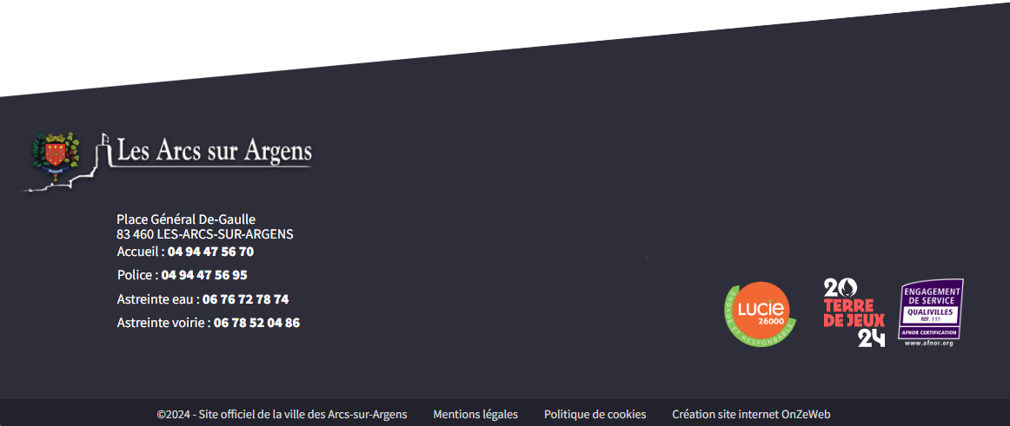
Sainte Cecile
The electric motor
It was in 1799 that Alessandro Volta invented the battery by piling alternately discs of different metals (copper and zinc) separated by acid-soaked felt discs.
By the end of the 19th century, industrial electricity production became possible, and the first technical applications appeared, such as electric motors, electric lighting, telegraph, and telephone.
The electrical factory of Les Arcs was under construction in 1896. From 1898, the streets and then the houses were lighted thanks to electricity.
In 1920, only 20% of the 38,014 French towns were connected to the electrical network and Les Arcs was one of them.
The engine used in the Sainte Cécile mill was a three-phase* asynchronous** motor produced by Ercole Marelli company in Witry-les-Reims between 1932 and 1978.
The engine was constituted of two parts:
The stator which is the “static” part. It consists of a ferromagnetic carcass containing three electric windings. The passage of power in these three windings creates a magnetic field inside the stator.
The rotor which is the “turning” element. It is located in the center and is subjected to the stator-induced magnetic field. It is the rotor that transmits the mechanical power, that is the movement of the wheel via the belt.
**Asynchronous means that the rotor does not rotate in “synchronism” (strictly at the same speed) with the magnetic field, it rotates slower.
*Three-phase means that the three windings are each powered by a phase. The three powers have the same frequency and the same amplitude. The alternation of the direction of the power in each phase will be such that each “winding” will generate successively a North pole towards which the South pole of the magnetized rotor will launch in an endless race.
Les Arcs sur Argens
Bastide Sainte
Cécile
Find all our news on the site of the Arcs town hall
here

