Slide 1
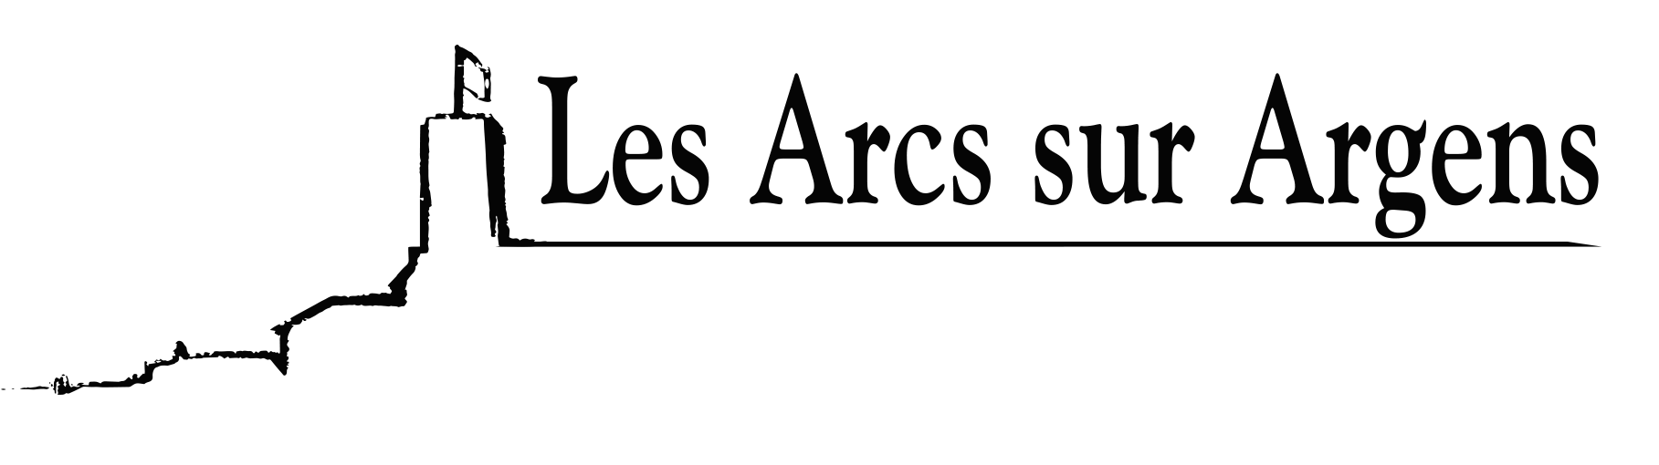

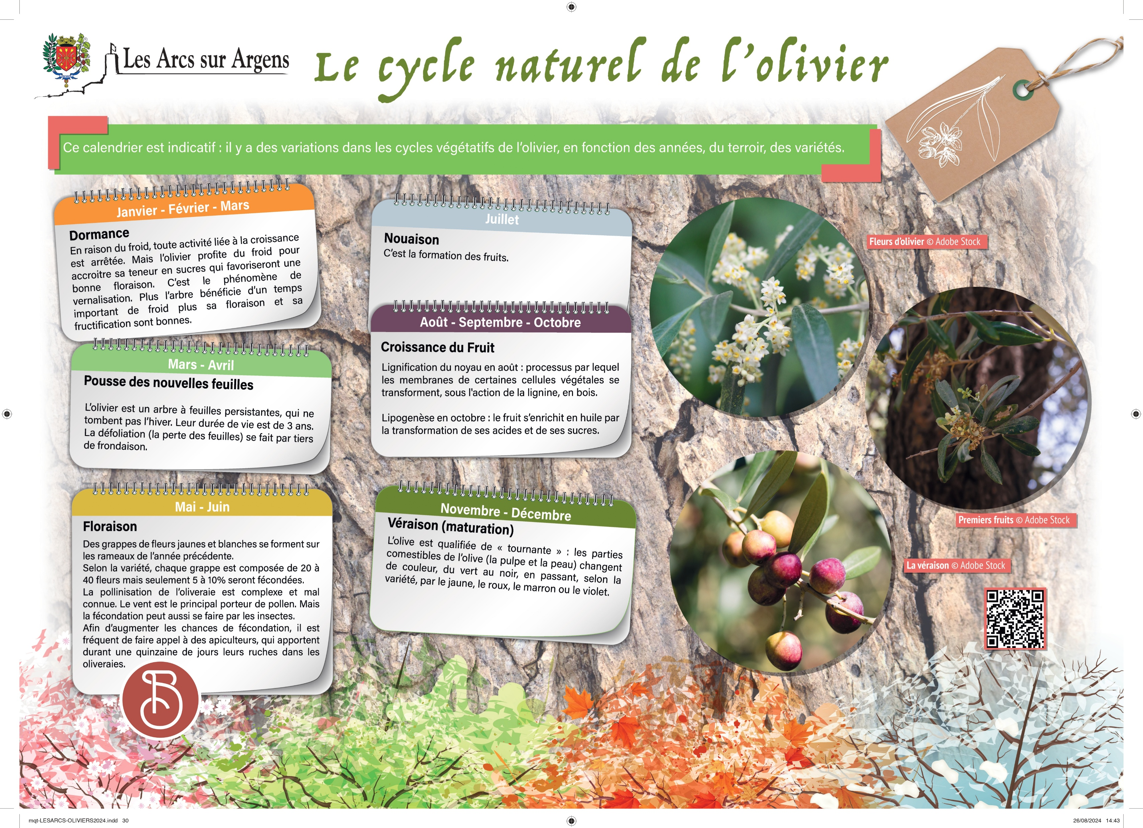



Sainte Cecile
The natural cycle of the olive tree
This is an indicative calendar: there are variations in the vegetative cycles of the olive tree growing cycle according to the years, the terroir, and the varieties.
January, February, and March
Dormancy.
Because of the coldness, all activities linked to growth are stopped, but the olive tree takes advantage of the coldness to increase its sugar content which would promote good flowering. This is the phenomenon of vernalization. The more the tree benefits from significant cold weather more its flowering and fruiting are good.
March and April
New leaves growth.
The olive tree is an evergreen tree, the leaves don’t fall during winter. Their lifespan is three years. The defoliation (the loss of leaves) is done by a third of the foliage.
May and June
Flowering.
Clusters of yellow and white flowers form on the branches of the previous years.
According to the variety, each cluster is formed by 20 to 40 flowers but only 5 to 10% will be fertilized. The pollination of the olive grove is difficult and little known. The wind is the major carrier of pollen, but bugs can also do fertilization. To increase the fertilization chances beekeepers are often used. They stay there for about fifteen days their hives in the olive groves.
July
“nouaison” – the formation of the fruit.
August
The growth of the fruit and the lignifying* of the pit.
Lignify = process by which the membranes of certain plant cells are transformed into wood, under the action of lignin.
September
The growth of the fruit.
October
The growth of the fruit.
The lipogenesis = the fruit is enriched with oil by the transformation of its acids and sugars.
November and December
Veraison (maturation)
The olive is qualified as “changeable”: the edible parts of the olive (the pulp and the skin) change color from green to black, passing by yellow, red, brown, or purple, depending on the variety.
Les Arcs sur Argens
Bastide Sainte
Cécile
Find all our news on the site of the Arcs town hall
here

