Slide 1


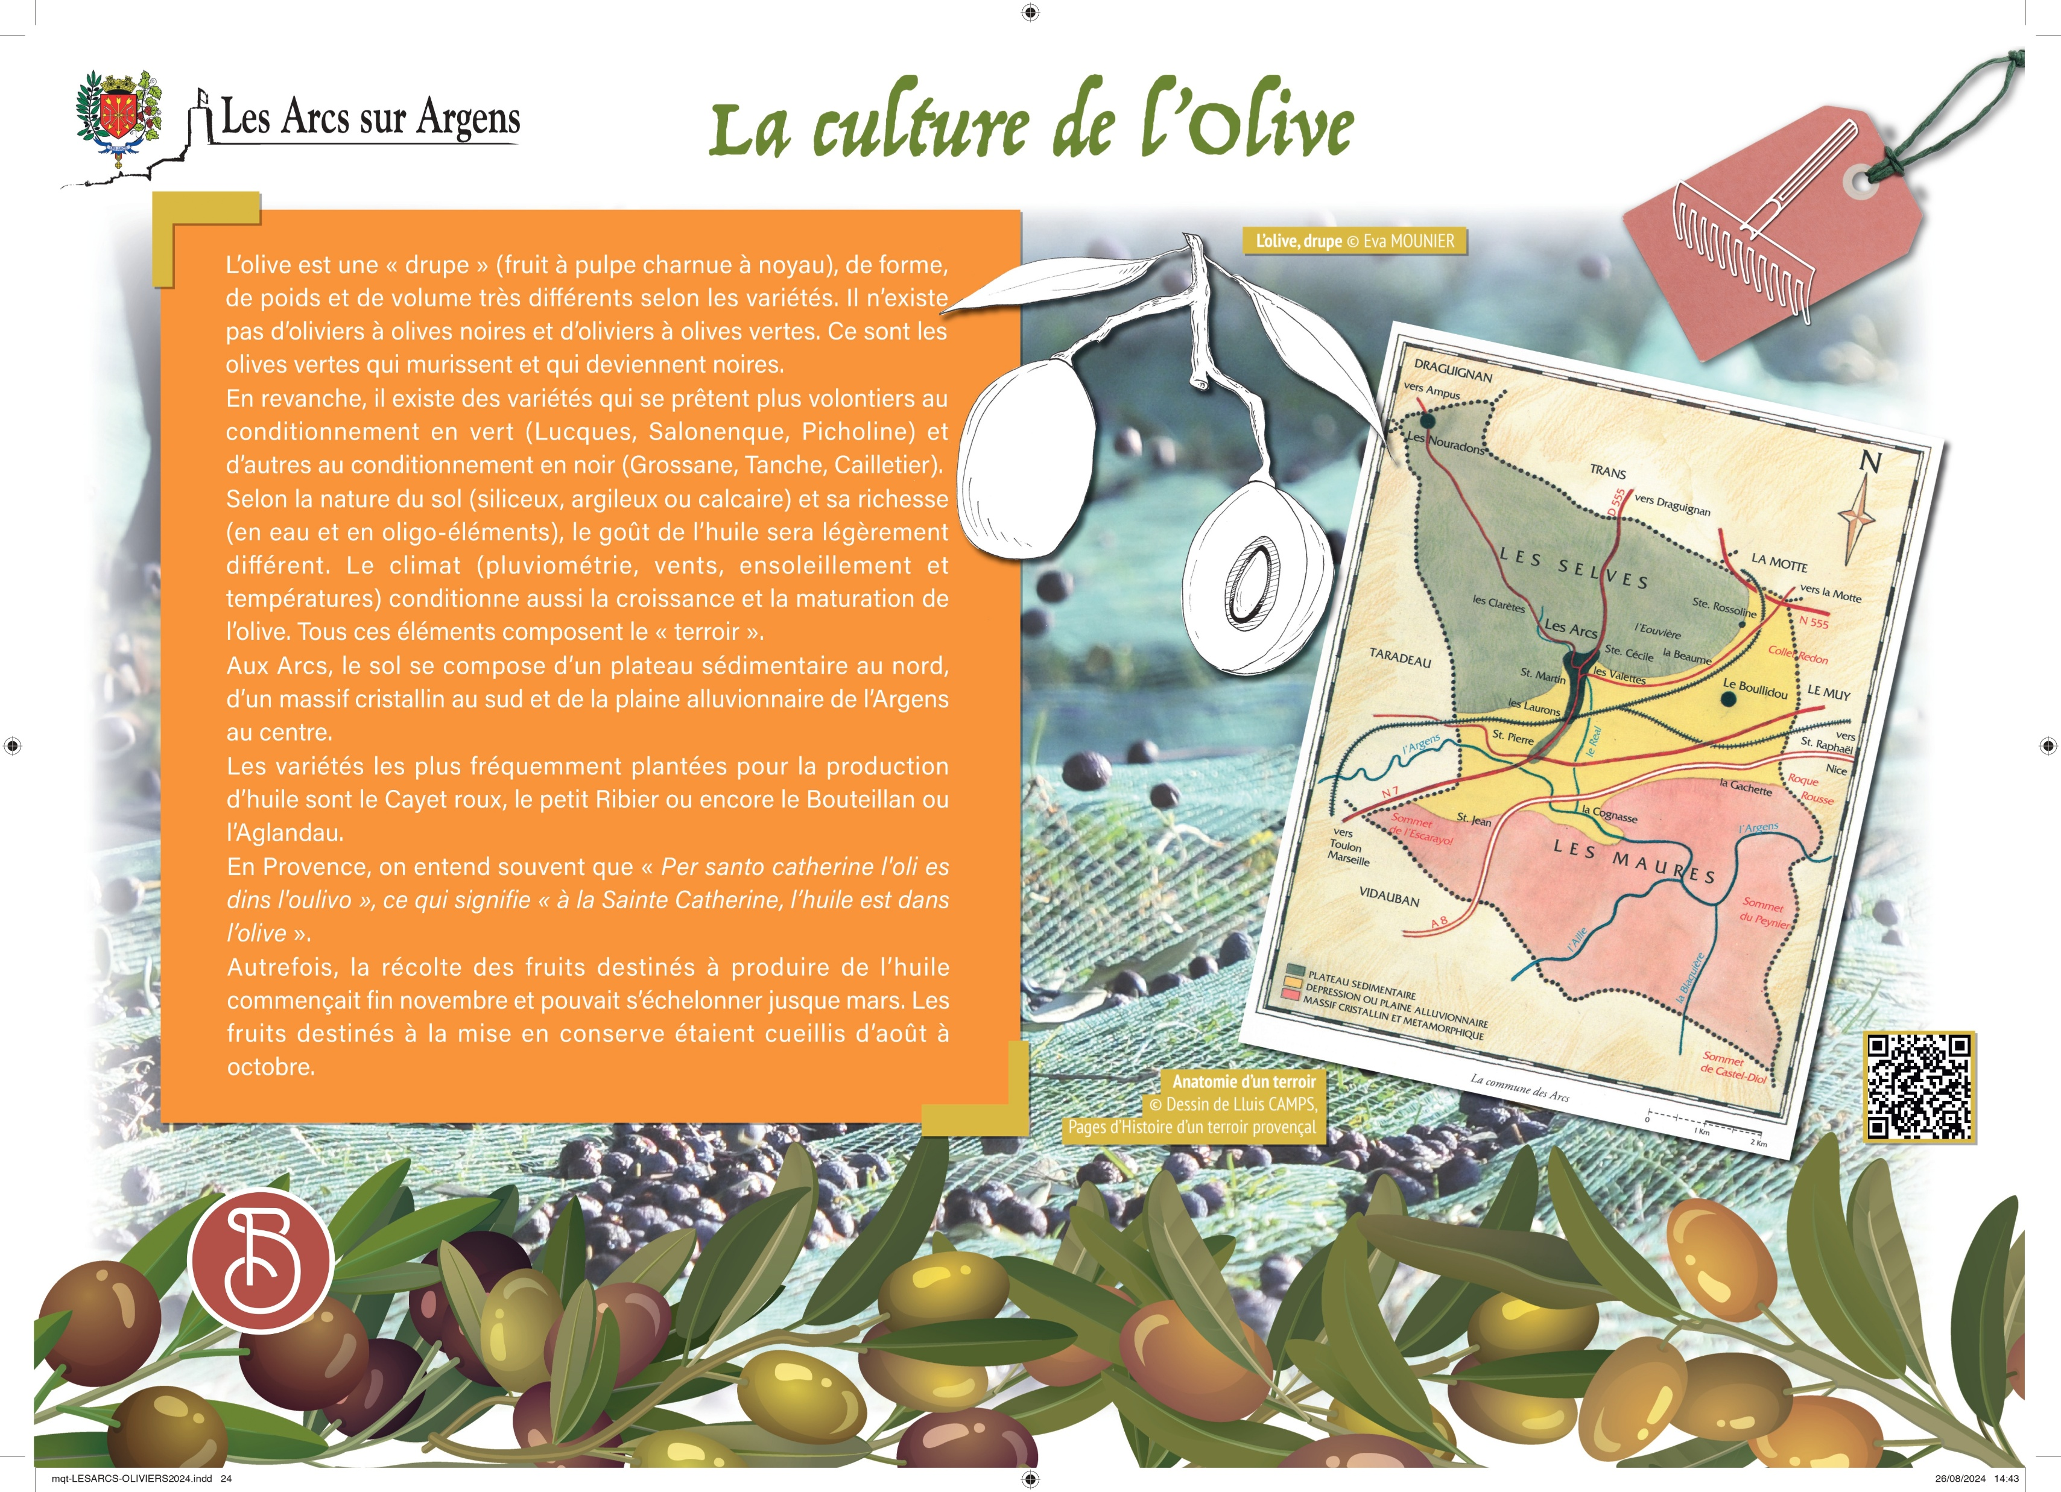



Sainte Cecile
The cultivation of olive trees in Les Arcs
The olive is a “drupe” (fleshy pulp fruit with a pit), it has a variable shape, weight, and volume according to the varieties. It does not exist olive trees for black olives and olive trees for green olives. It is only green olives that ripen and then become black.
However, there exist some varieties that are better for green conditioning (Lucques, Salonenque, Picholine) and others for black conditioning (Grossane, Tanche, Cailletier).
According to the type of soil (siliceous, clayey, or chalky) and its richness (in water and trace elements), the oil taste will be slightly different. The climate (rainfall, winds, sunshine, temperatures) also influences olive growth and olive maturation. All these elements form the “terroir”.
In Les Arcs, the ground consists of a sedimentary plateau to the North, a crystalline massif to the South, and an alluvial plain from l’Argens River to the center.
The most frequently planted varieties for oil production are “Cayet roux”, “petit Ribier”, “Bouteillan”, or “l’Aglandau”.
In Provence, we often hear that “Per santo catherine l’oli es dins l’oulivo”, which means “at the Sainte Catherine, the oil is into the olive”.
In the past, the harvest of fruits to produce oil began at the end of November and could extend until March. Fruits for canning were picked from August to October.
Les Arcs sur Argens
Bastide Sainte
Cécile
Find all our news on the site of the Arcs town hall
here

