Slide 1
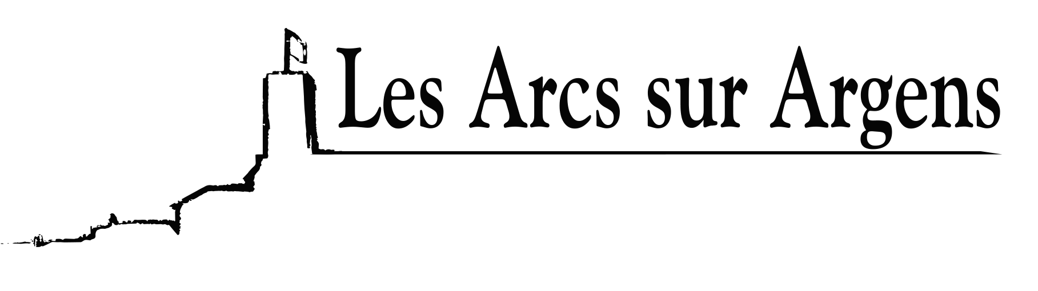

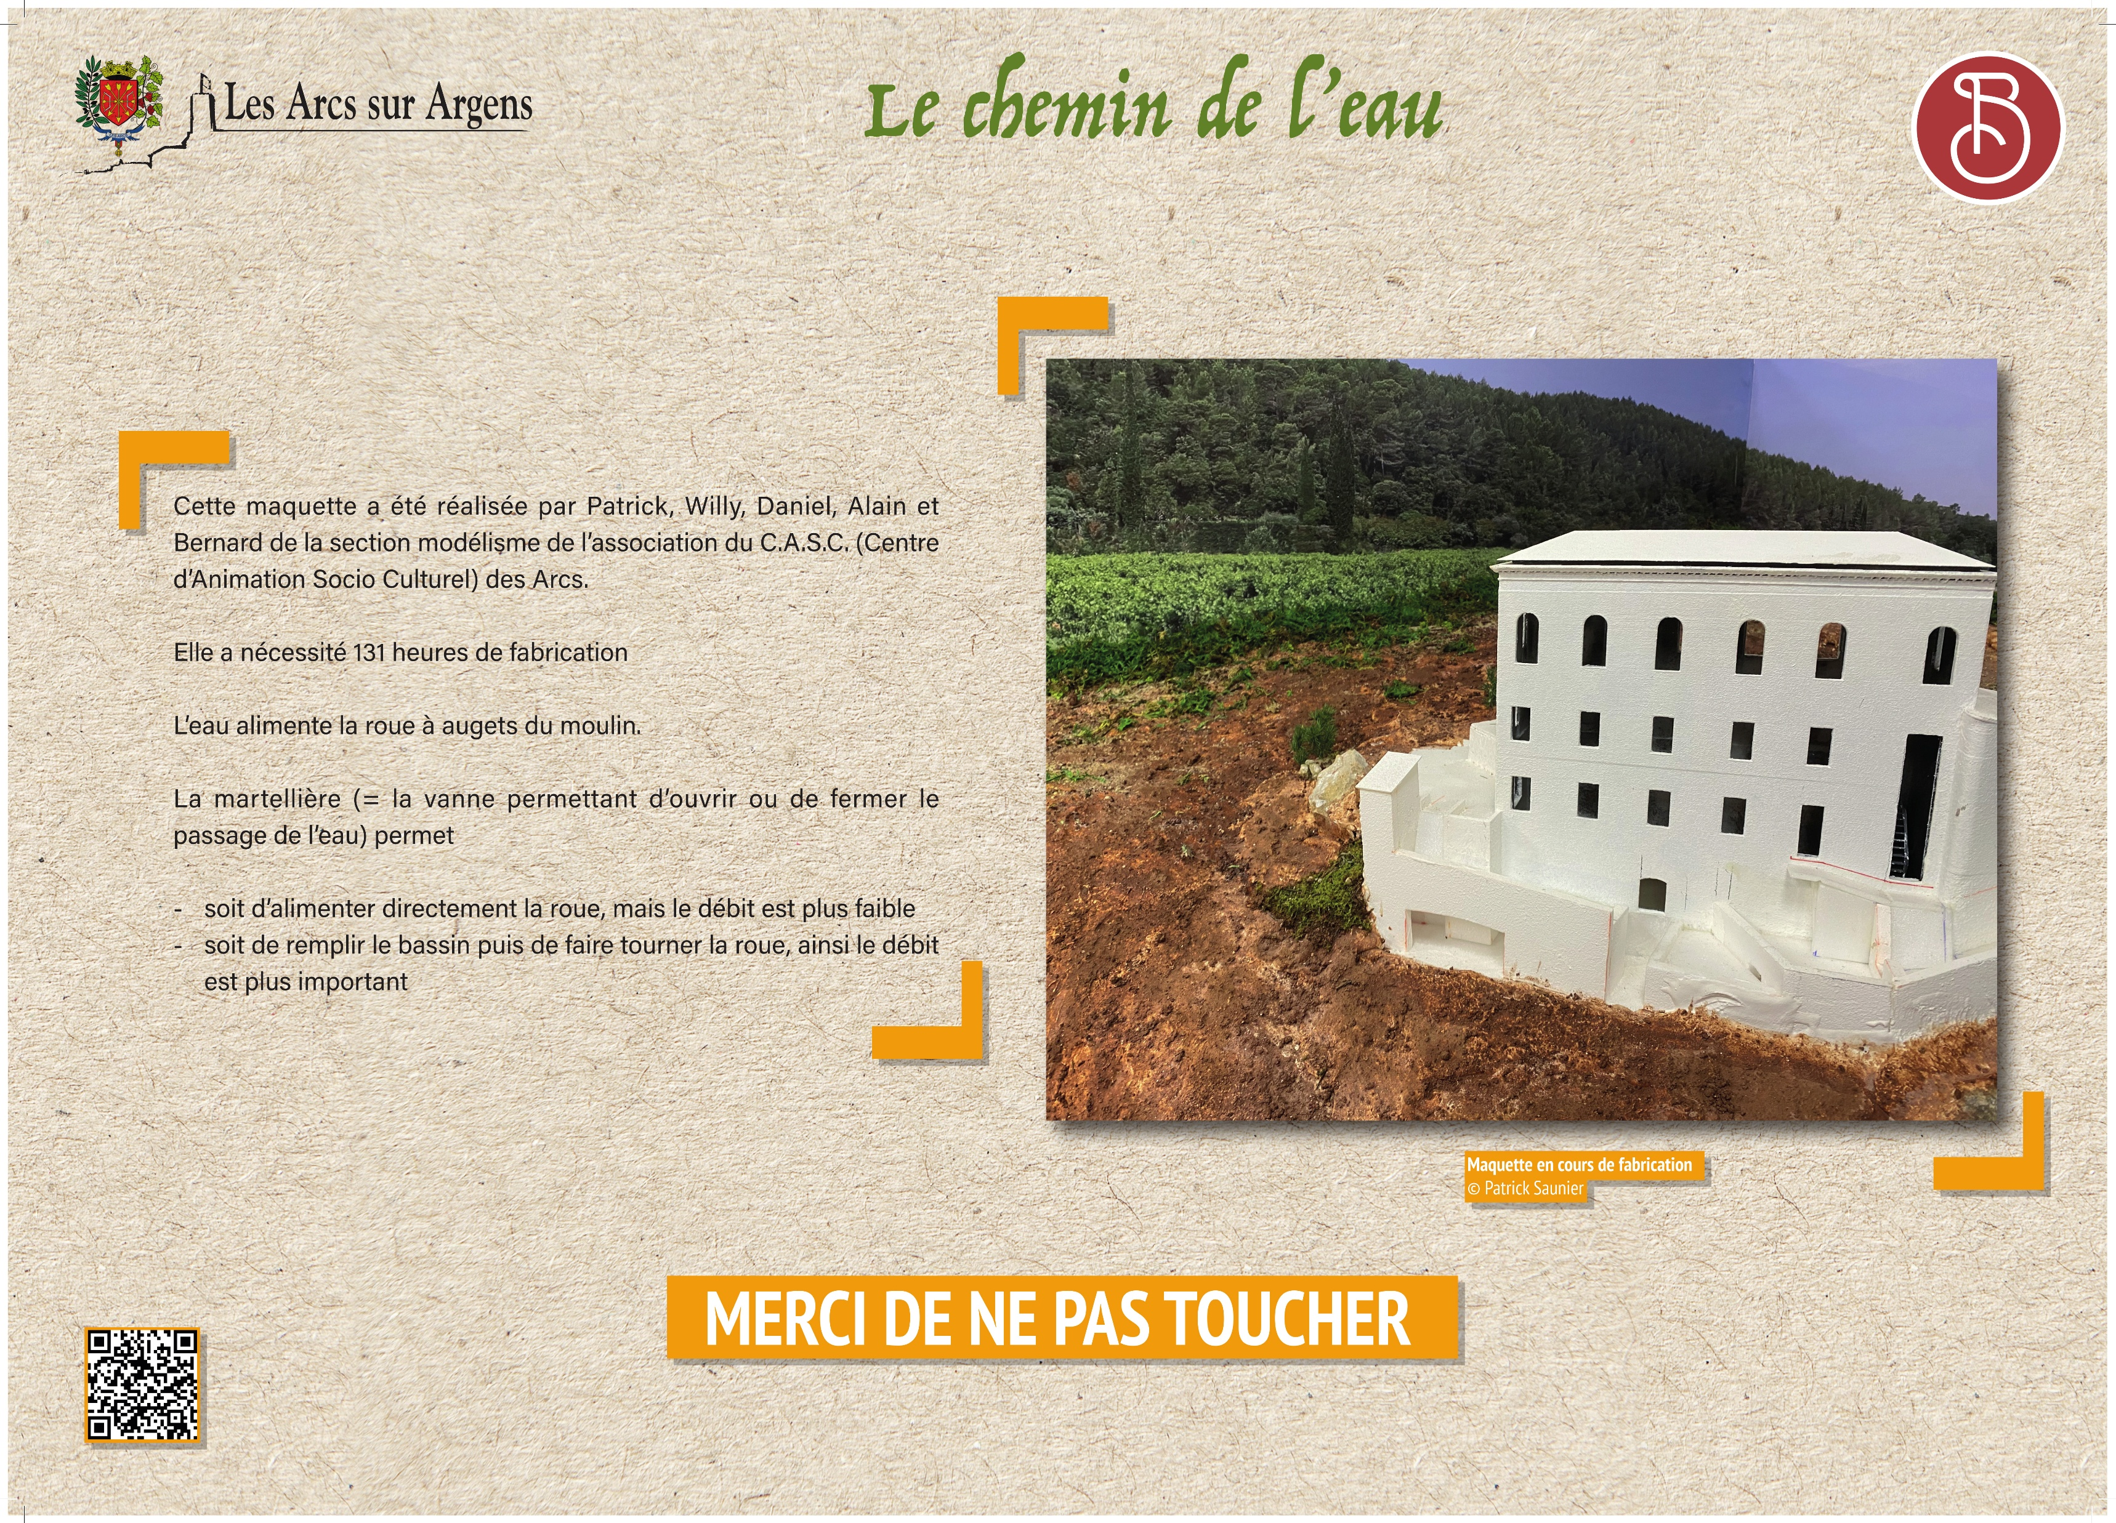


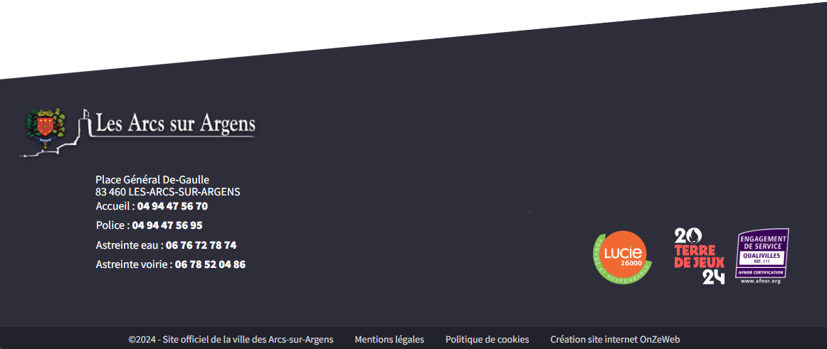
Sainte Cecile
The water path
This model was made by Patrick, Willy, Daniel, Alain, and Bernard from the modeling section of the C.A.S.C. (Centre d’Animation Socio-Culturel) of Les Arcs.
It required 131 hours of work.
The water powers the mill’s bucket wheel.
The “martellière” (the sluice gate that opens or closes the water passage) allows you to:
either feed the wheel directly, with a lower flow rate, or fill the basin first and then turn the wheel, producing a higher flow rate.
Les Arcs sur Argens
Bastide Sainte
Cécile
Find all our news on the site of the Arcs town hall
here

