Slide 1
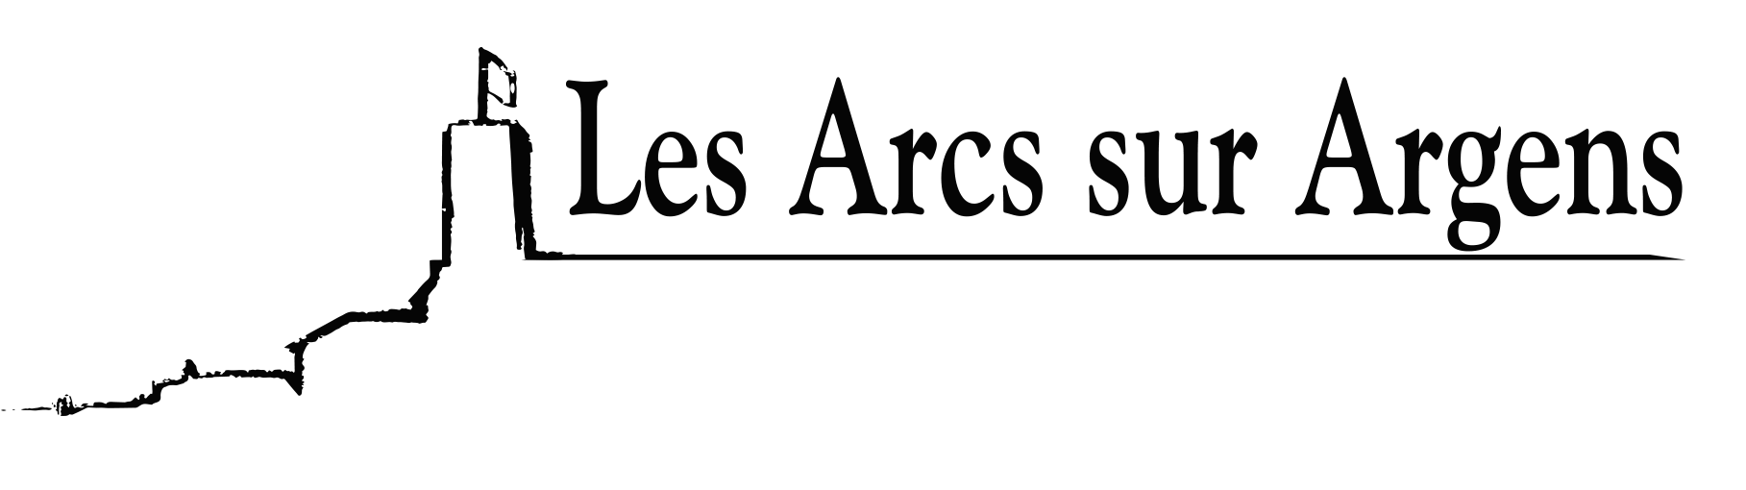

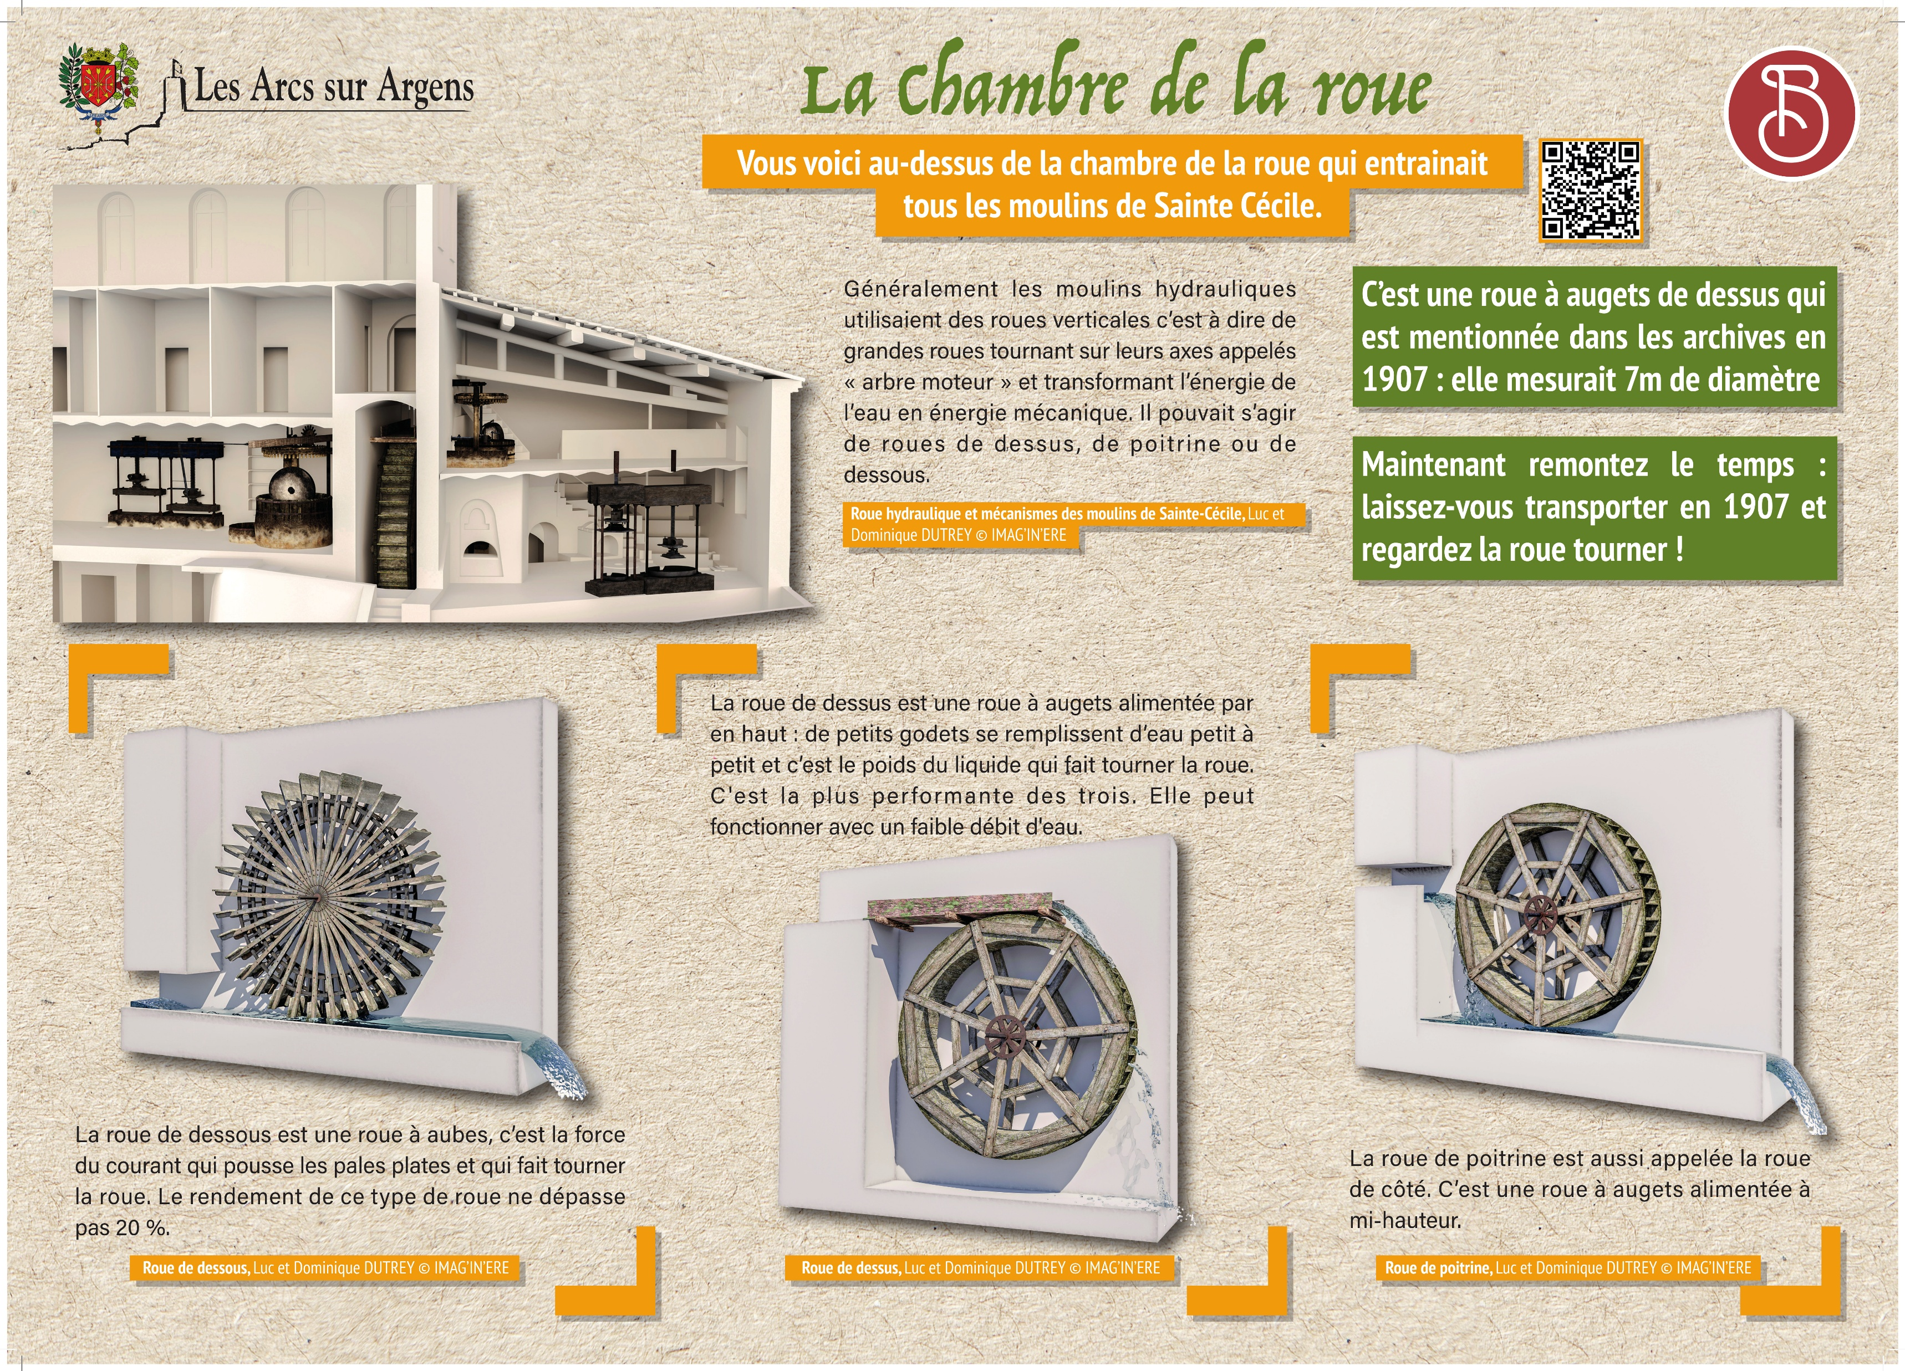



Sainte Cecile
The wheel chamber
Here you are above the wheel chamber which drove all Sainte Cécile’s mills.
Generally, hydraulic mills used vertical wheels, that is to say, big wheels rotating on their axes called main axis and transforming water energy into mechanical energy. It could be top, chest, or bottom wheels.
It is a bucket wheel from the top that is mentioned in the archives in 1907: it was 7 meters (22.96 feet) in diameter.
Now, go back in time: let yourself be transported in 1907 and watch the wheel turn.
The top wheel is a bucket wheel supplied by the top: small buckets fill up step by step and it’s the weight of the liquid that turns the wheel. It is the most high-performance of the three. It can even work with a light water flow.
The bottom wheel is a waterwheel, it’s the waterpower that pushes the flat paddles and turns the wheel. The yield of this type of wheel doesn’t exceed 20%.
The chest wheel is also called a sidewheel. It’s a bucket wheel supplied halfway up.
Les Arcs sur Argens
Bastide Sainte
Cécile
Find all our news on the site of the Arcs town hall
here

