Slide 1
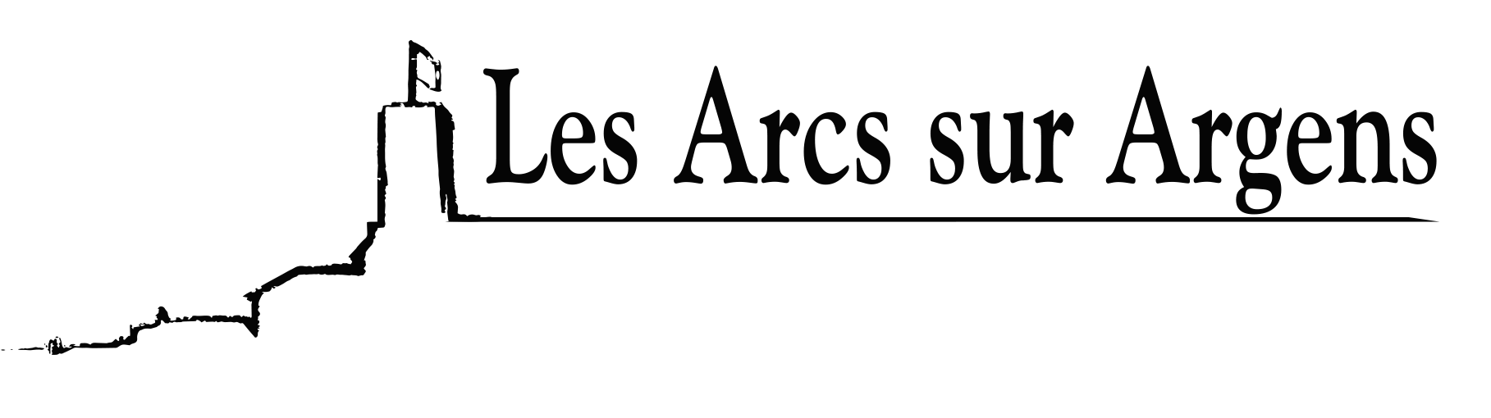

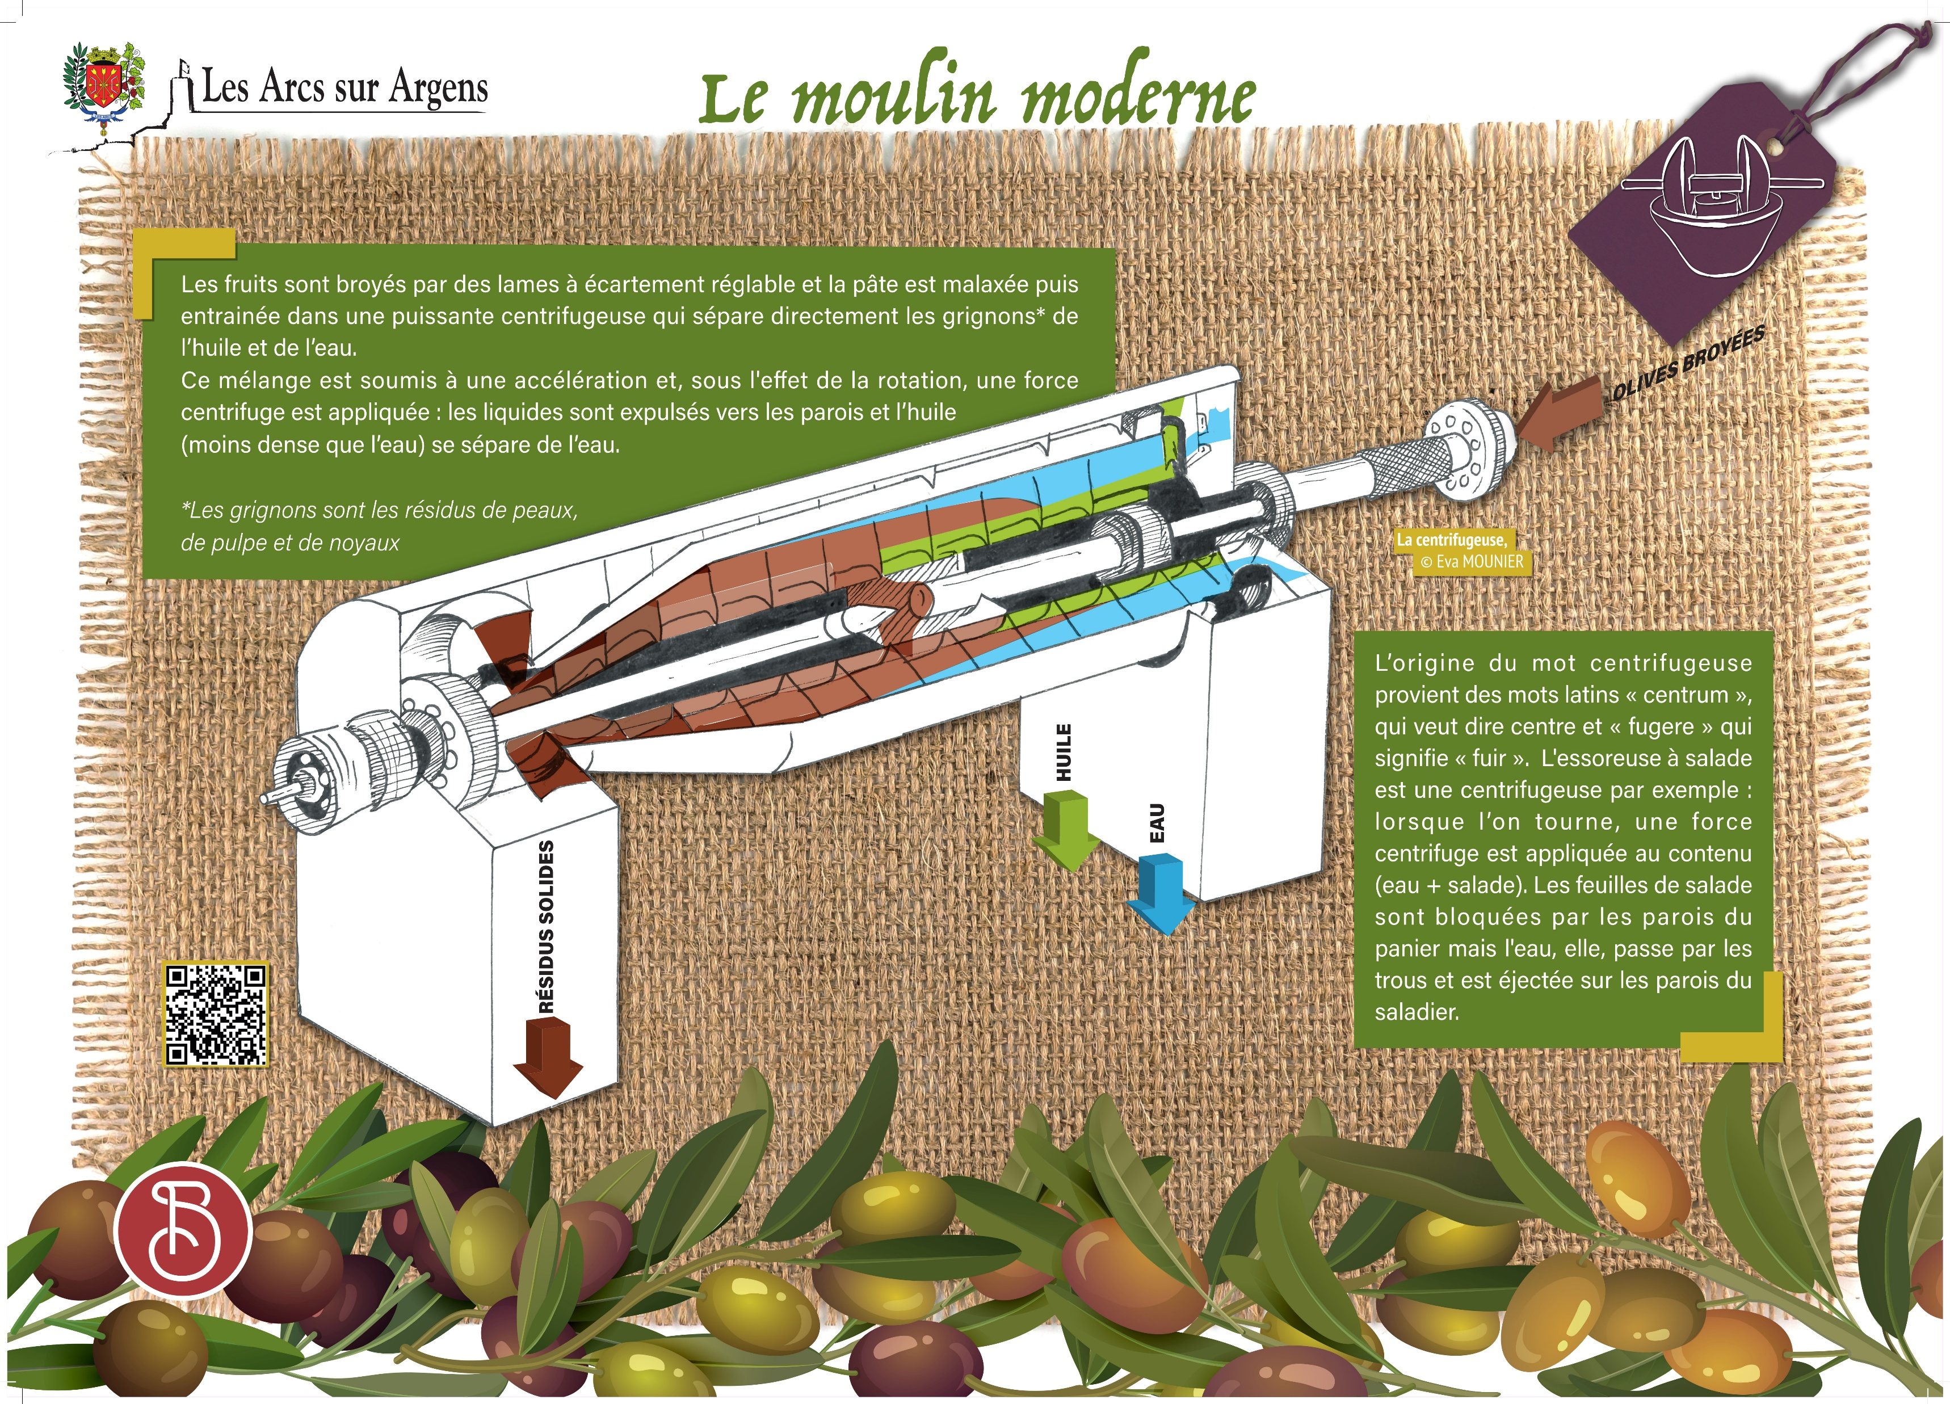



Sainte Cecile
The centrifuge
Fruits are ground by adjustable gap blades and paste is kneaded and then put in a powerful centrifuge that directly separates grignons* from oil and water.
This mixture is subjected to an acceleration and, under the effect of rotation a centrifugal force is applied: liquids are expelled towards the walls, and oil (less dense than water) separates from water.
The origin of the word centrifuge comes from the Latin words ‘centrum’ which means “center” and ‘fugere’ which means “flee”. The salad spinner for example is a centrifuge: when you spin, a centrifugal force is applied to the contents (water + salad). Salad leaves are blocked by the basket side but the water goes through the holes and is ejected on the basket sides.
*grignons are residues of skins, pulps, and pits.
Les Arcs sur Argens
Bastide Sainte
Cécile
Find all our news on the site of the Arcs town hall
here

