Slide 1
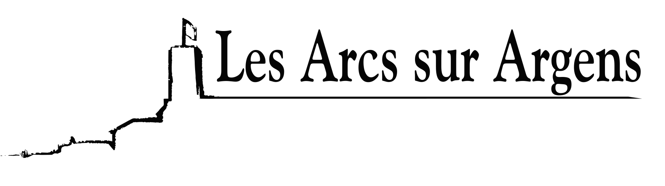

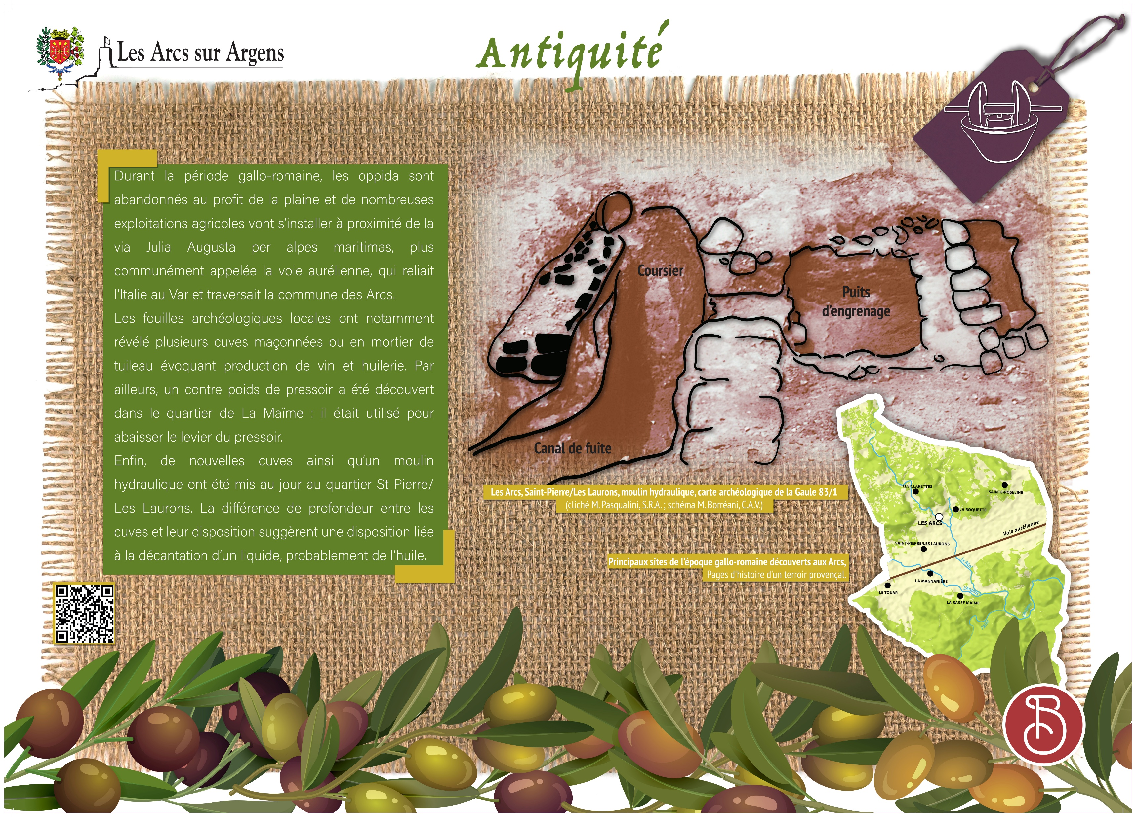


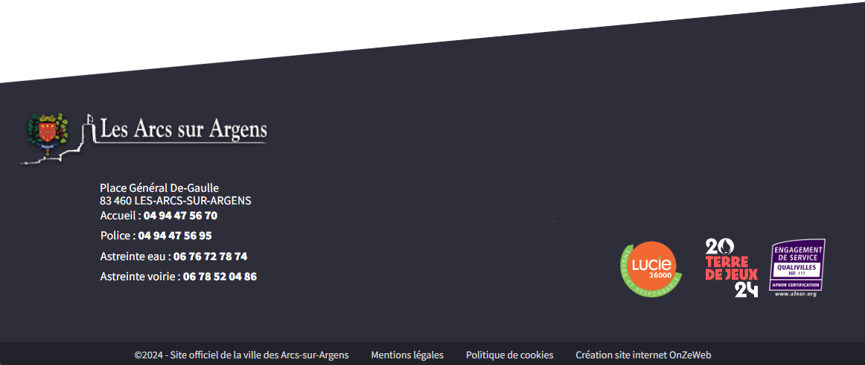
Sainte Cecile
Vestiges of the olive-growing activity in Les Arcs in antiquity
During the Gallo-Roman period the Oppida are abandonned for the plains. Numerous farms set up near the ‘via Julia Augusta per alpes maritimas’, more commonly known as the Aurelian Way that linked Italy to the Var and crossed Les Arcs.
The local archaeological excavations revealed several masonry or mortar vats evoking wine and oil production. Moreover, a press counterweight was discovered in the Maïme district. It used to lower the press lever.
Finally, new vats and a hydraulic mill were discovered in the Saint-Pierre and Laurons districts. The difference in depth between vats and their arrangement suggests an arrangement related to the decantation of a liquid, probably oil.
Les Arcs sur Argens
Bastide Sainte
Cécile
Find all our news on the site of the Arcs town hall
here

