Slide 1
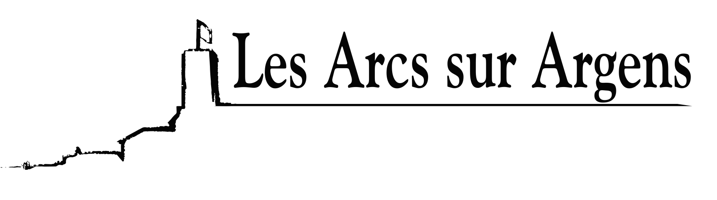

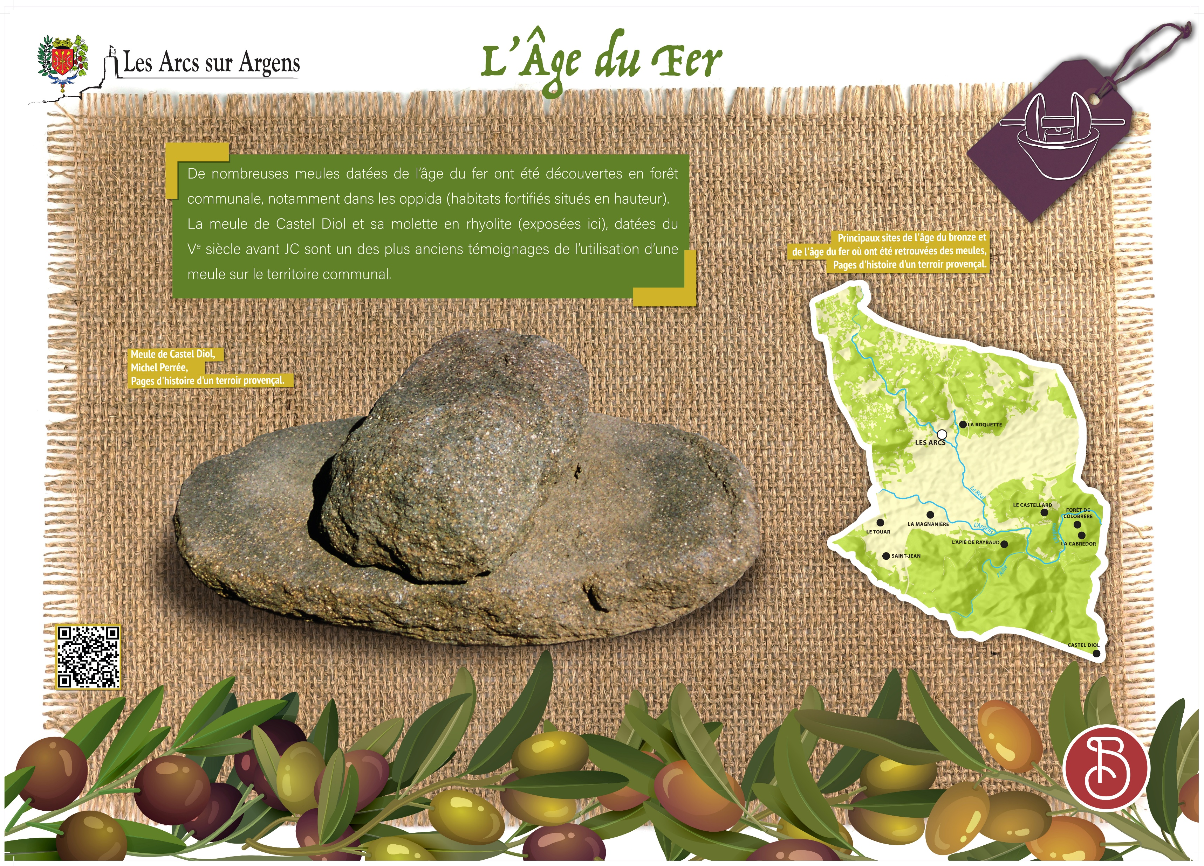



Sainte Cecile
The iron age and the most ancient mill stone of Les Arcs
Numerous millstones from the Iron Age were discovered in the town forest, especially in the oppida (fortified habitats located at height). The Castel Diol’s millstone and its rhyolite wheel (displayed here) dated from the 5th century before B.C. are one of the oldest testimonials of the use of a millstone in town.
Les Arcs sur Argens
Bastide Sainte
Cécile
Find all our news on the site of the Arcs town hall
here

