Slide 1
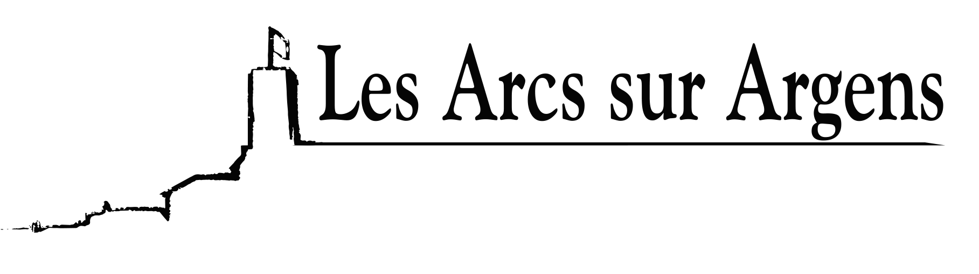

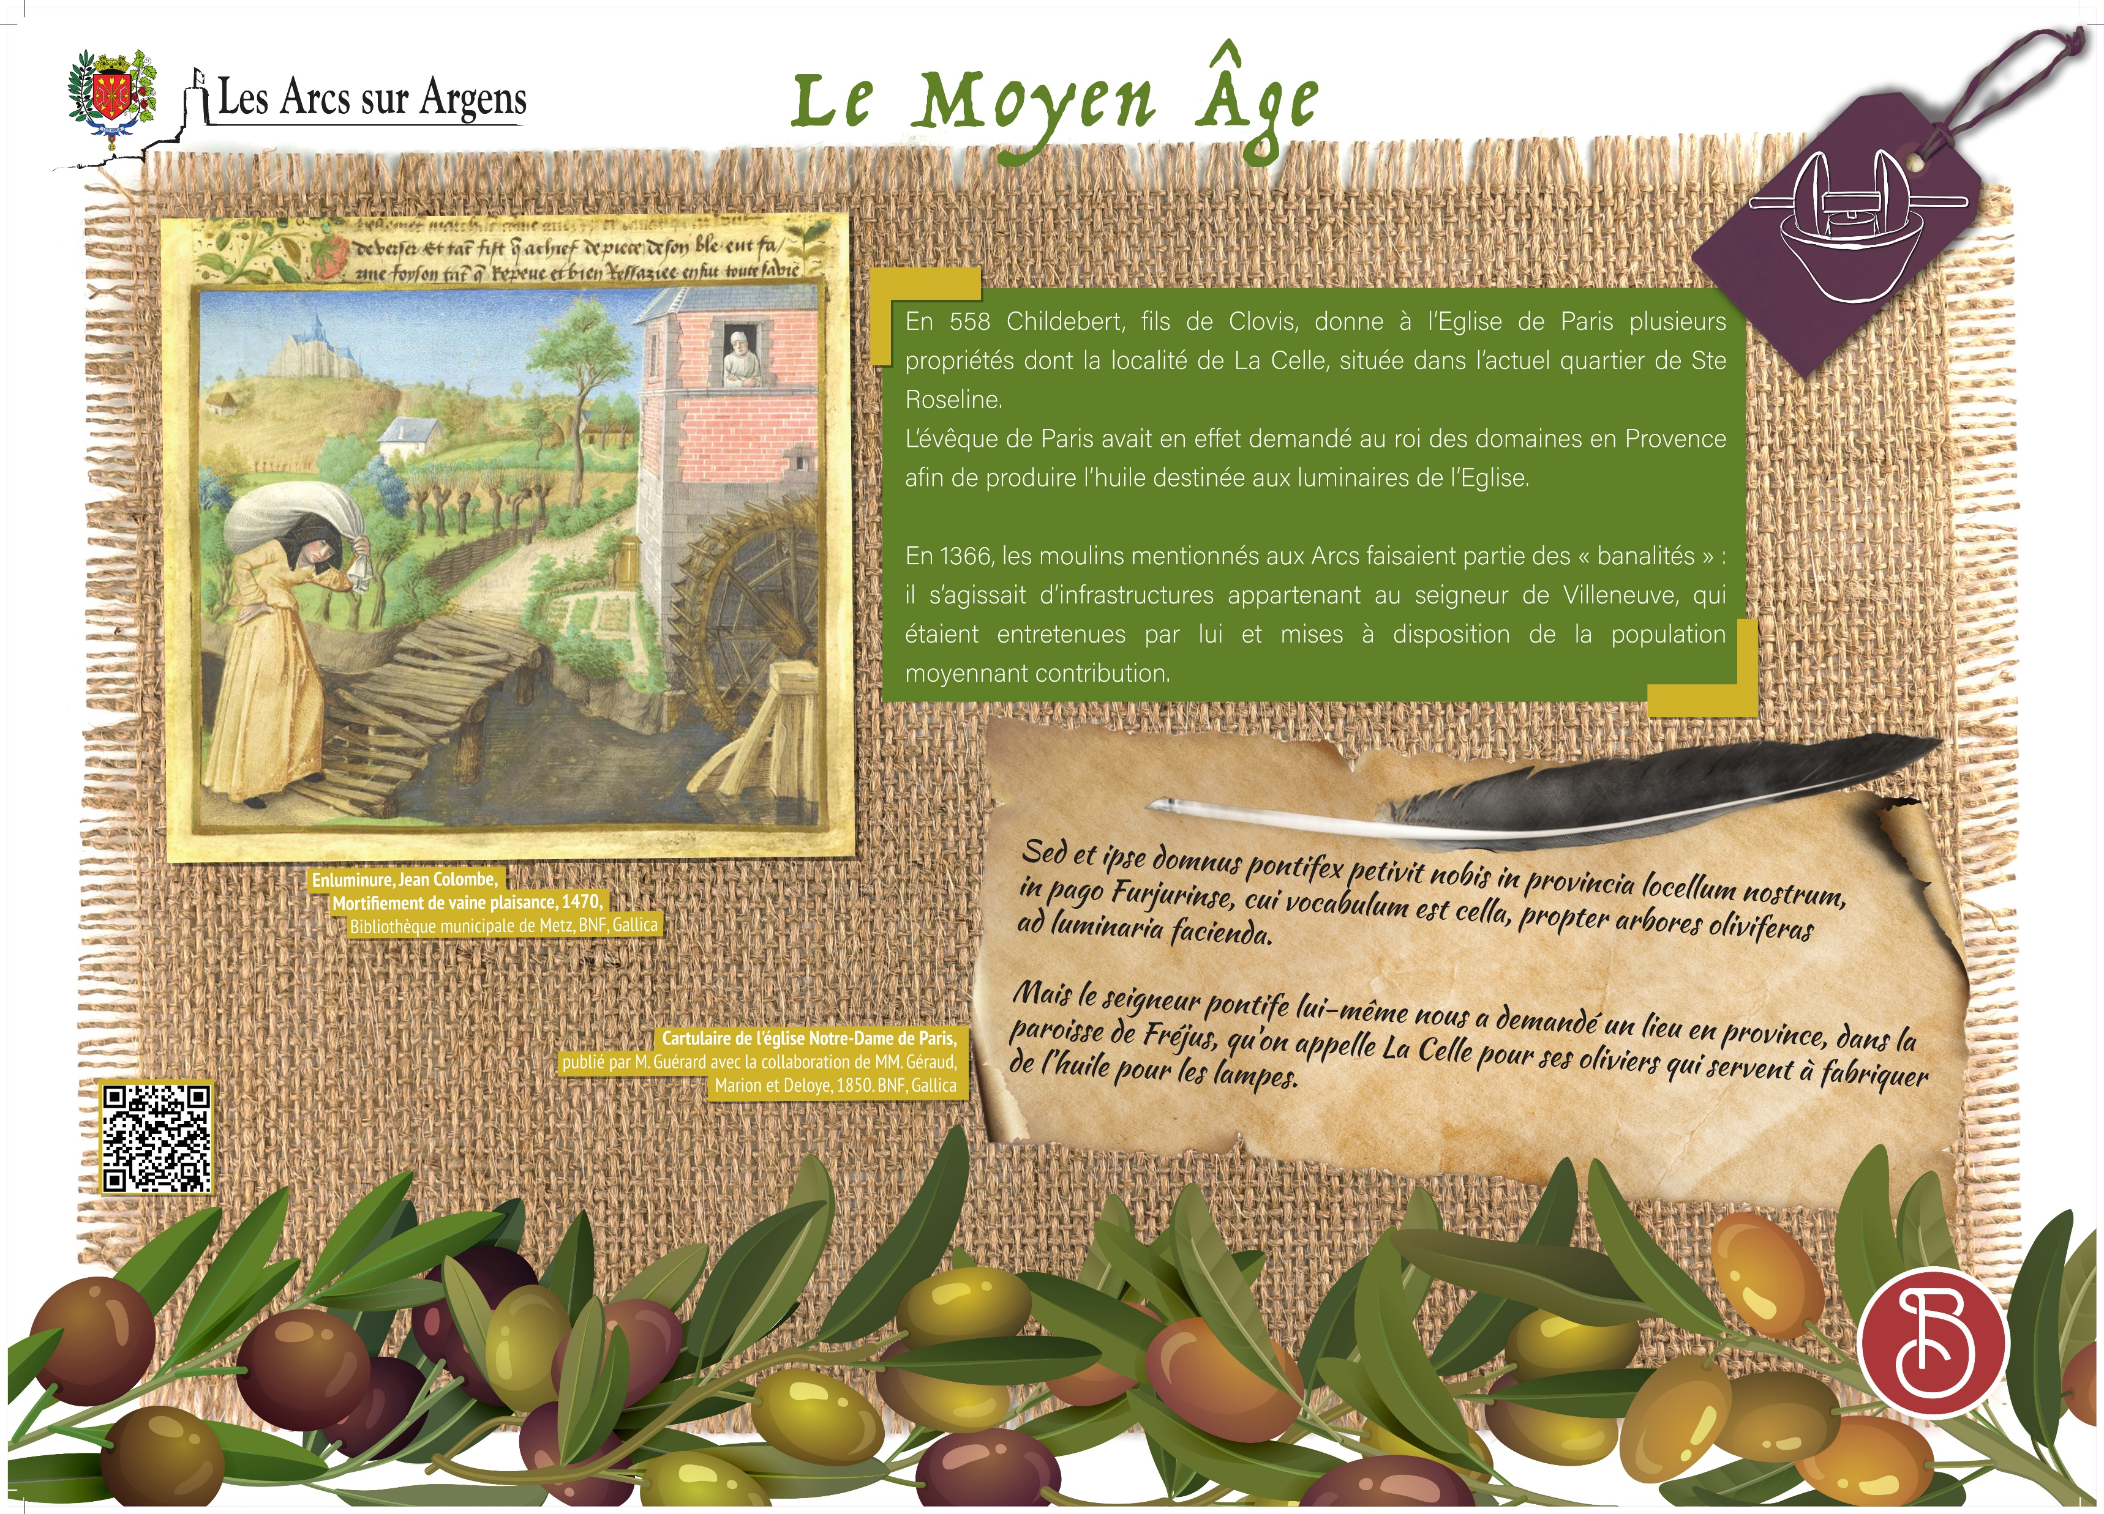



Sainte Cecile
Vestiges of the olive-growing activity in Les Arcs during the middle age
In 558, Childebert, Clovis’ son, gave Paris Church several properties, including the locality of La Celle in the Sainte Roseline district. the bishop of Paris asked indeed the King of the properties in Provence to produce oil for the Church’s lamps.
In 1366, mills in Les Arcs were infrastructures belonging to the Lord of Villeneuve that were maintained by him and made available to the population against a contribution (an amount of the oil that was produced in the mill for instance).
Picture caption
Translation of the latin extract of the cartulary :
But the Lord Pontife himself asked us for a location in the province, in the parish of Fréjus, also known as La Celle for its olive trees that permit to produce oil for lamps.
Les Arcs sur Argens
Bastide Sainte
Cécile
Find all our news on the site of the Arcs town hall
here

